Slide 2
Motion
Least understood about Ageless Wisdom: Motion
Show the Ageless Wisdom Teachings in tabulations, charts and particularly animations.
When the big picture is seen we must find ourselves somewhere on these master outlines and charts.
Notes:
Preparatory work before the Higher mind and intuition awaken. Y

Slide 3
After 1975
What is required for the next decade is a presentation of the ancient yogic teachings fused with the modern quantum sciences. A new language of symbols, through color, sound and vibration presented through the most advanced electronic and audio-visual tools available to the modern disciple.
Not just the quality of the teachings presented but the way they are presented.
AAB predicted that after 1975 there would be a major revelation going out via the radio. Uranus expressing rays (1&7) lies behind all exoteric expressions of an electrical nature particularly the Internet and the electronic high speed highway.

Slide 4
Mind separates; love attracts
"The concrete mind hinders in another and more unusual way, and one that is not realized by the student who attempts at first to tread the thorny road of occult development. When the concrete mind is rampant, and dominates the entire personality the aspirant cannot cooperate with these other lives and diverse evolutions until love supersedes concrete mind (even though he may, in theory, comprehend the laws that govern the evolution of the Logoic plan and the development of other solar entities besides his own hierarchy). Mind separates; love attracts. Mind creates a barrier betwixt a man and every suppliant deva. Love breaks down every barrier, infuses diverse groups in union. Mind repeals by a powerful, strong vibration, casting off all that is contacted, as a wheel that casts off all that hinders its whirling periphery." (WM:81)

Slide 5
Blast them wide open with the newer approaches to truth.
“The Master takes a group of people with fixed ideas (which they are entirely sure are correct, being the best and highest they have been able to grasp to date) and with the conviction that they have reached a point where they have registered certain spiritual values and concepts, where they have evolved their own formulations of truth and where they are eagerly demanding the next step.
The first thing, therefore, which He has to do is (using a strong and perhaps a strange phrase) to blast them wide open, give them a deep sense of insecurity as to the formulas and symbols of the lower concrete mind and so prepare them for the reception of newer and higher approaches to truth.” (709 DINA 1)

Slide 6
The Law of Supplementary Seven Law of Correspondence's visually seen
The perfect group contains all of the 7 rays.
“The lesser 7, the greater 7 and the planetary 7 form one great whole, and these the group must know. (R&I 4 22-23)

Slide 7
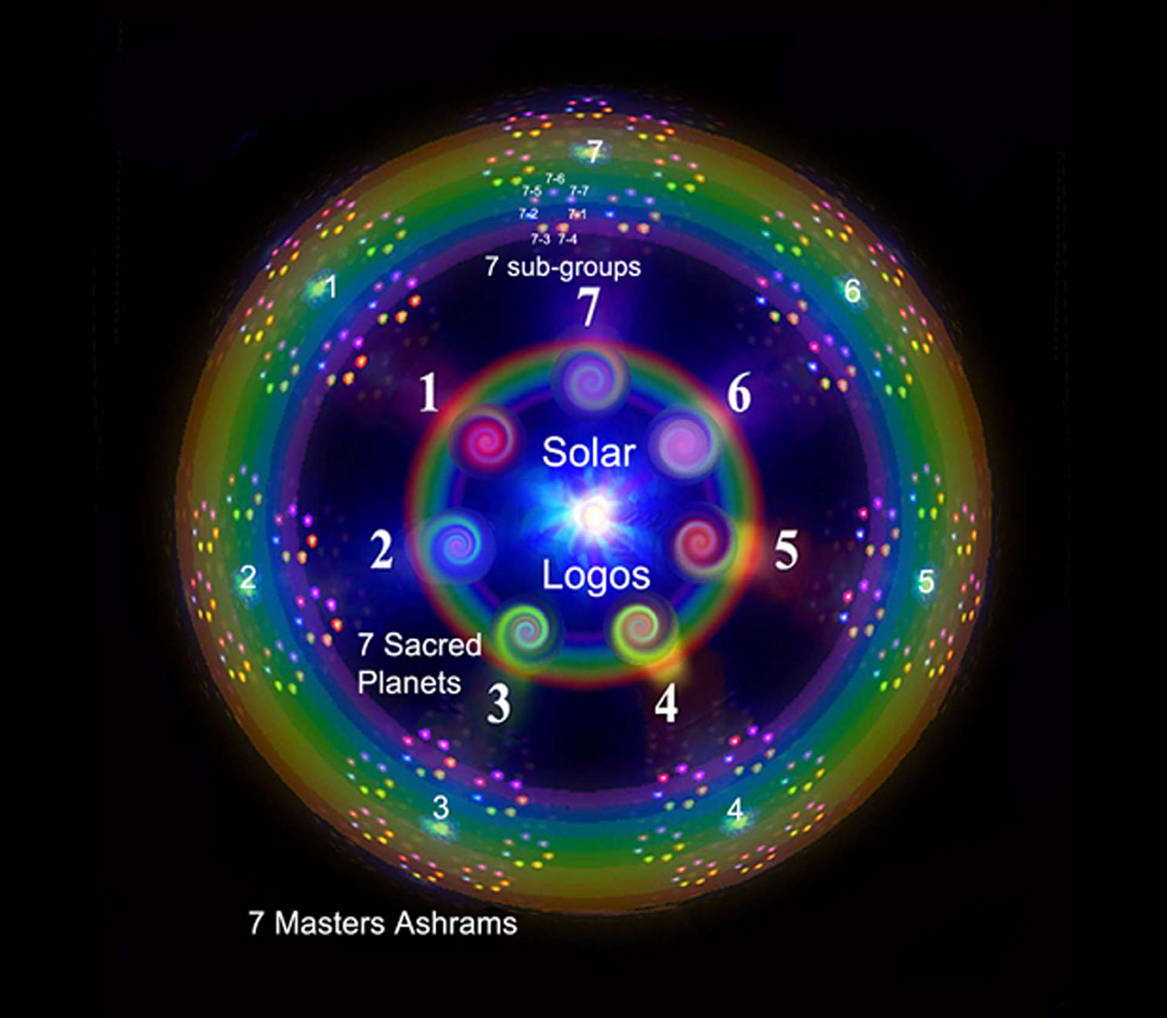

Slide 8
The Law of Correspondences
“We must resign ourselves to the fact that the only way in which we can find the clue to the mystery of the rays, systems, and hierarchies, lies in the study of the law of correspondences or analogy. It is the one thread by which we can find our way through the labyrinth, and the one ray of light that shines through the darkness of the surrounding ignorance. H. P. Blavatsky, in "The Secret Doctrine," has told us so, but as yet very little has been done by students to avail themselves of that clue. In the study of this Law we need to remember that the correspondence lies in its essence, and not in the exoteric working out of detail as we think we see it from our present standpoint.” (IHS 7)

Slide 9
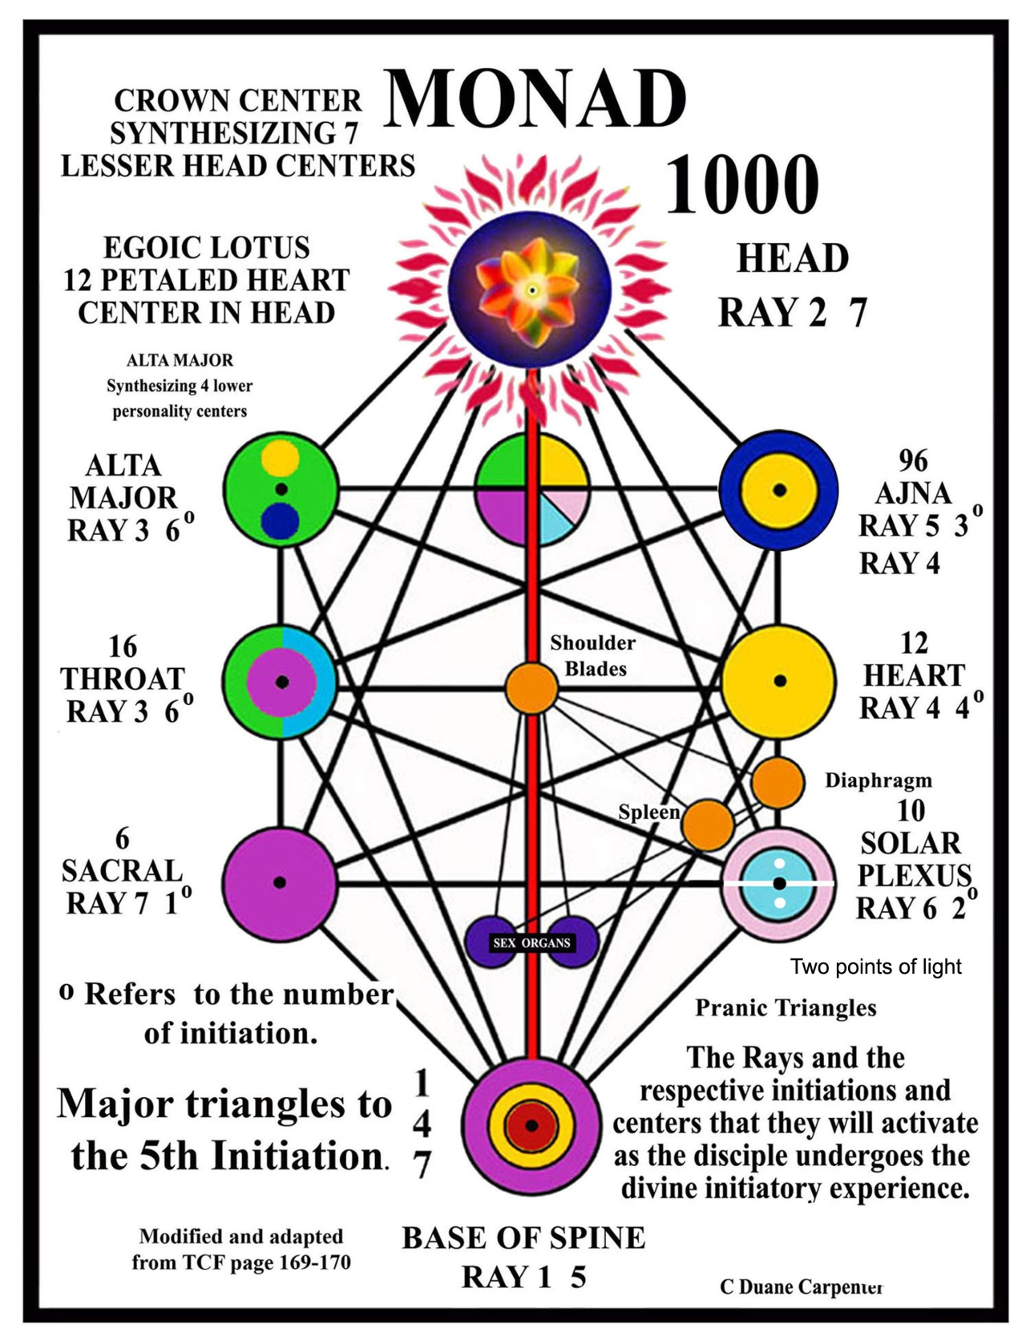

Slide 10
Entire universal pattern
Owing to the constant movement everywhere, inherent in the solar system and the zodiac—onward, interior and revolving—some idea can be grasped of the intricacy of the entire pattern. A further aid to the grasping of this essential beauty of coordinated and organised movement and its power to qualify and condition the entire universal pattern can be gained by those students who have studied somewhat the various triangles to be found in the etheric body of man through the inter-relation of the seven centres to which I have referred elsewhere in my various books.

Slide 11
Notes:
Not fully given

Slide 13
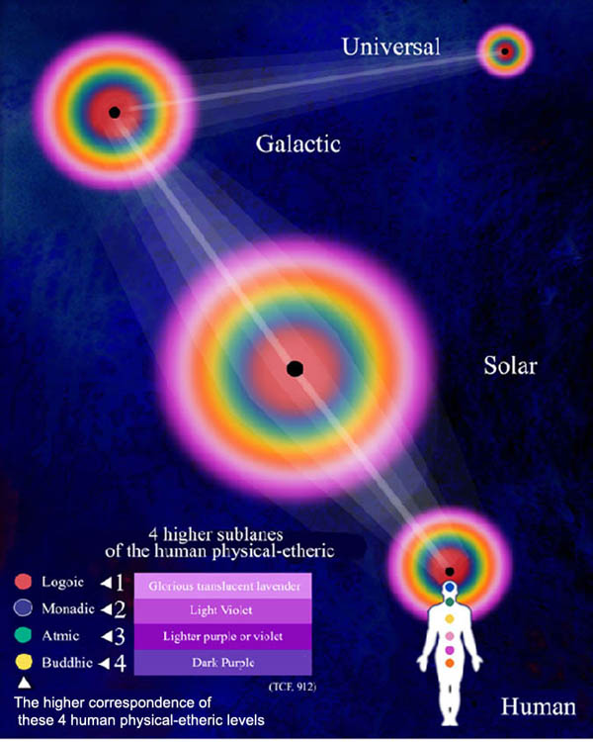

Slide 14
Rose Triangle
“These forces are symbolized to the manipulating Master by a triangle. In the Old Commentary it says:
"The Master throws Himself - under the liberating Law of Sacrifice - into the vortex of the astral life of the One to Whom our Lord relates Himself with humble joy. And as the Master works, there forms before His eyes a triangle of force in shades of varying rose. By His magnetic power, He concentrates the energy required. Then through this triangle of force, as through an open door, He sends the potency of love into our planet, and till His cycle ends He thus must work.“ (R&I 4 403)
Next image 7 ray colored ring with a rose triangle passing down through an astral vortex. Law of correspondence.
M –PL-SL

Slide 15
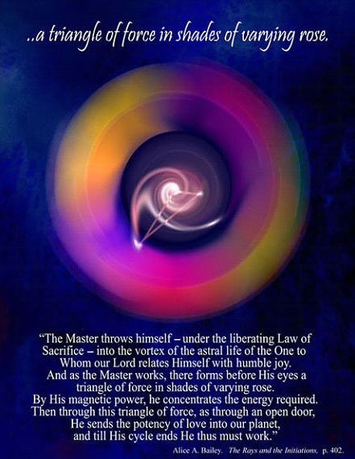

Slide 16
Energy is fluid and in motion
“Disciples, during the early stages of their training, are apt to regard energy as a pool or a reservoir upon which they can learn to draw, thus appropriating a quota of that energy for their need, their service and their use. But energy is fluid and in motion; we live in a veritable sea of moving forces, qualified in countless ways, conditioned by countless minds….” (DINA 2 133-3)

Slide 17
7 ray reflections upon a limpid pool
These seven types of energy produce the seven types of souls or rays, and in this thought you find the secret of soul unity. During manifestation, owing to the seven types of energy impacts, playing upon the matter of space, one finds the seven types of soul, the seven fields of expression, and the seven grades of consciousness and of ray characteristics. These differentiations as you well know are like the colouring that the prism takes when subjected to the rays of the sun, or to the tracery of pattern found in reflection upon a limpid pool. (TWM 434)

Slide 18
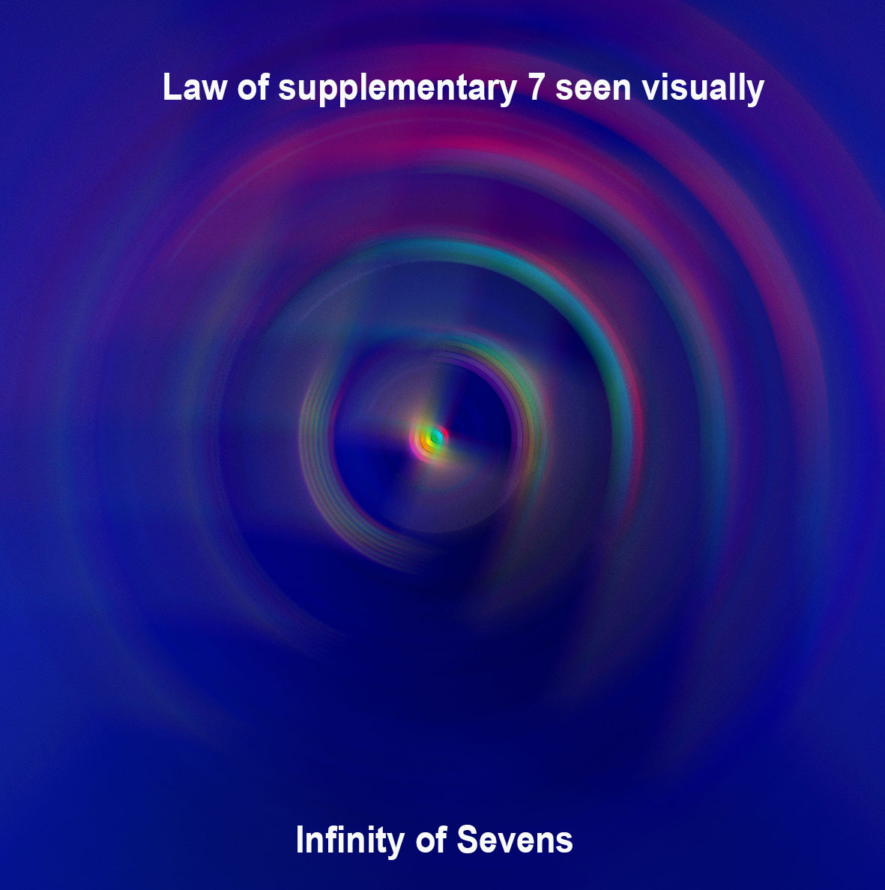

Slide 19
Infinity of Sevens
“The cycles in the evolutionary process of all these Entities may be divided mainly into three groups, though necessarily these groups can be extended into septennates and into an infinity of multiples of seven.”
(TCF 301)

Slide 20
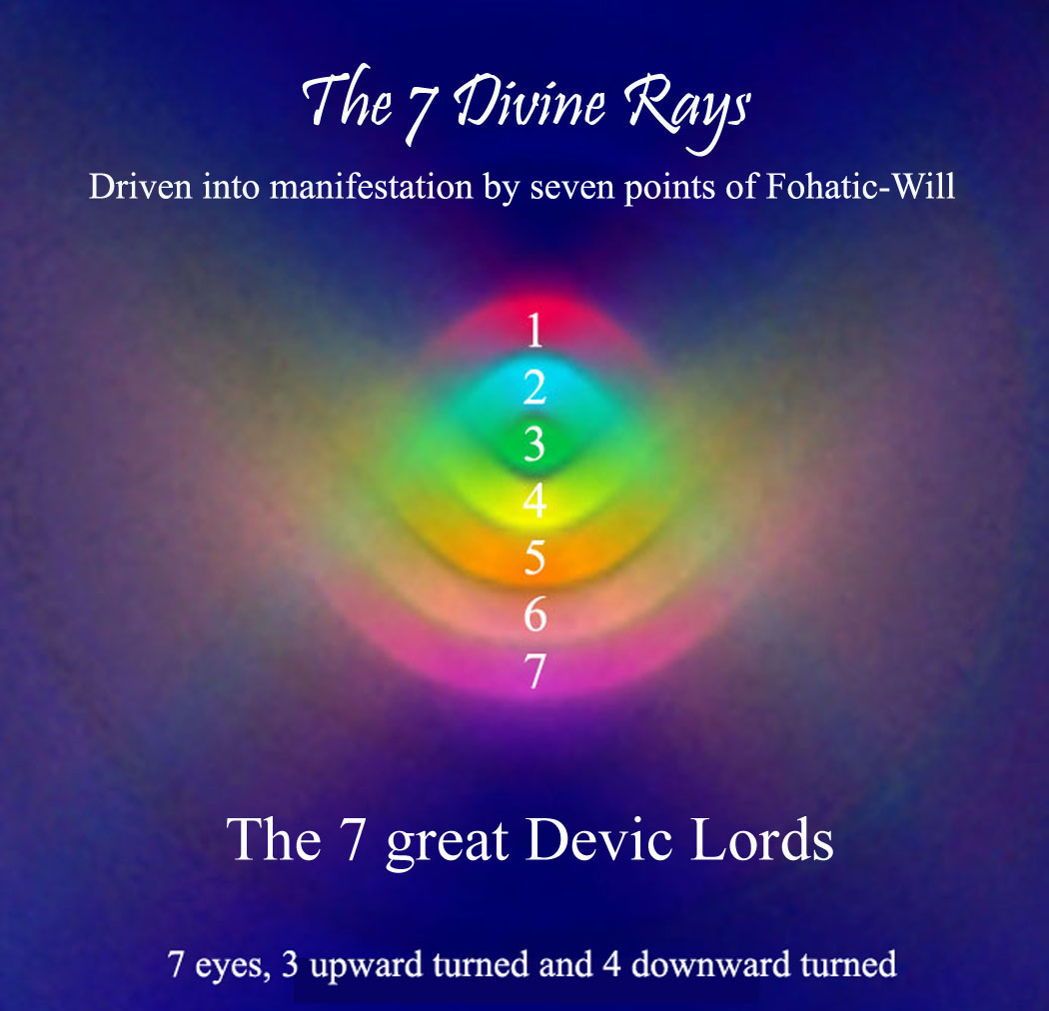

Slide 21
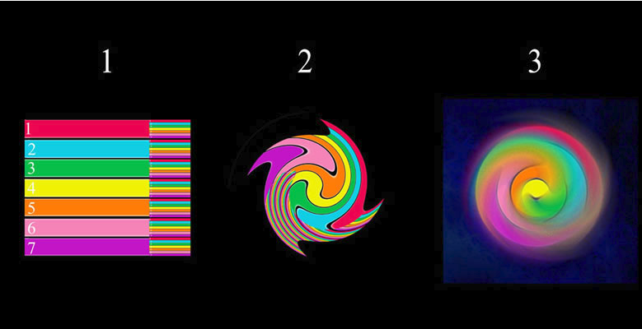

Slide 22
Lisa Gerard music to serpent seven ray swirl video, go to web link
http://www.light-weaver.com/LW-old/raycharts/page3.html#music
Once on website scroll slight up to see video and right underneath it is music track play button

Slide 24
The 7 Rays

Slide 25
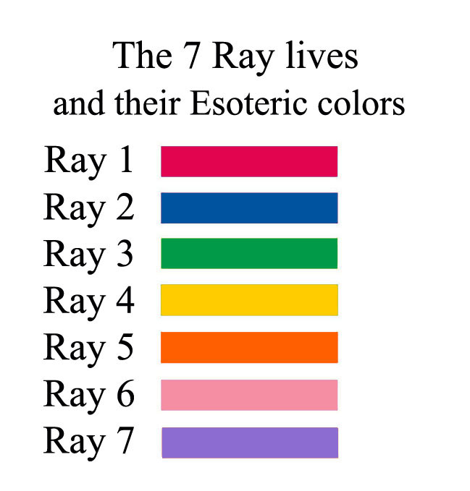

Slide 26
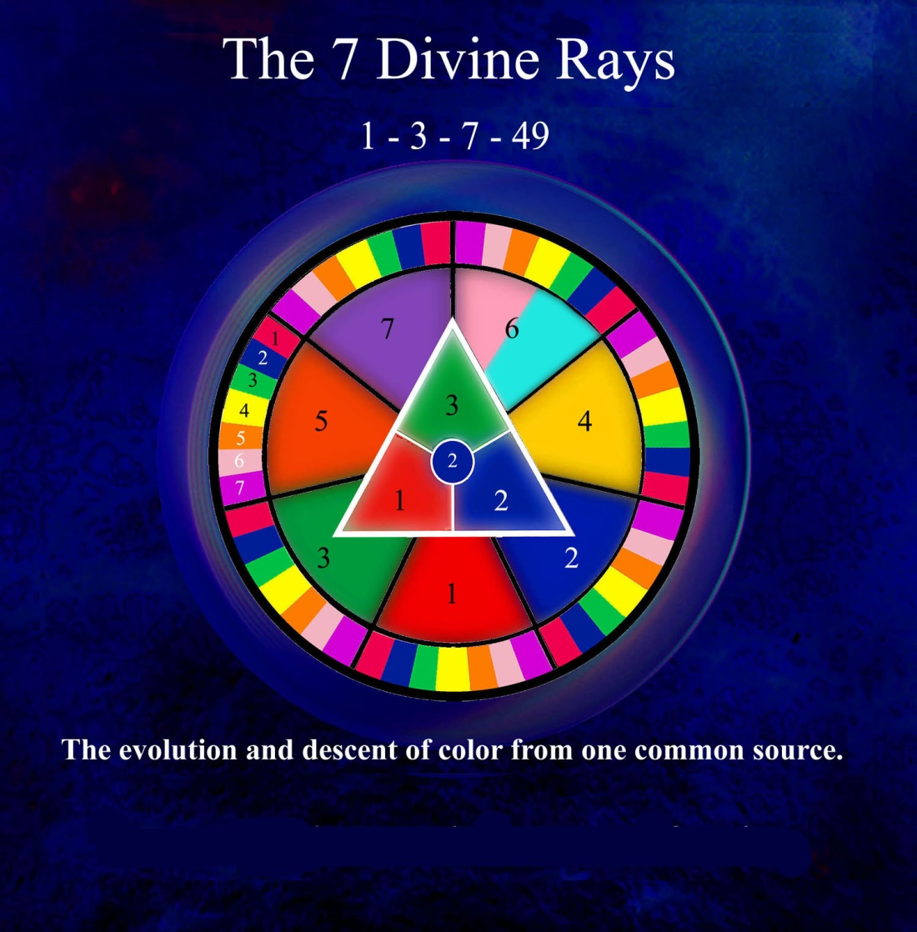

Slide 27
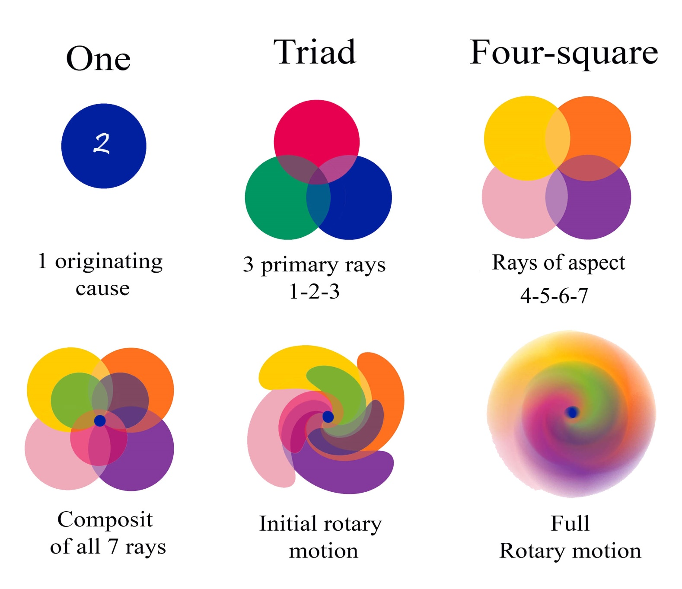

Slide 28
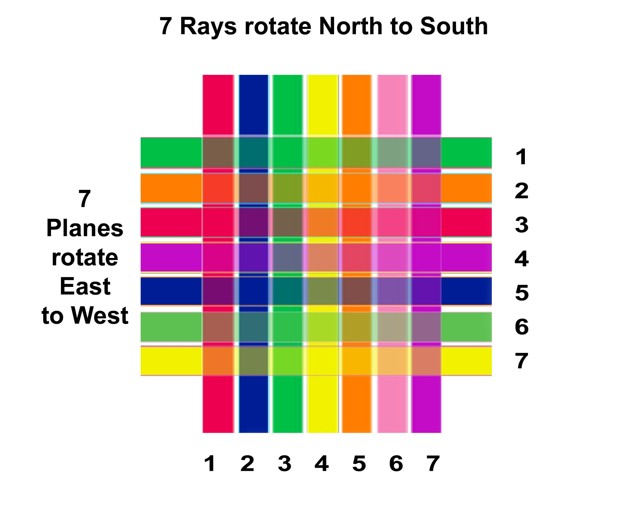

Slide 29
Rotation of the Rays and Planes
In connection with these two types of spheres we might, by way of illustration and for the sake of clarity, say that:
a. The planes rotate from east to west.
b. The rays rotate from north to south…..
--------------------------------------------------------------------------------------------------
The seven planes, likewise atoms, rotate on their own axis, and conform to that which is required of all atomic lives.
The seven spheres of any one plane, which we call subplanes, equally correspond to the system; each has its seven revolving wheels or planes that rotate through their own innate ability, due to latent heat—the heat of the matter of which they are formed. (TCF 153-4)

Slide 31
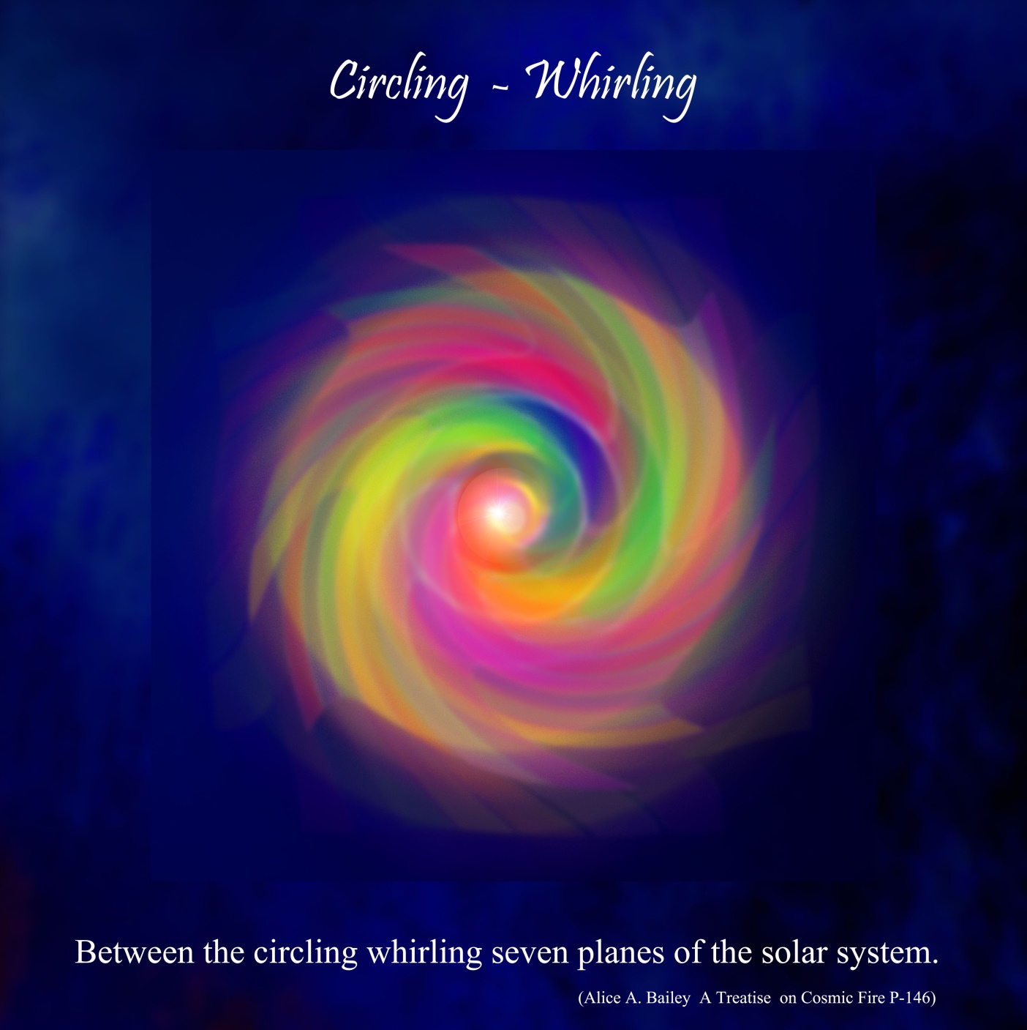

Slide 32
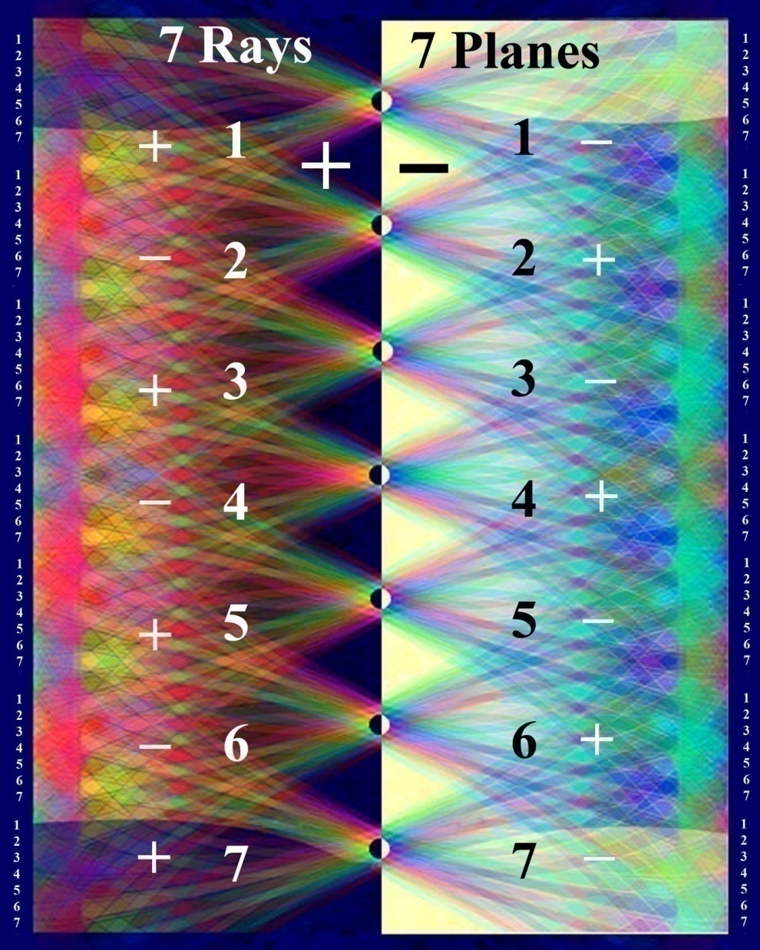
Notes:
Rays and planes seen electrically

Slide 33
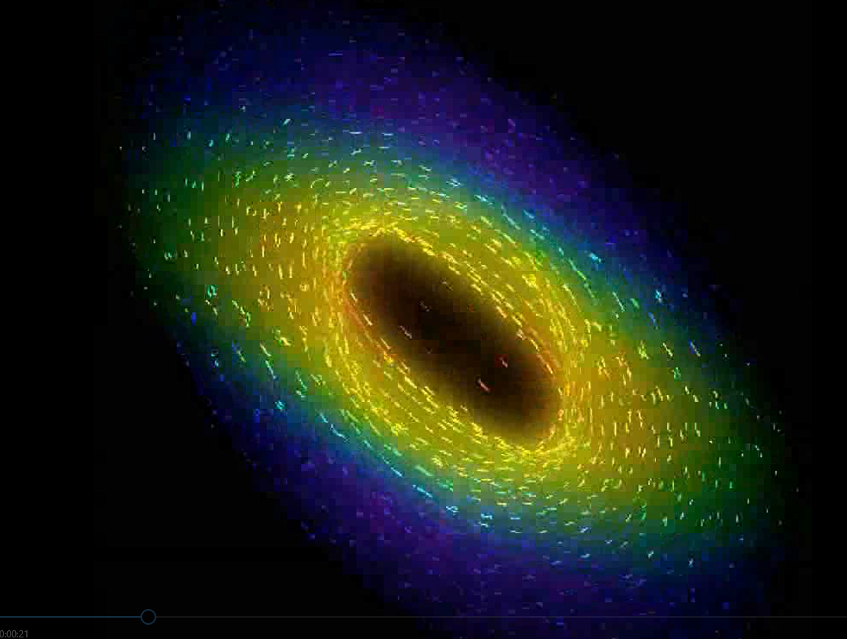

Slide 34
CLICK ( hover mouse over) ANIMATION BELOW ON NEXT SLIDE TO PLAY

