Slide 2
“Disciples, during the early stages of their training, are apt to regard energy as a pool or a reservoir upon which they can learn to draw, thus appropriating a quota of that energy for their need, their service and their use. But energy is fluid and in motion; we live in a veritable sea of moving forces, qualified in countless ways, conditioned by countless minds….” (DINA 2 p-133-3)

Slide 3
1. Morya Go-to webinar What we are attempting to achieve here.
1. Information is very important but too much information can move us away from the abstract mind and the development of the intuition.
2. HPB and DK have continuously affirmed that symbols are the true language of initiates and if we want to communicate with these advanced beings we must learn their language. (Deva & Angelic)
3. We must not just view these occult symbols from the outside as if a casual observer but as HPB affirmed, we must go deeper and literally get inside them and imagine we are this greater and expanded life that we seek to understand and know.
4. All progress on the path of evolution is achieved by the right use of the imagination or picture making faculty. “Energy we know follows thought” and a visualized image is the first step towards creating a bridge from the known to the unknown, and from effect to causes.
Hierarchy of symbols, new and creative ways they are presented.
Notes:
1. Cell Phones 2. effective member of a group

Slide 4
A New Terminology more suited to the modern mind.
So much has been discussed in relation to these laws from the mystical and strictly Christian angle that the terms used are essentially meaningless; the whole subject requires revitalising; it needs to be endowed with a fresh and new presentation and a new terminology, more suited to the growing mental grasp of the scientific and modern mind. (238 DINA 2 )
(Science of energy and force)

Slide 5
The New Approaches appeal to the abstract mind
“I would have this group which I am training forget the details about initiation as presented so oft by the mystery monger and the emotional person, and concentrate upon the far more factual realities of meaning, cause and being. The old and outworn presentations were the product of the concrete mind, and are therefore crystallising in their effects and distorting in their results; they are also evocative of spiritual selfishness and isolation, as well as of astral curiosity. The new approach which I seek to indicate makes its appeal to the abstract mind and to the soul, whose values are sound, and eventually to the intuition;…” (284 DINA 2)
Astrology – Healing – Meditation - Psychology

Slide 6
Blast them wide open with the newer approaches to truth.
The major task of the Master in the early stages of training His disciple is to bring to an end the period of the disciple's intense preoccupation with himself, with his service, with his reaction to the Master or the promise of future contact with the Master,…
The Master takes a group of people with fixed ideas (which they are entirely sure are correct, being the best and highest they have been able to grasp to date) and with the conviction that they have reached a point where they have registered certain spiritual values and concepts, where they have evolved their own formulations of truth and where they are eagerly demanding the next step.
The first thing, therefore, which He has to do is (using a strong and perhaps a strange phrase) to blast them wide open, give them a deep sense of insecurity as to the formulas and symbols of the lower concrete mind and so prepare them for the reception of newer and higher approaches to truth. This is frequently brought about by forcing them to question all the conclusions of the past. (709 DINA 1) not attempt

Slide 7
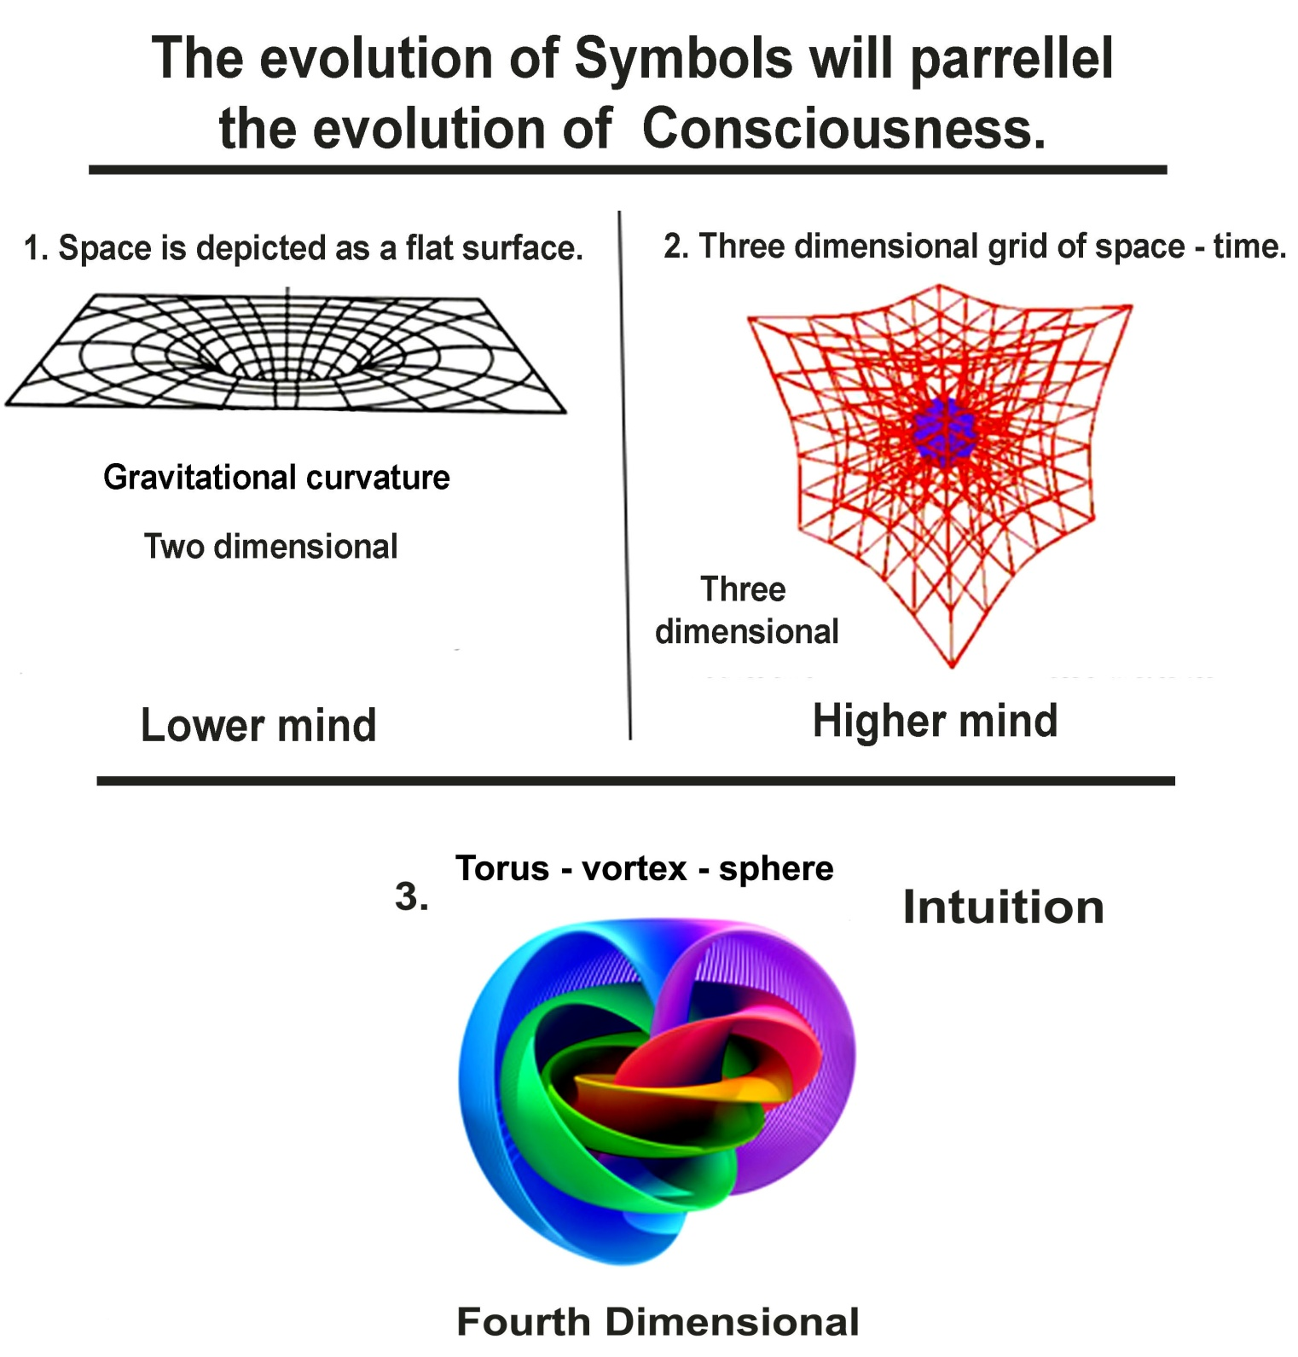

Slide 8
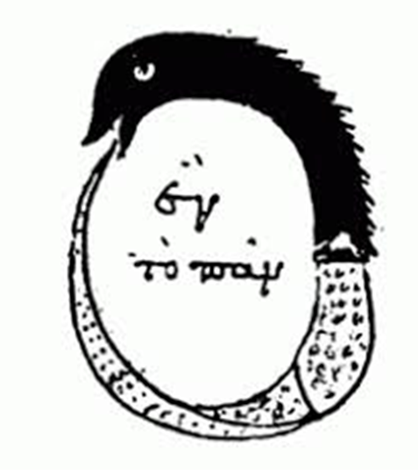
The Oroborus or serpent swallowing its own tail.

Slide 11
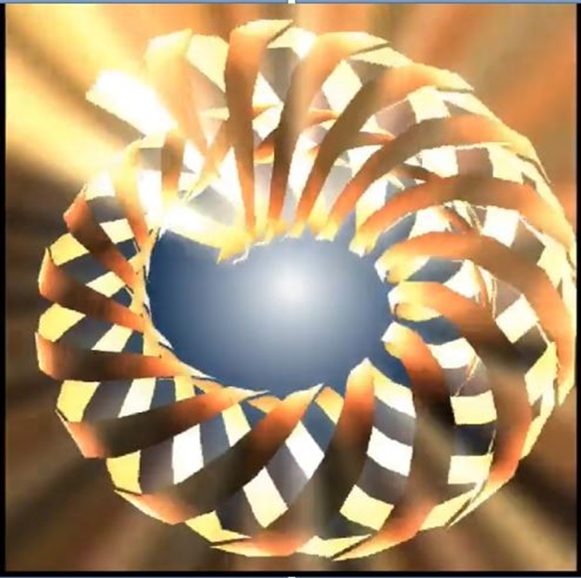

Slide 12
Hover your mouse over the image on the next slide to bring up the "play" button at the bottom of the image, then click the play arrow.

Slide 14
Virtual Reality

Slide 15
2

Slide 16
Walter Pullen astrolog
http://www.astrolog.org/astrolog/ast3d.htm
“The concept of three dimensional houses or "3D houses" refers to a method of placing planets in one of the 12 astrological houses that requires considering the planet's latitude in addition to its zodiac position longitude. All the various classic systems of house division (e.g. Placidus) attempt to define a single zodiac position for each house cusp. That model is simple and easy to work with, however it's limited because it doesn't take into account the third dimension, or a planet's ecliptic latitude. "3D houses" is not a standard system of house division like others, because it goes beyond the old model of picking a single zodiac position for each house cusp.”

Slide 17
Hover your mouse over the image on the next slide to bring up the "play" button at the bottom of the image, then click the play arrow.

Slide 19
Lynda Vugler
http://simplysacredspaces.com/
7 Schemes, 7 Chains 7 Globes 7 Rounds
When, therefore, the esoteric side of astrology, and of mystical geometry, has been studied, and alliance has been made between these two sciences, a flood of light will be thrown upon this matter of the intelligent principle; when the inner workings of the Law of Cause and Effect (the law whereby the Lipika Lords govern all Their action) is better comprehended, then—and then only—will the sons of men be able to study with profit the place of manas in the evolutionary scheme….
Until the intuition is better developed in the average man, the very principle of manas itself forms a barrier to its due understanding. (TCF 397-8)
Sound- Color-Light- Vibration - Number

Slide 21
Astrological key to the Secret Doctrine Stephen Douglas Pugh
http://www.aksdp.net/07_72faces/72toc.htm

Slide 24
MDR rotating 5 pointed star creates vortex.

Slide 25
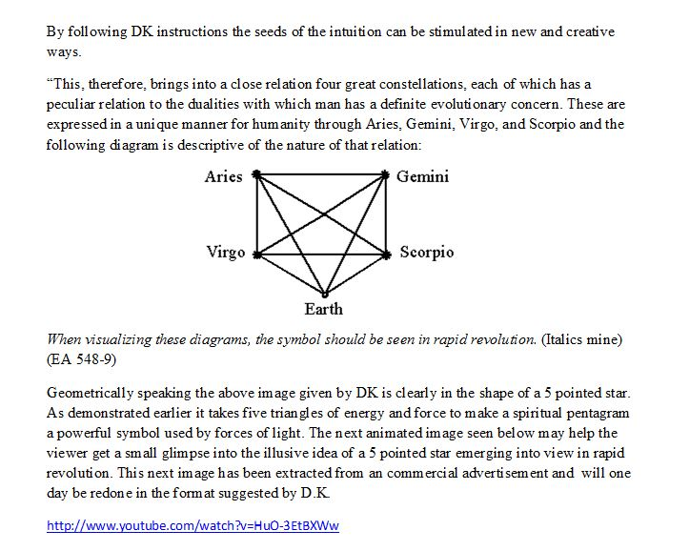

Slide 26
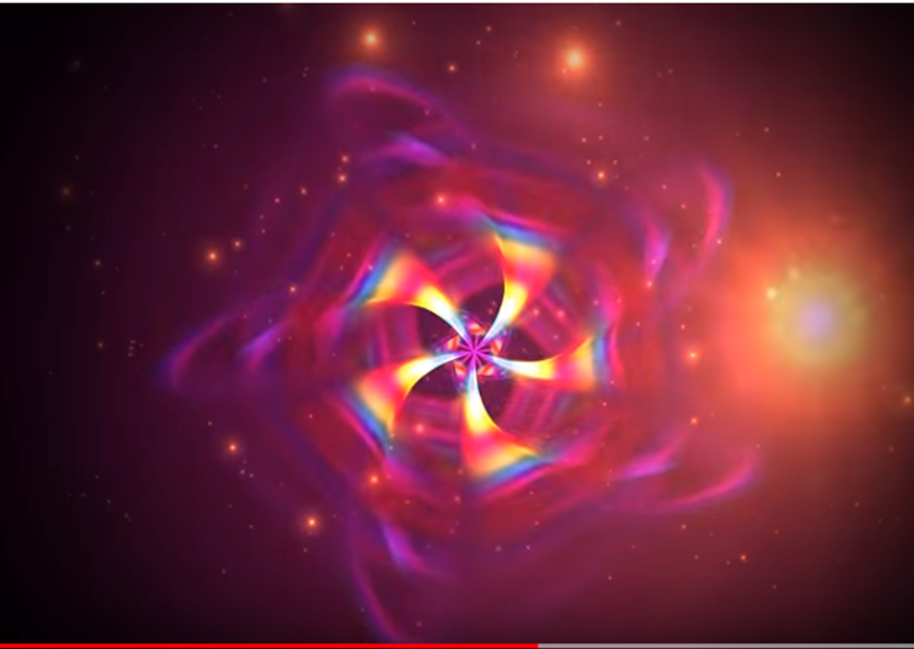

Slide 28
Double click on the file above, and it should open in a player on your computer

Slide 29
Hover your mouse over the image on the next slide to bring up the "play" button at the bottom of the image, then click the play arrow. It will not loop automatically for you

