Slide 2
New ideas inhibited by the concrete mind
“Knowledge can be expressed in concepts and precepts; wisdom is revealed through ideas against which (very frequently) much mundane knowledge powerfully militates. The concrete mind often inhibits, as you well know, the free flow of ideas intuitively impulsed; it is with this free flow of the new ideas that the initiate is basically concerned, because it is ideas, their right application and interpretation, which determine the future of humanity and of the planetary life.” (DINA 2,280-1)
Notes:
Paradox

Slide 3
The 7 Rays and the & Planes
Future presentations of the Ancient Wisdom Teachings.
Least understood of the Ageless Wisdom Teachings is motion. (TCF)
Motion is difficult to see or understand unless you are clairvoyant or you have some visual representation outwardly.
Not just the quality of the information given but how that information is shared.
Rely on Audio-video aids and computer animations to help bridge the gap.

Slide 4
Printing 3-D objects.
Photophoretic – trap (Princess Laya Projector)

Slide 6
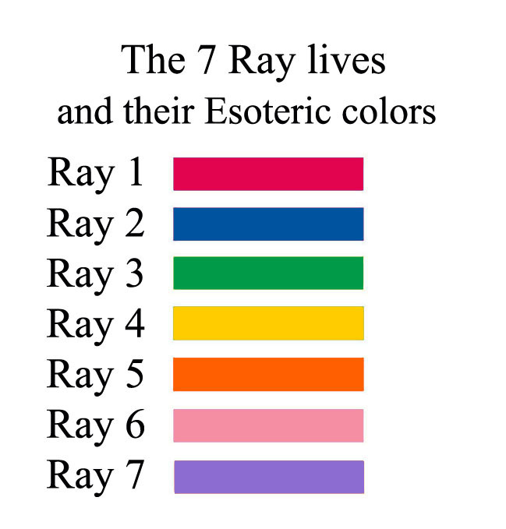

Slide 7
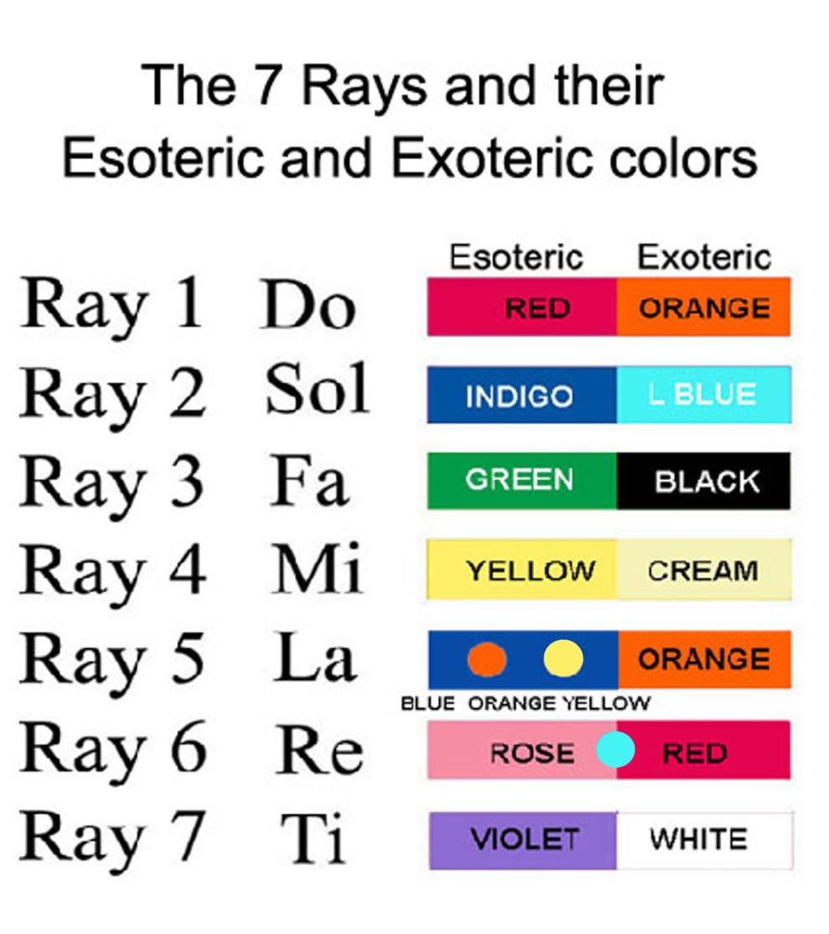
Notes:
Musical scales

Slide 8
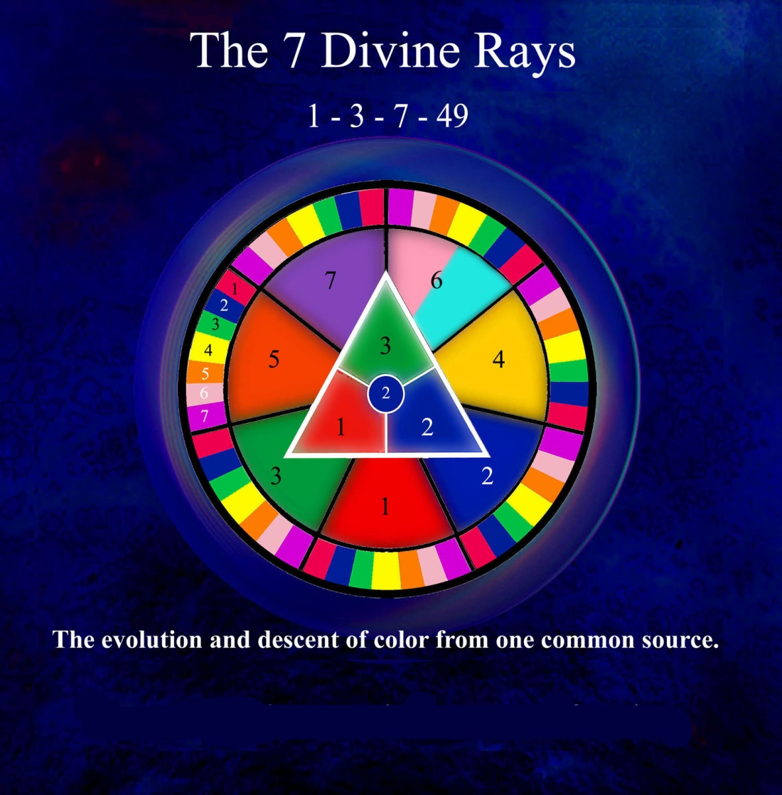

Slide 9
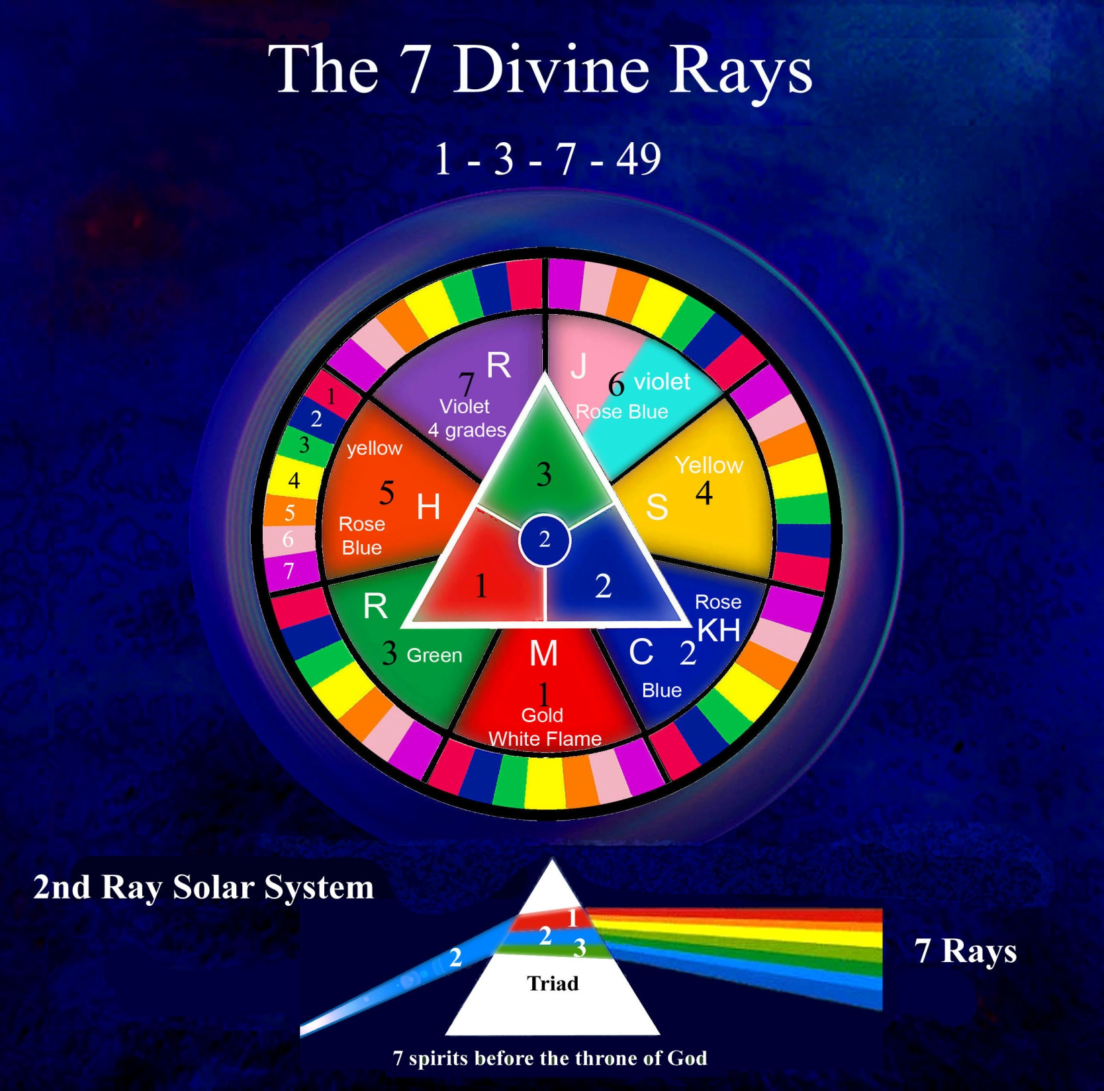

Slide 10
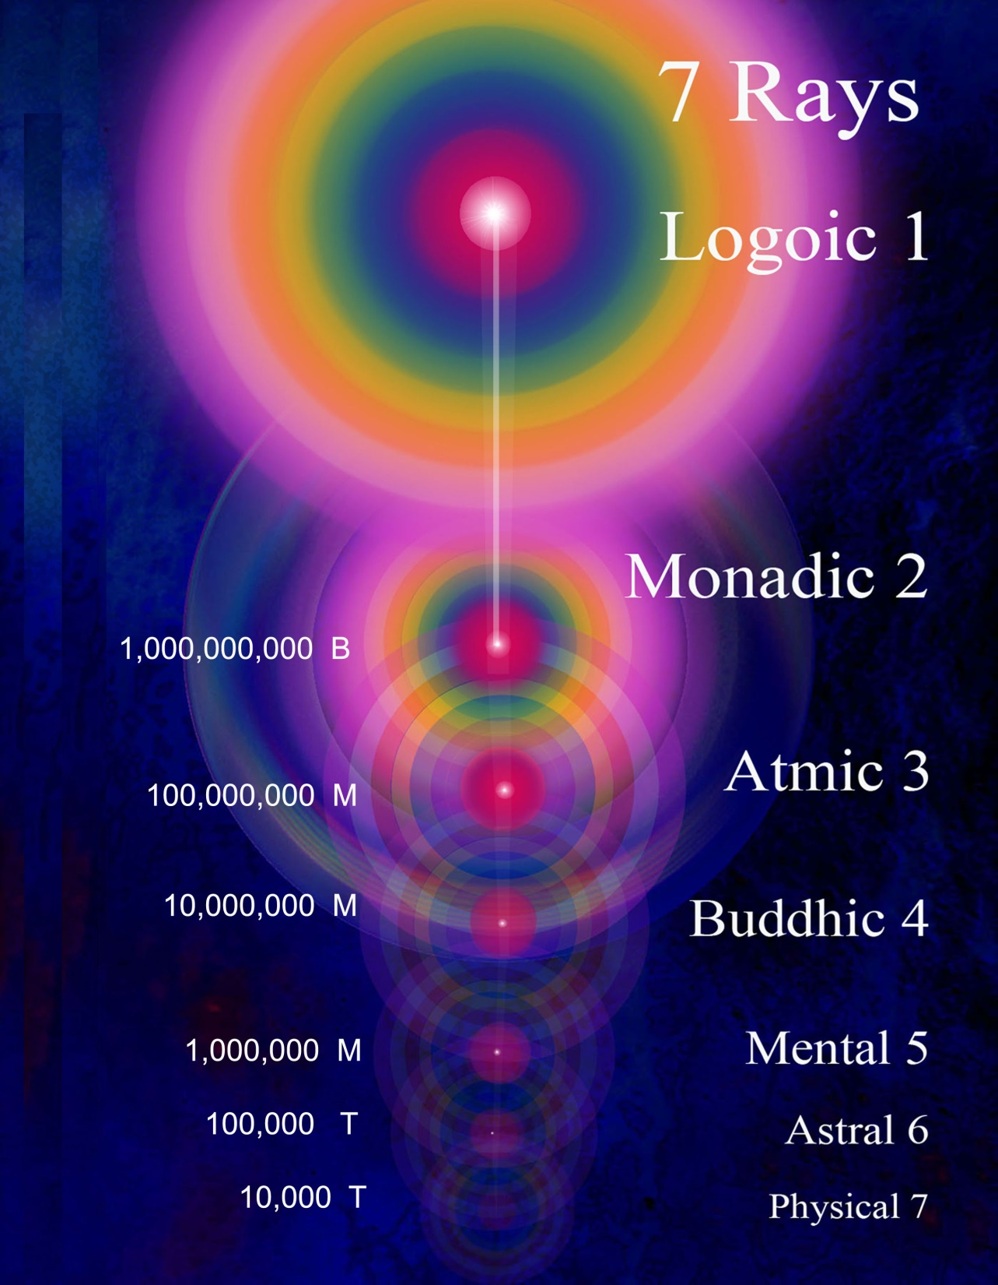

Slide 11
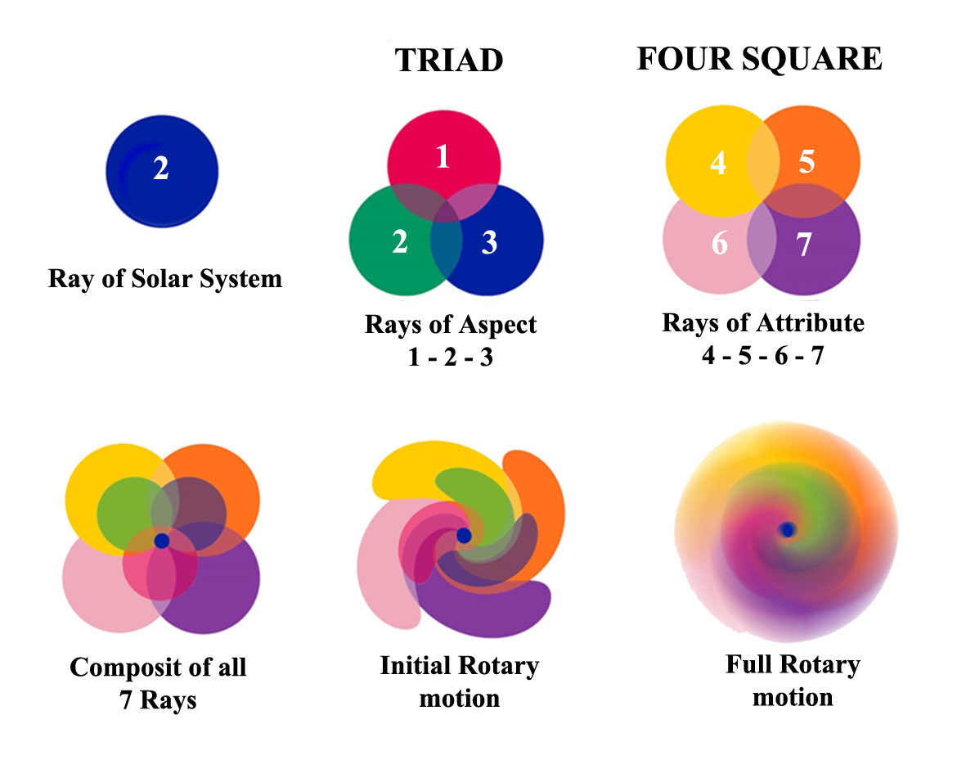

Slide 12
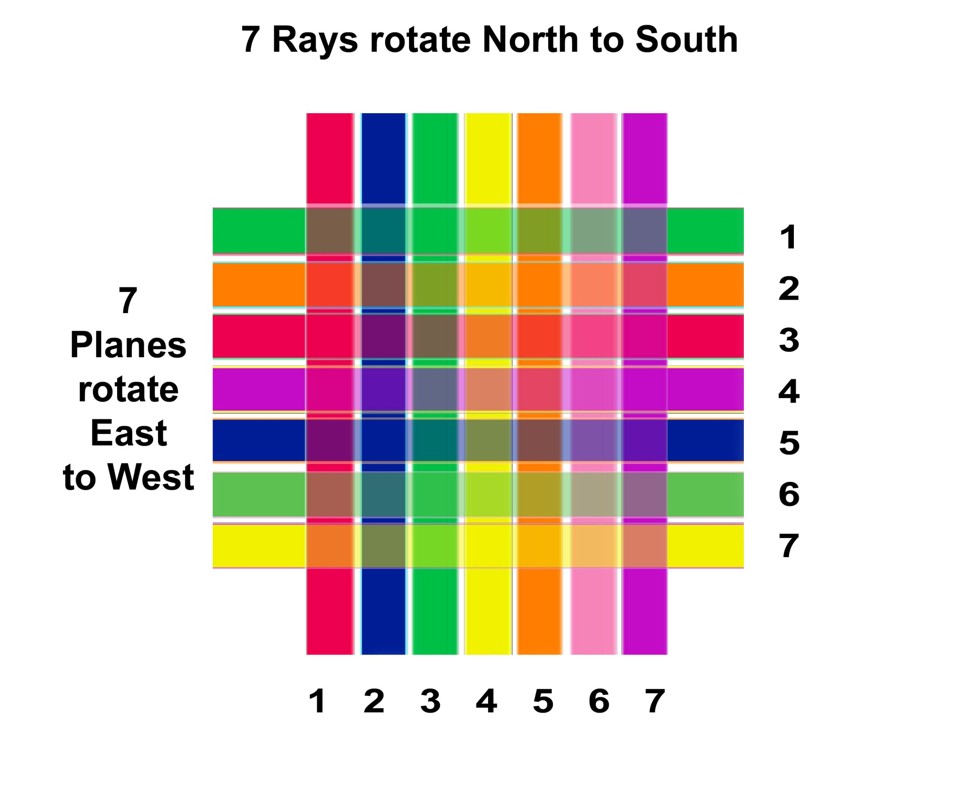

Slide 13
Rotation of the Rays and Planes
In connection with these two types of spheres we might, by way of illustration and for the sake of clarity, say that:
a. The planes rotate from east to west.
b. The rays rotate from north to south…..
--------------------------------------------------------------------------------------------------
The seven planes, likewise atoms, rotate on their own axis, and conform to that which is required of all atomic lives.
The seven spheres of any one plane, which we call subplanes, equally correspond to the system; each has its seven revolving wheels or planes that rotate through their own innate ability, due to latent heat—the heat of the matter of which they are formed. (TCF 153-4)

Slide 16
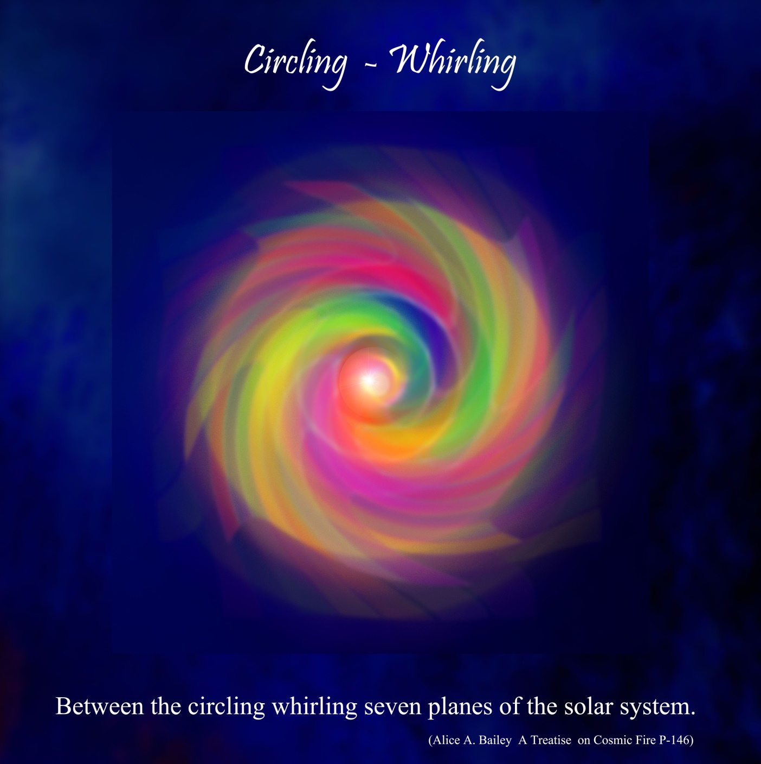

Slide 17
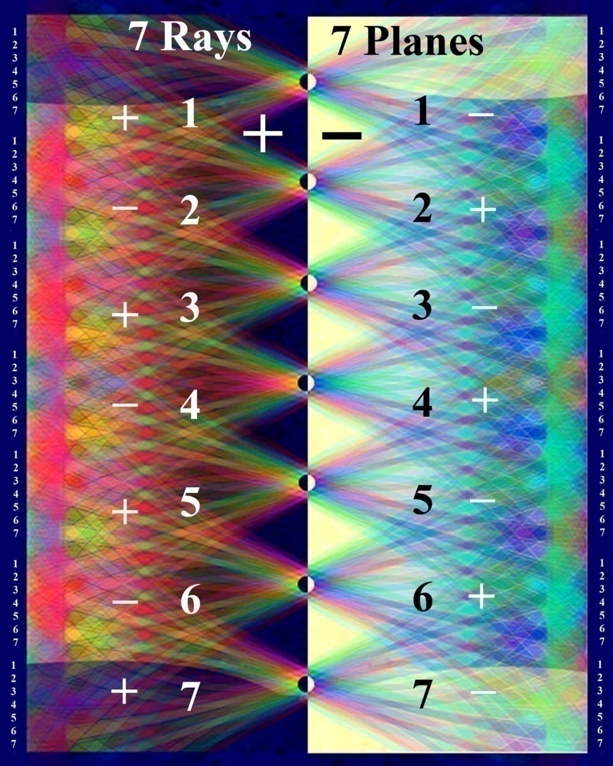
Notes:
Rays and planes seen electrically

Slide 18
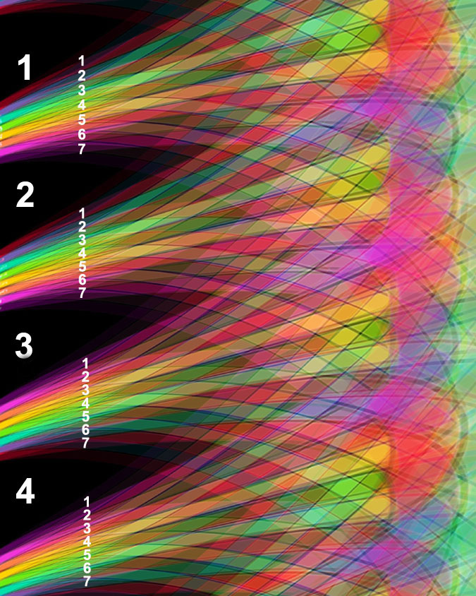

Slide 19
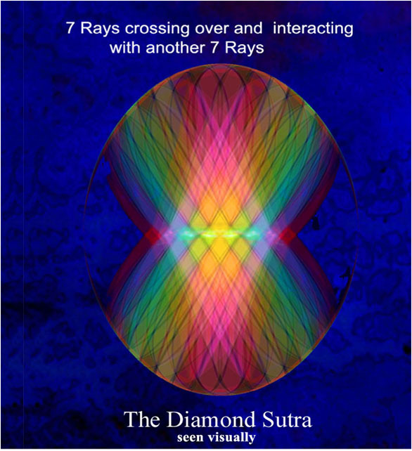

Slide 20
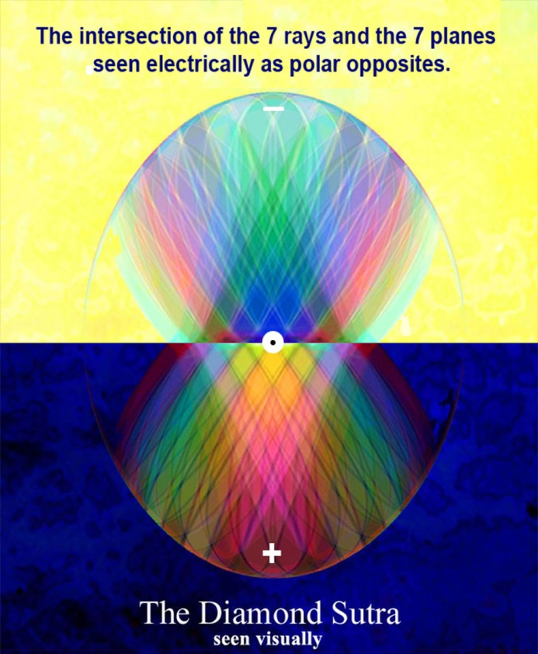
Notes:
Enlargement of previous image

Slide 21
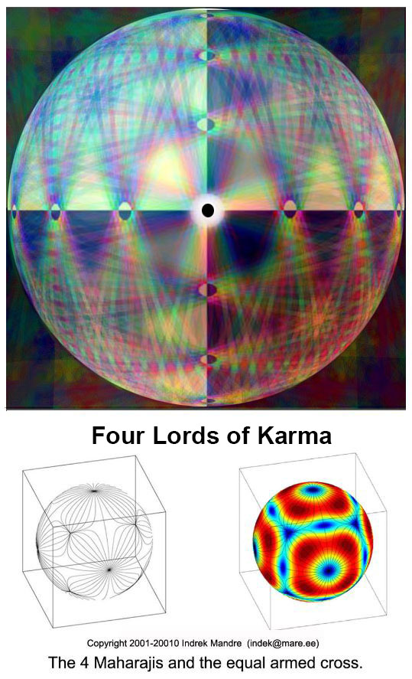
Notes:
Folded into a sphere.

Slide 23
Notes:
Can loop

Slide 24
Music by: Lisa Gerrard “Now we are Free”

Slide 25
The vortex and dual rotary motion
How ray and planes are formed
How petals are formed
"In the whirling of the force through the vortex (which whirling forms the petals of the lotus) it will be observed that certain petals predominantly stand out, …” (LOM:85)
Notes:
Did this last session with limited results

Slide 26
The forces flowing through these vortices.
It is simple to grasp the informative intellectual data regarding the centers of force; it is most difficult to bring about the rearrangement of the forces flowing through these vortices, and to learn to function consciously through the higher centers, subordinating the lower ones. "
The interplay between the centres below and above the diaphragm
is of vital importance to the modern aspirant, for the mechanism of their transmutation, results in the activated heart, the throat, and the eye - and lead to true esoteric endeavour and to creative work on the subtler planes.

Slide 27
Centrifugal and Centripetal motion
“One of the fundamental concepts which is grasped by all magical workers, is that both will and desire are force emanations. They differ in quality and vibration, but are essentially currents of energy, one forming an initial vortex or center of activity, being centrifugal, and the other being centripetal, and the main factor in the accretion of matter into a form around the central vortex.” (TCF 1080)
Notes:
Also going in opposite directions Like the rays and planes

Slide 28
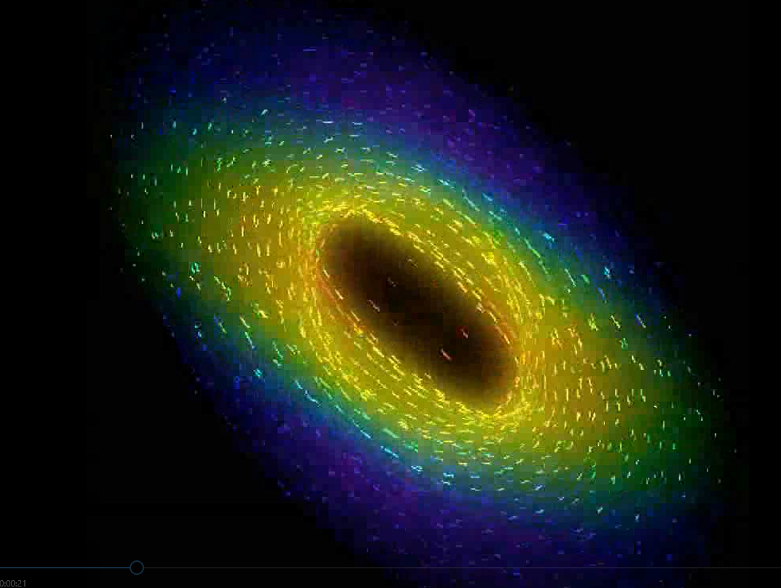
Notes:
Use still chart to explain motion Energy welling up

Slide 30
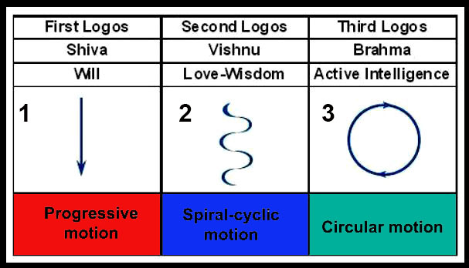

Slide 31
Welling up from within a radiant center
“Let your influence, welling forth from a steady and radiant centre, make itself felt in ever widening ranges of contact.” (310 DINA 1)
. “A welling up of magnetic force on Sirius, which produces effects upon our solar system and particularly upon our Earth, via the Hierarchy.” (410 EA)
Wikipedia
welled, well·ing, wells
v.intr.
1. To rise to the surface, ready to flow:
2. To rise or surge from an inner source:

Slide 32
