Slide 2
New ideas inhibited by the concrete mind
“Knowledge can be expressed in concepts and precepts; wisdom is revealed through ideas against which (very frequently) much mundane knowledge powerfully militates. The concrete mind often inhibits, as you well know, the free flow of ideas intuitively impulsed; it is with this free flow of the new ideas that the initiate is basically concerned, because it is ideas, their right application and interpretation, which determine the future of humanity and of the planetary life.” (DINA 2,280-1)
Notes:
Paradox

Slide 3
The 7 Rays and the & Planes
Future presentations of the Ancient Wisdom Teachings.
Least understood of the Ageless Wisdom Teachings is motion. (TCF)
Motion is difficult to see or understand unless you are clairvoyant or you have some visual representation outwardly.
Not just the quality of the information given but how that information is shared.
Rely on Audio-video aids and computer animations to help bridge the gap.

Slide 4
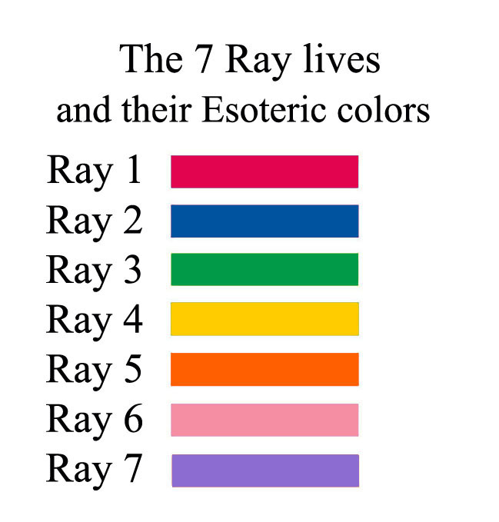

Slide 5
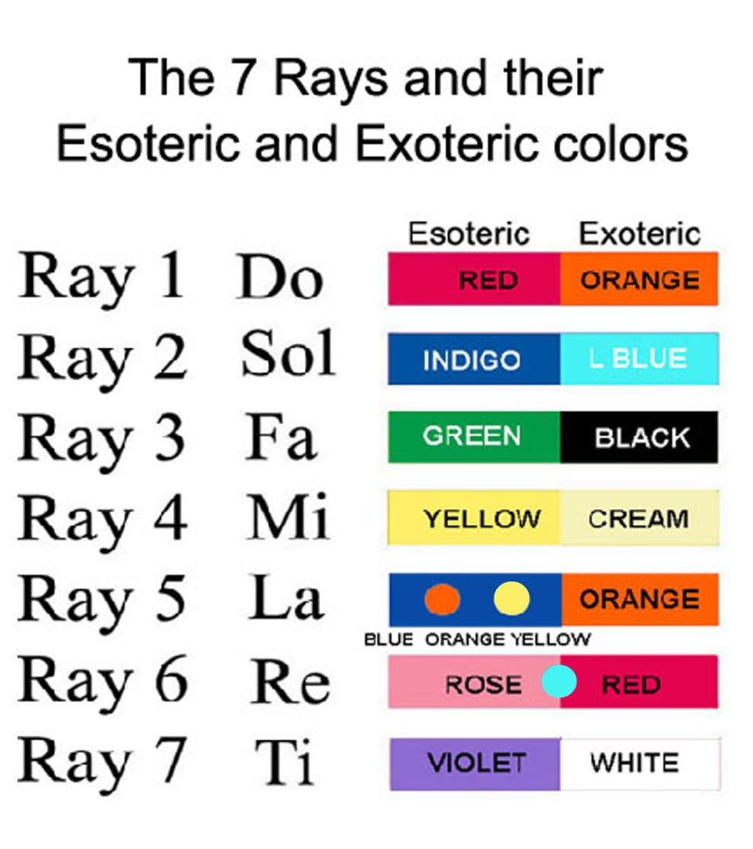
Notes:
Musical scales

Slide 6
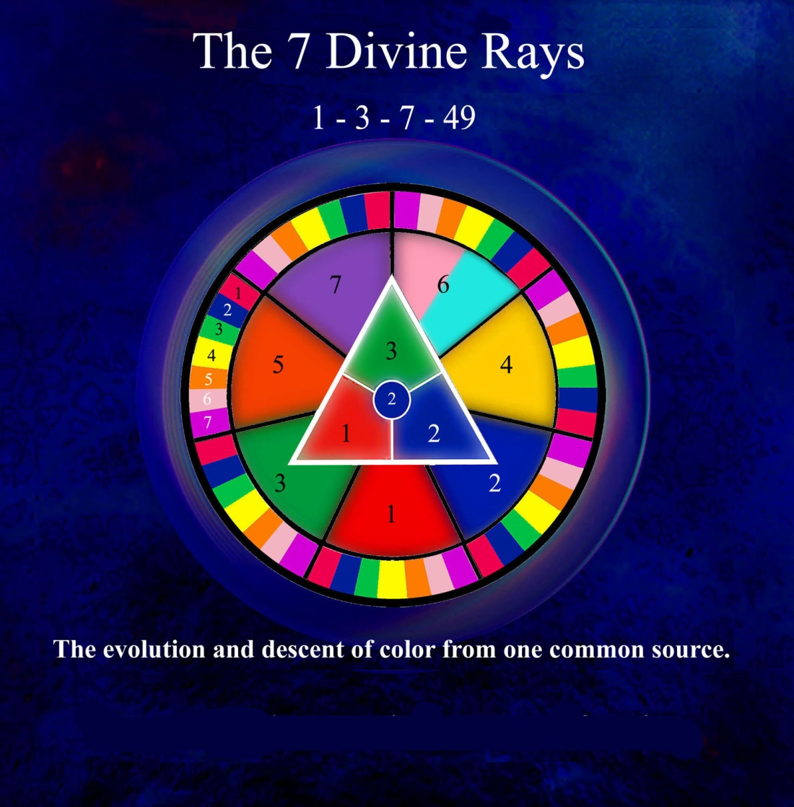

Slide 7
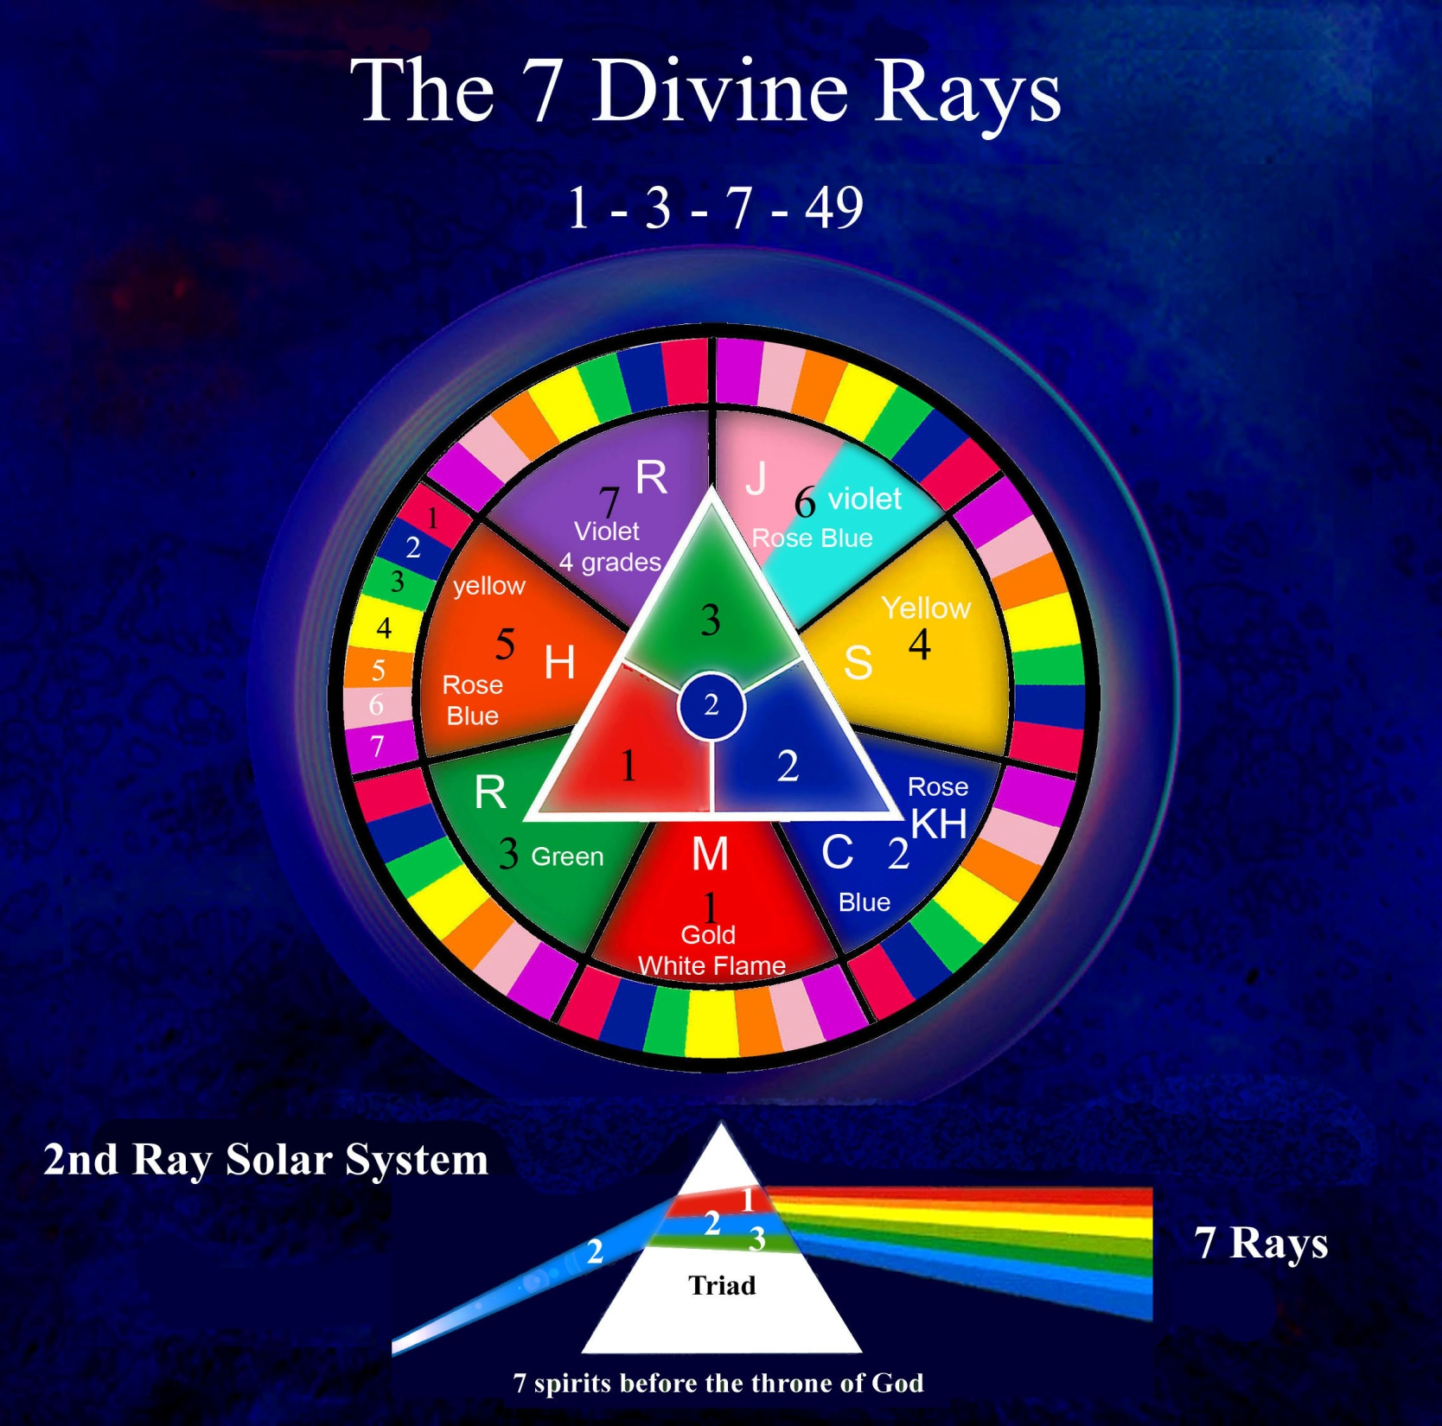

Slide 8
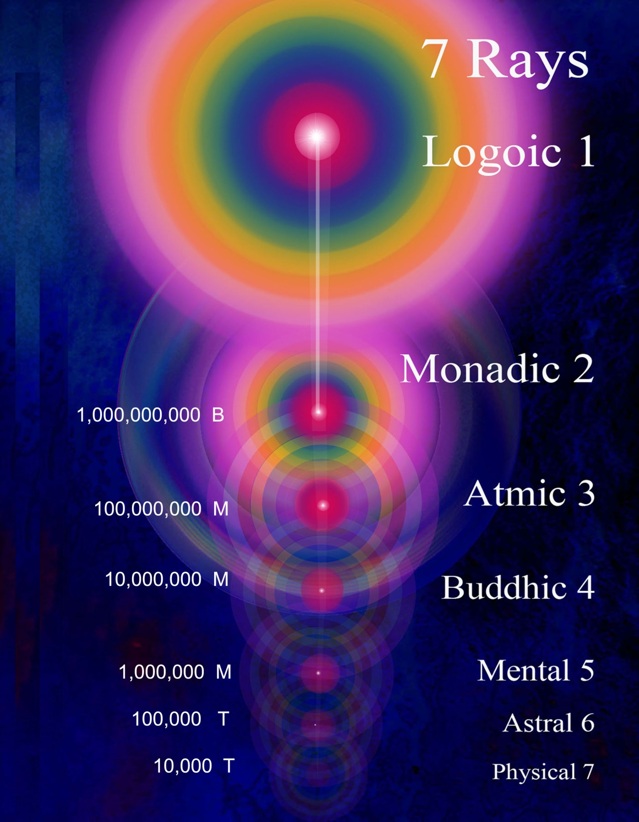

Slide 9
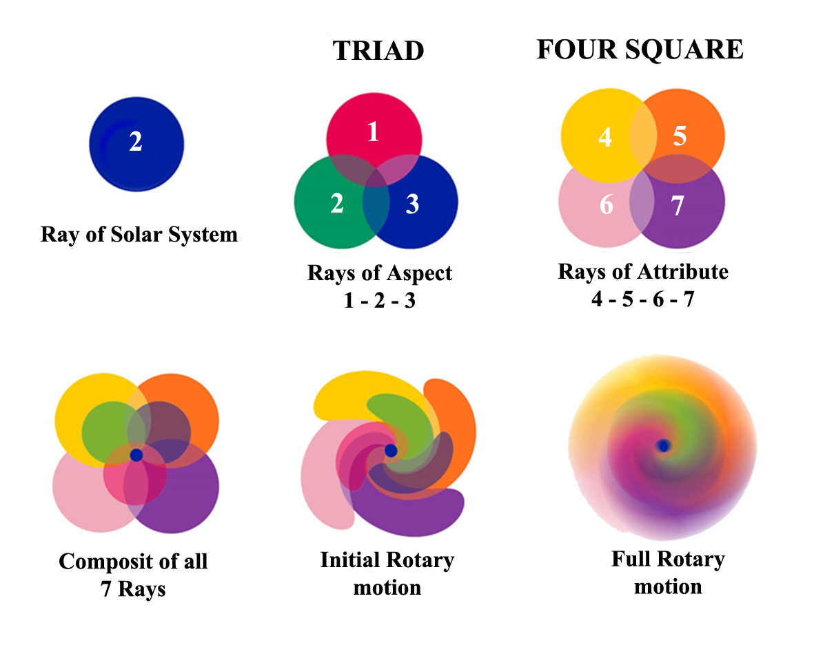

Slide 10
Rotation of the Rays and Planes
In connection with these two types of spheres we might, by way of illustration and for the sake of clarity, say that:
a. The planes rotate from east to west.
b. The rays rotate from north to south…..
--------------------------------------------------------------------------------------------------
The seven planes, likewise atoms, rotate on their own axis, and conform to that which is required of all atomic lives.
The seven spheres of any one plane, which we call subplanes, equally correspond to the system; each has its seven revolving wheels or planes that rotate through their own innate ability, due to latent heat—the heat of the matter of which they are formed. (TCF 153-4)

Slide 11
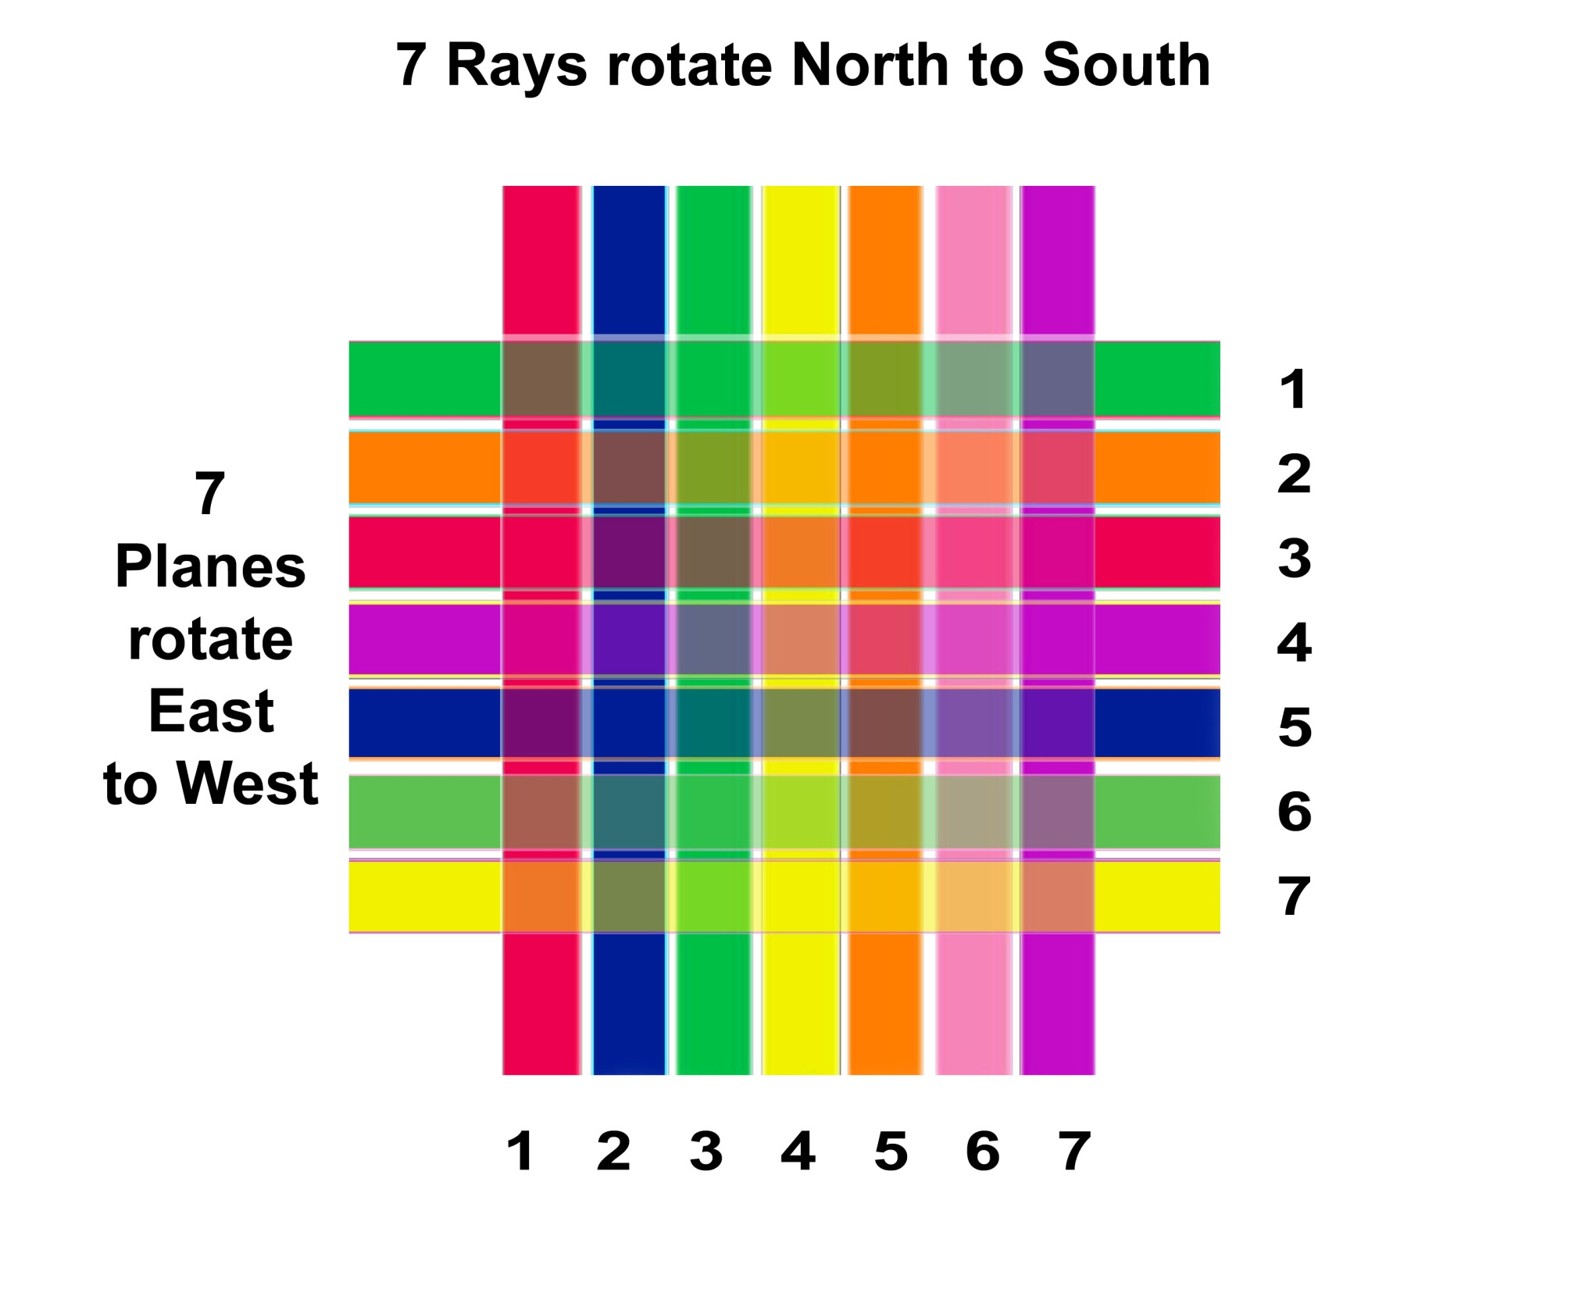

Slide 13
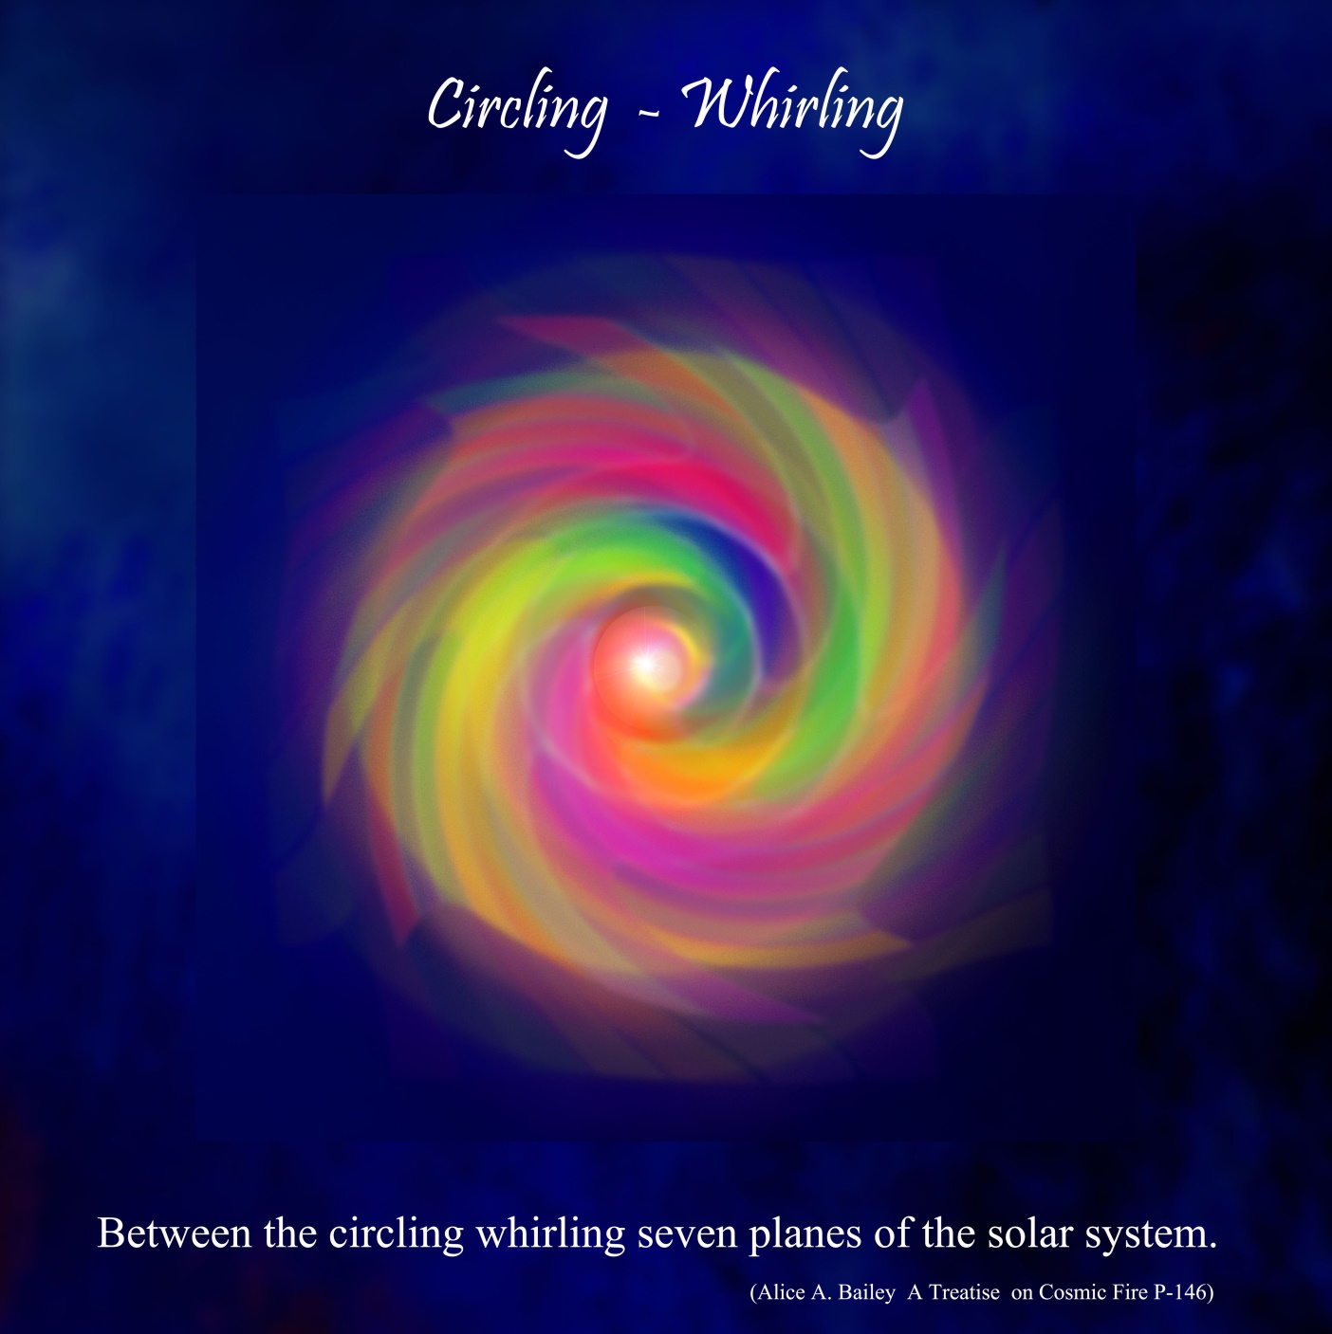

Slide 14
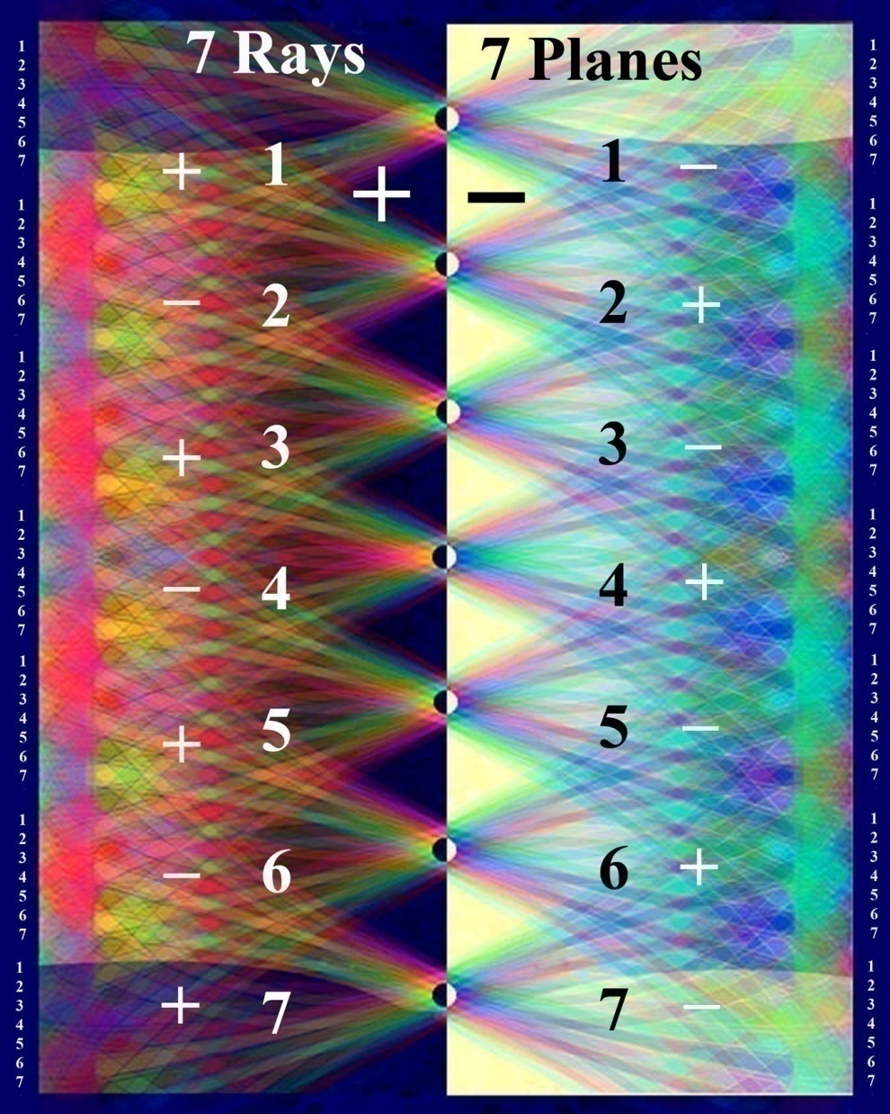
Notes:
Rays and planes seen electrically

Slide 15
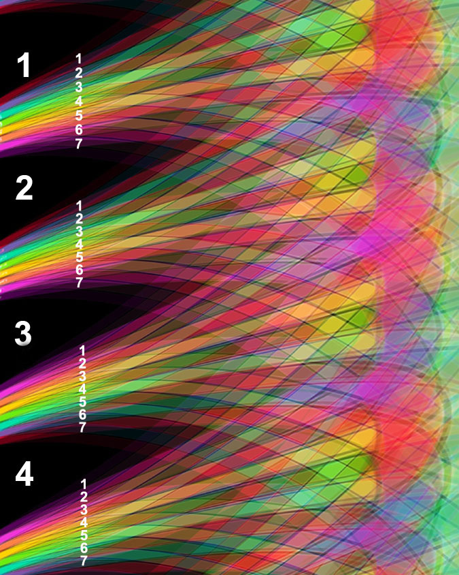

Slide 16
Interaction of the Rays and Planes through motion Vortex and petal formation
Notes:
Will brings rays and Planes into each others orbit and the rays pass through the planes adding to each.

Slide 17
. The aspirant may regard each centre symbolically as a lotus.
2. This lotus is formed of energy units moving or vibrating in a specific manner and these vibration-waves assume the forms we call the petals of the lotus.
[Page 83]
3. Each lotus consists of:
a. A certain number of petals,
b. A pericarp or supporting calyx,
c. A centre of pure white light called the "jewel."
4. Each centre corresponds to a sacred planet, the body of manifestation of one of the seven Heavenly Men. (LOS 83-84)
Notes:
# Pericarp - supporting layers

Slide 18
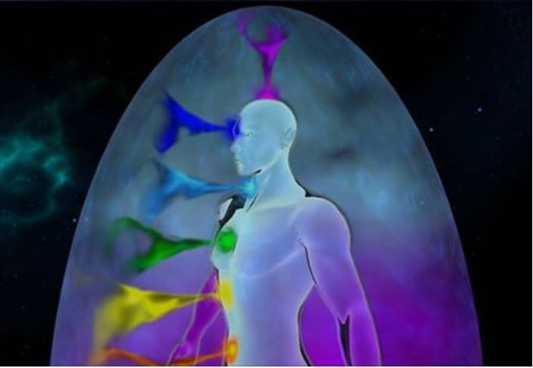
Notes:
How does a petal come into existence ? What is the hidden dynamic in which a center or chakra is build NUMBER relates to how many vibrations that are working through that center RAYS 1,2,3

Slide 19
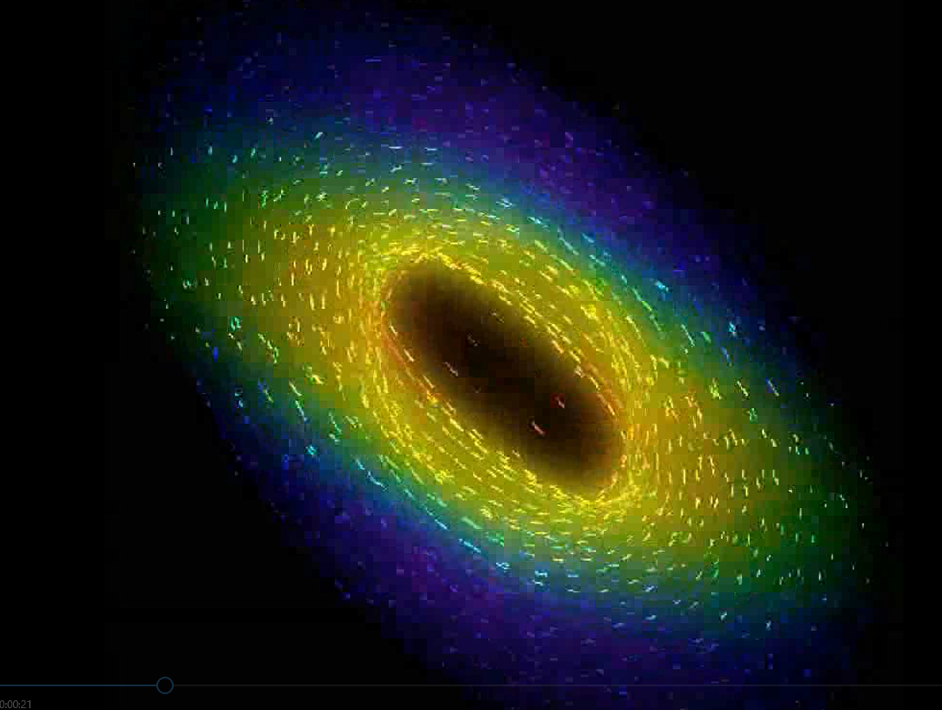
Notes:
Use still chart to explain motion Energy welling up

Slide 20
Notes:
Chart 2 main poles BS and Crown -- Shifting and evolving dualities and polarities.--------- Tension – Crises – Emergence Devas light-color – sound - vibration - number ----- Formula OLP Objective – location procedure

Slide 21
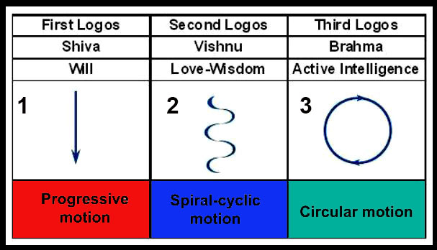
Notes:
Least understood of the ancient wisdom teachings motion

Slide 22
THE DIAMOND SUTRA TEXTS
“The Diamond Sutra is one of the most revered texts of Mahayana Buddhism and a jewel of the world's religious literature.
The sutra's title in Sanskrit, Vajracchedika Prajnaparamita Sutra, could be very roughly translated as the "diamond-cutting perfection of wisdom sutra." Thich Nhat Hanh says the title means "the diamond that cuts through afflictions, ignorance, illusion, or delusion." It is also sometimes called the Diamond Cutter Sutra, or the Vajra Sutra.”
The Prajnaparamita Sutras
“The Diamond is part a large canon of early Mahayana sutras called the Prajnaparamita Sutras. Prajnaparamita means "perfection of wisdom." In Mahayana Buddhism, the perfection of wisdom is the realization or direct experience of sunyata (emptiness)”. (Barbara O'Brien)
Notes:
Left off with the many pictures of the rays and the planes extend those ideas a little bit more

Slide 23
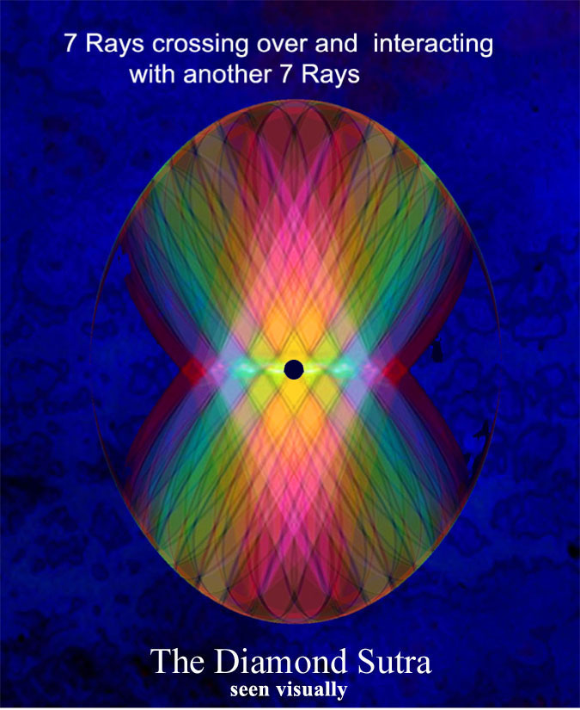

Slide 24
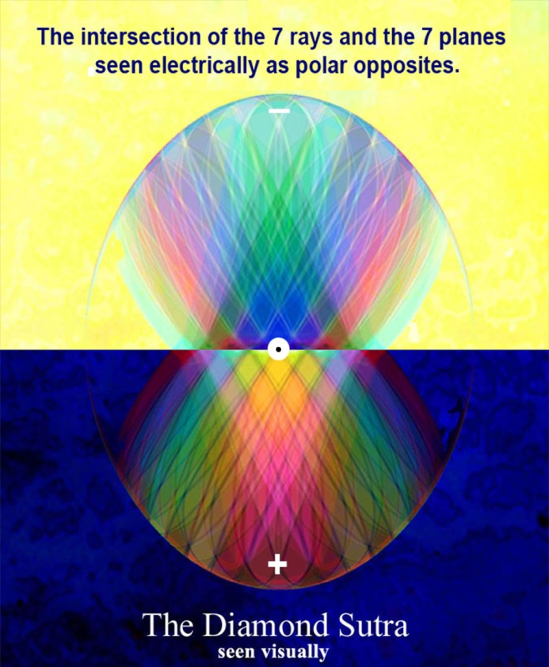
Notes:
Enlargement of previous image

Slide 25
Rule 8 for Disciples and Initiates Law of supplementary seven
“The lesser seven, the greater seven and the planetary seven form one great whole, and these the group must know. When this is realised and the Law of the Supplementary Seven is understood let the group understand the Three and then the ONE. This they can do with the united breath and the unified rhythm.” (RI 4 22-23)
Notes:
Law of correspondances

Slide 26
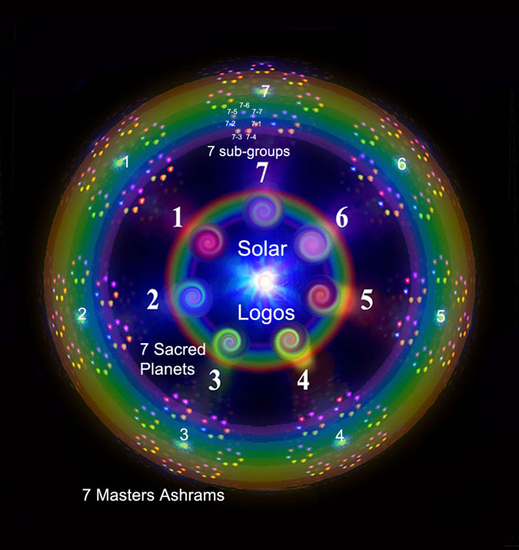
Notes:
7 sacred heavenly men --- 7 masters ashrams ---- 7 sub-groups 3 R 4 SB 5 Hilarion masters not confined to just one ray

Slide 27
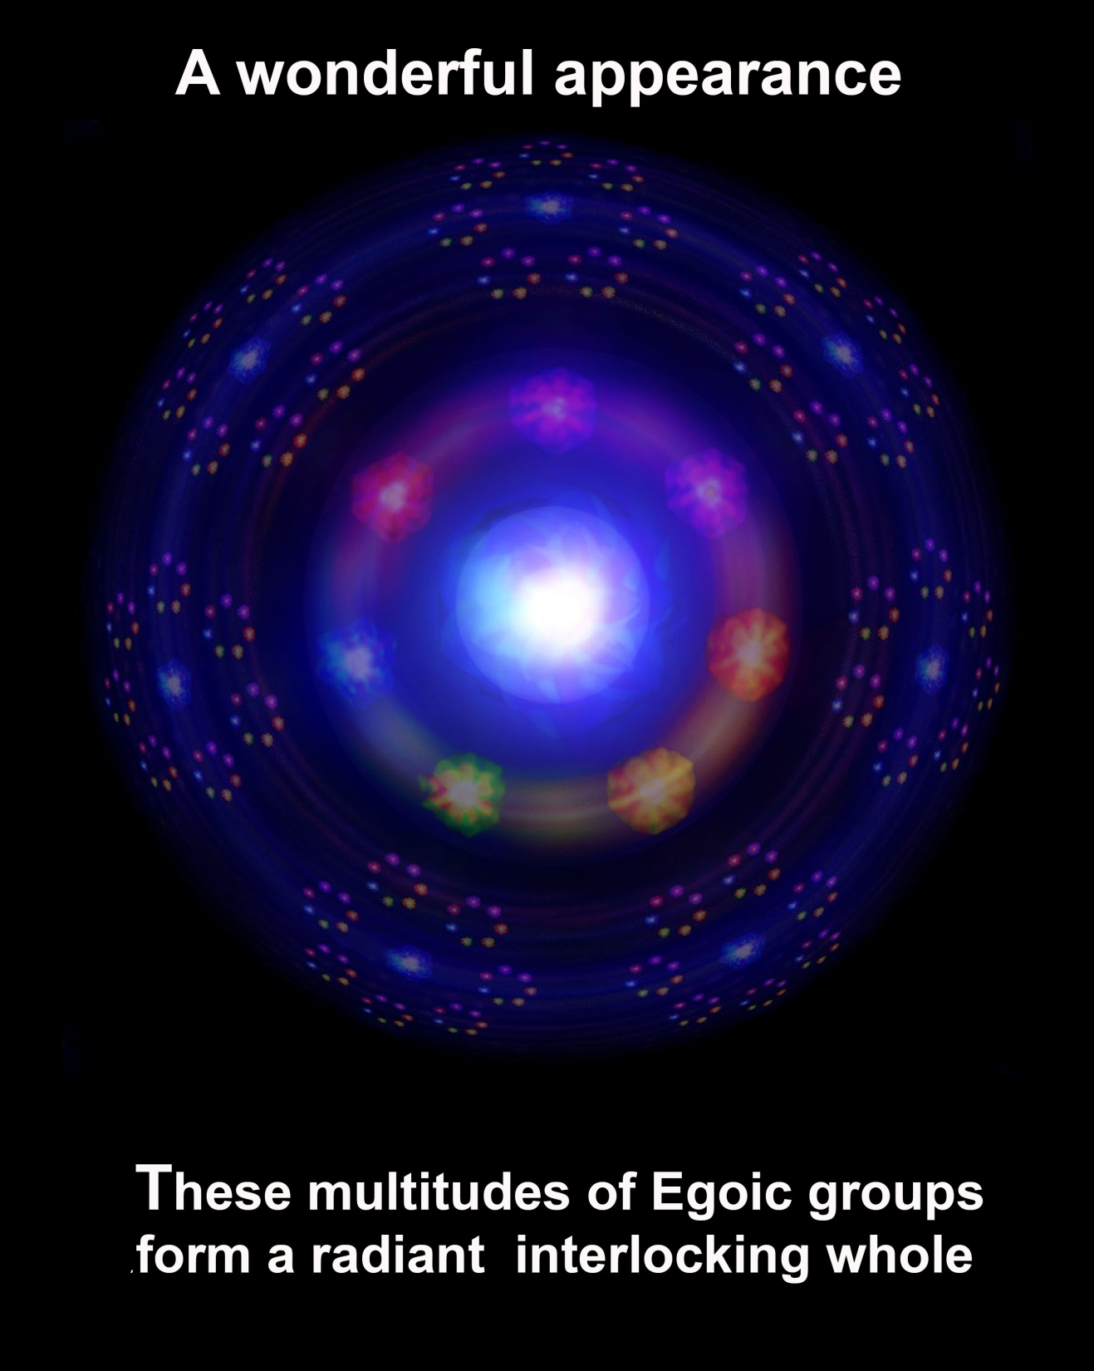
Notes:
(TCF 770)

Slide 28
The forces flowing through these vortices.
It is simple to grasp the informative intellectual data regarding the centers of force; it is most difficult to bring about the rearrangement of the forces flowing through these vortices, and to learn to function consciously through the higher centers, subordinating the lower ones. "
The interplay between the centres below and above the diaphragm is of vital importance to the modern aspirant, for the mechanism of their transmutation, results in the activated heart, the throat, and the eye - and lead to true esoteric endeavour and to creative work on the subtler planes.

Slide 29
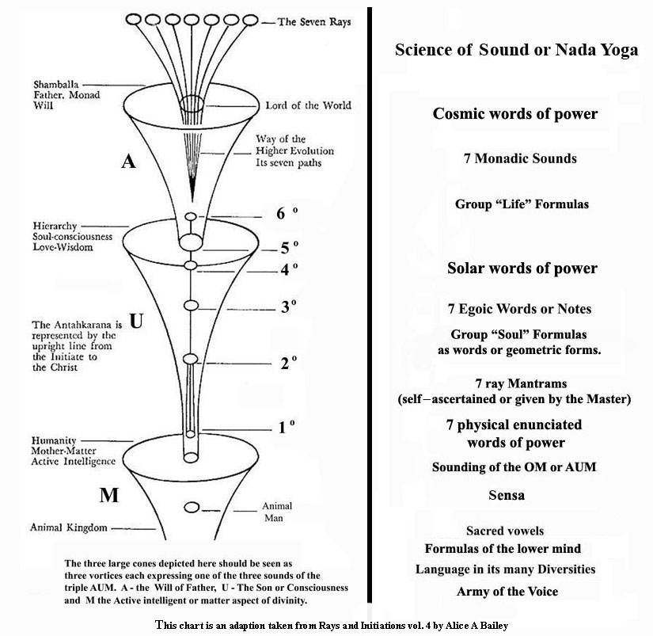

Slide 30
AUM
"The secret of the Fire lies hid in the second letter of the Sacred Word. The mystery of life is concealed within the heart. When the lower point vibrates, when the Sacred Triangle glows, when the point, the middle centre and the apex, connect and circulate the Fire, when the threefold apex likewise burns, then the two triangles—the greater and the lesser—merge into one Flame, which burneth up the whole."

Slide 31
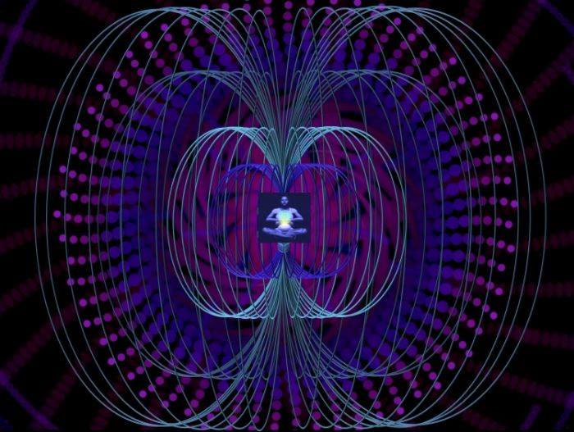

Slide 32
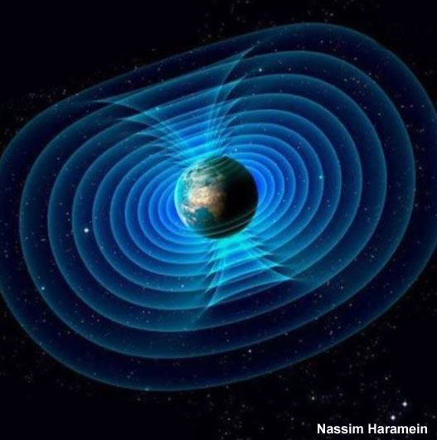

Slide 33
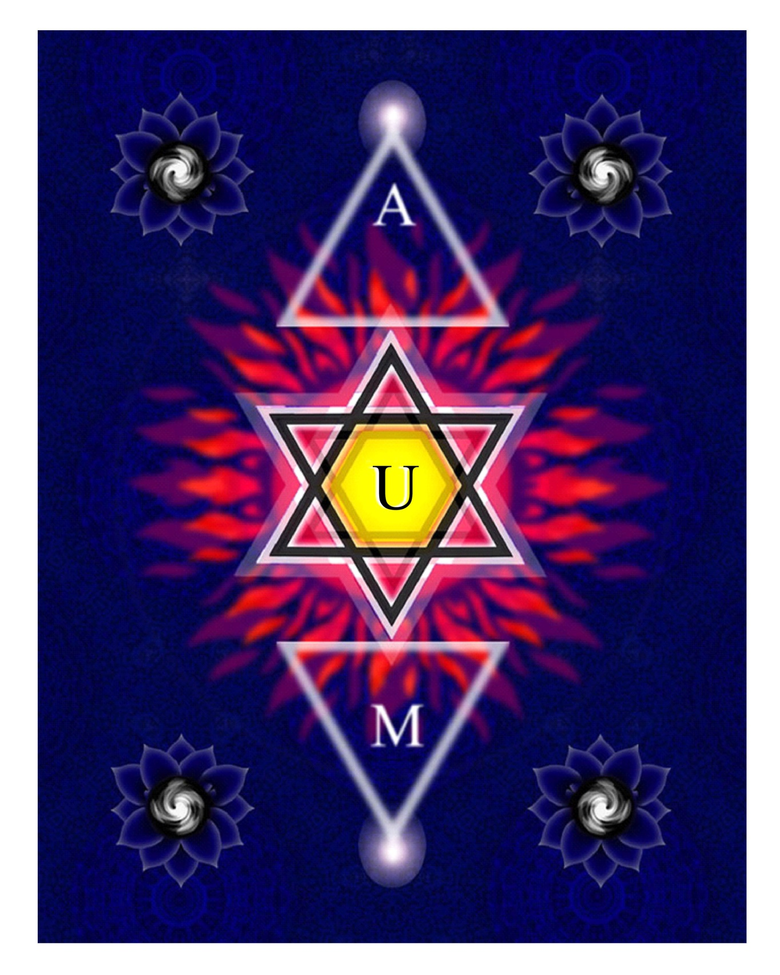

Slide 34
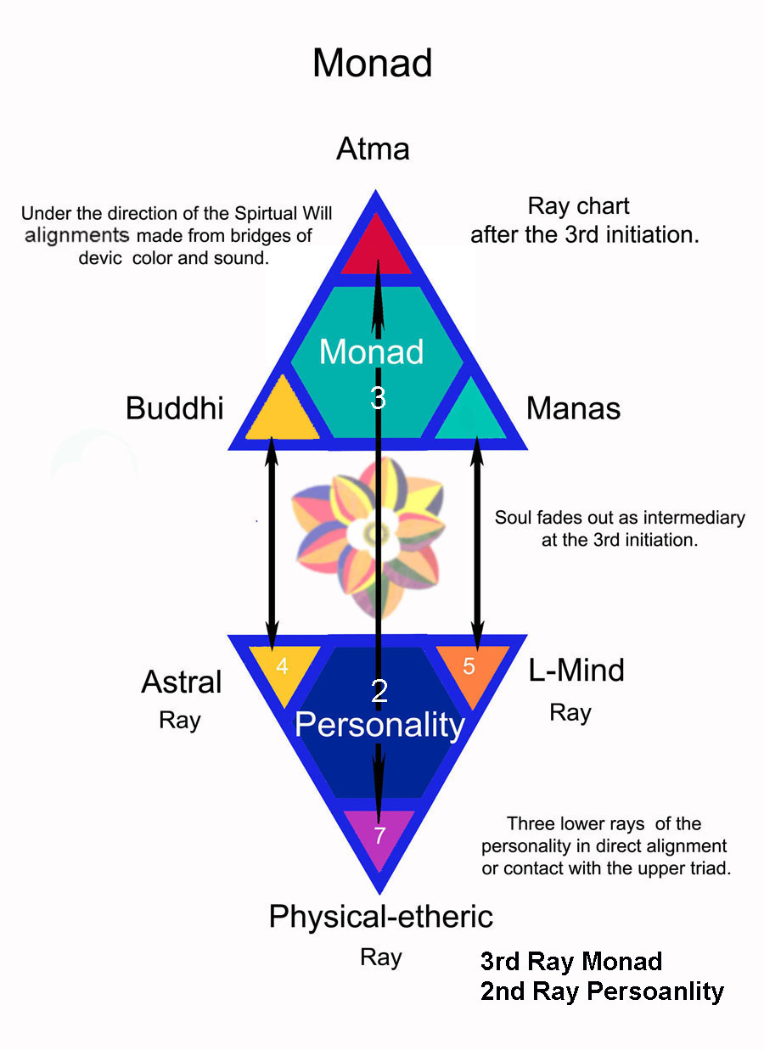

Slide 35
Centrifugal and Centripetal motion
“One of the fundamental concepts which is grasped by all magical workers, is that both will and desire are force emanations. They differ in quality and vibration, but are essentially currents of energy, one forming an initial vortex or center of activity, being centrifugal, and the other being centripetal, and the main factor in the accretion of matter into a form around the central vortex.” (TCF 1080)
Notes:
Also going in opposite directions Like the rays and planes

Slide 36
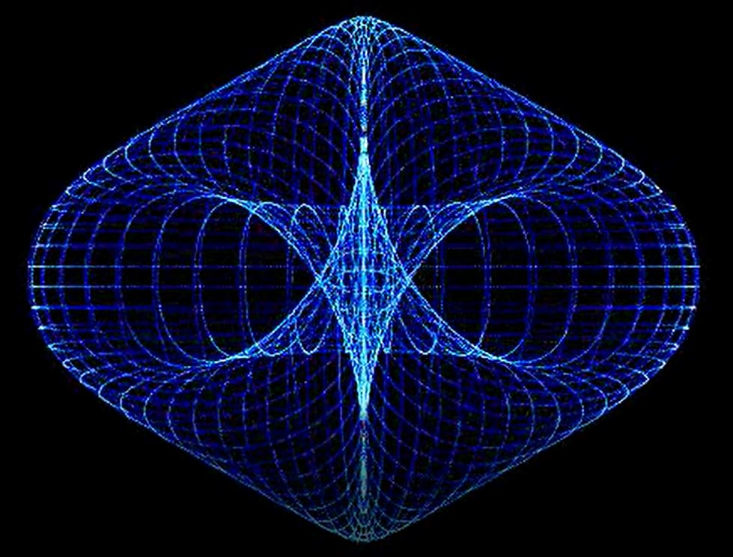
Notes:
In out- up-down Centrifugal - Centripetal in - out

Slide 37
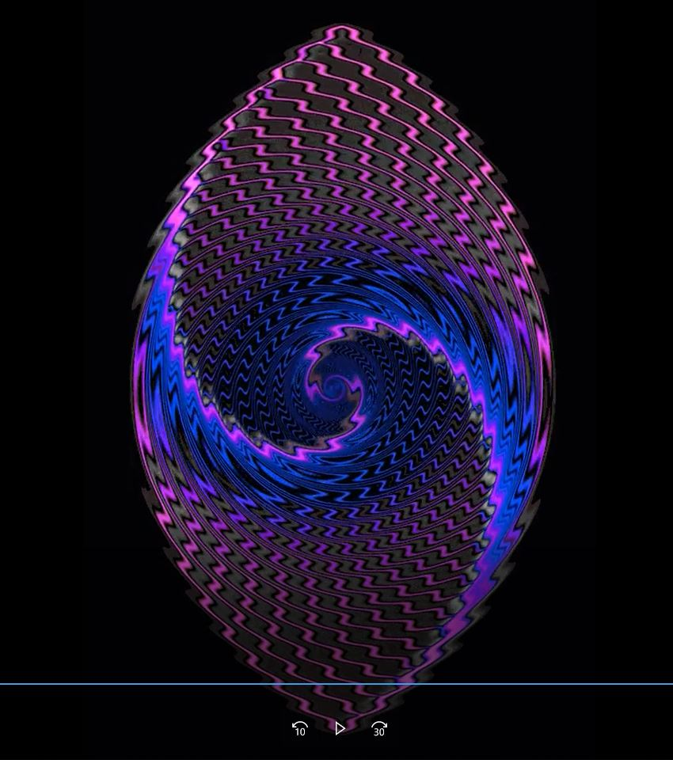
Notes:
Folding into itself can only be done if other dimensions are involved

Slide 38
THE POWER OF EIGHT
“The emphasis laid upon the dominance of the Christ principle by Christianity has laid a sure foundation for the work to be done. This truth is curiously substantiated in a study of the number "eight" in connection with the centres which, we are told, is the number of the Christ. There are eight centres if the spleen is counted, all of them are multiples of eight with the exception of the centre at the base of the spine which has four petals, one half of eight. In our day and in the Anglo Saxon mode of writing, the number eight is the basic symbol of all the centres, for the petals are really in form like a number of superimposed eights. The word petal is purely pictorial and a centre is formed on this pattern. First, a circle, O; then two circles, touching each other and making therefore an 8. Then, as the petals increase in number, it is simply a growth of these double circles, superimposed at differing angles one upon another until we arrive at the thousand-petalled lotus in the head. “(TWM 597-8)

Slide 39
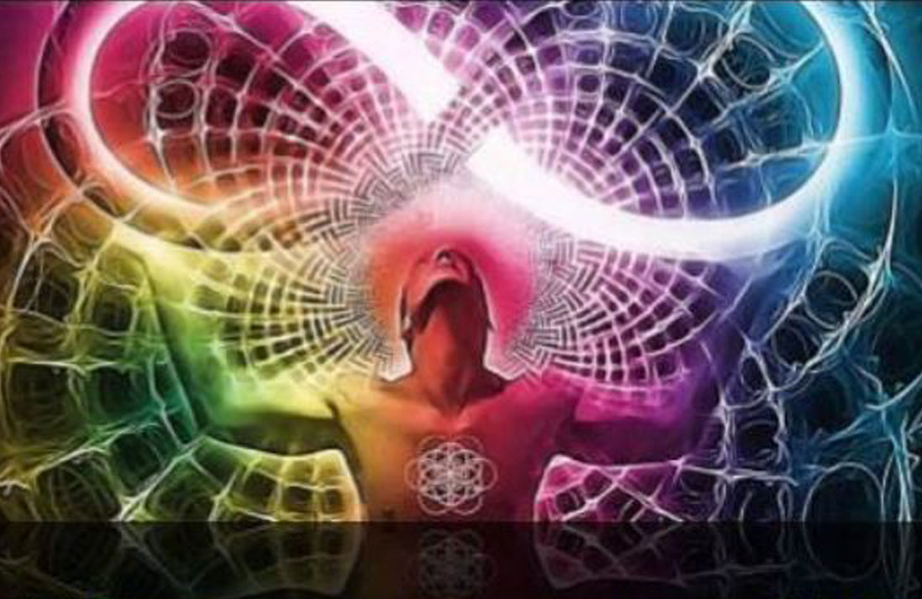

Slide 41
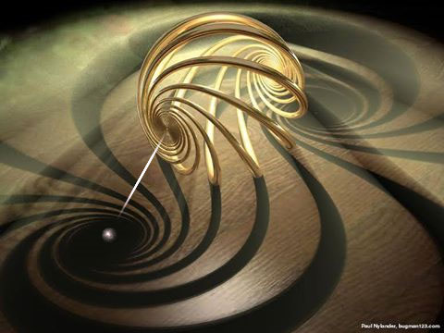
Notes:
Soul many lighted bands Knowledge Love Will petals rotating counter-clockwise – personality clockwise Personality note is a reitererated word sounding in time and space

Slide 42
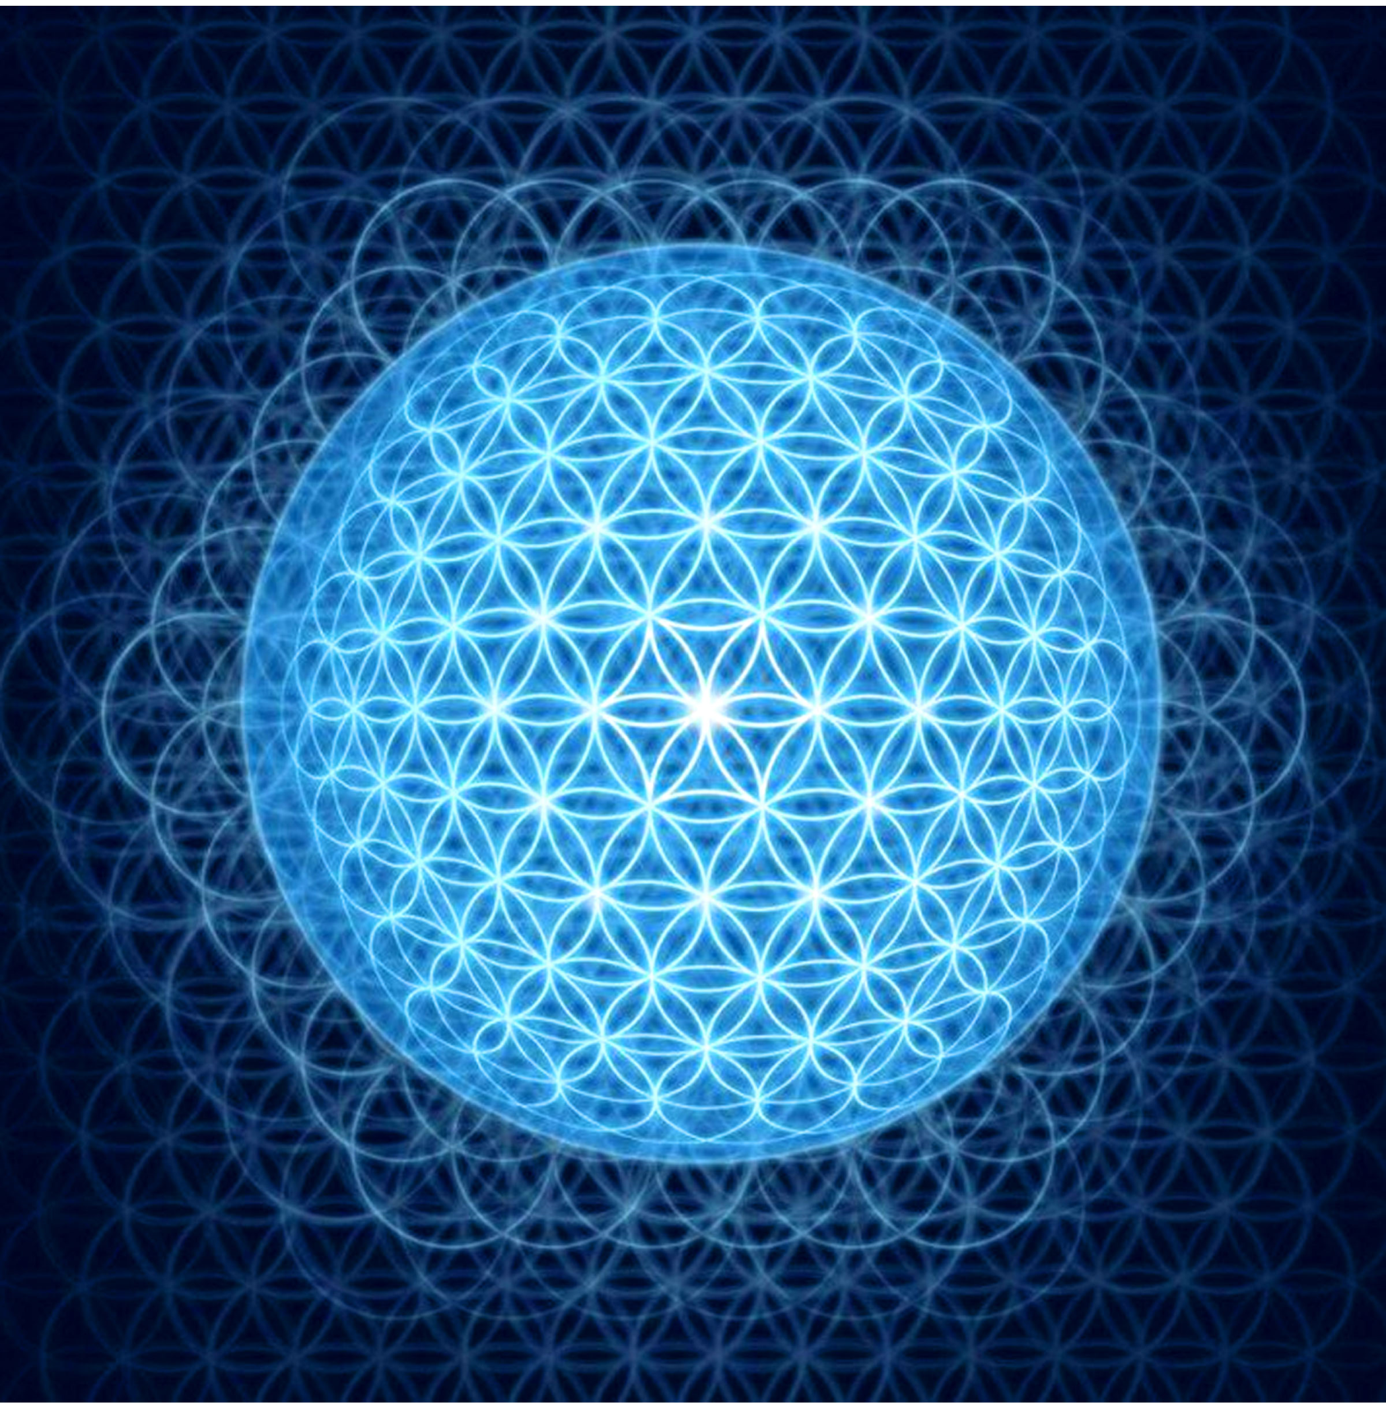

Slide 43
Welling up from within a radiant center
“Let your influence, welling forth from a steady and radiant centre, make itself felt in ever widening ranges of contact.” (310 DINA 1)
. “A welling up of magnetic force on Sirius, which produces effects upon our solar system and particularly upon our Earth, via the Hierarchy.” (410 EA)
Wikipedia
welled, well·ing, wells
v.intr.
1. To rise to the surface, ready to flow:
2. To rise or surge from an inner source:

Slide 44
