Slide 1
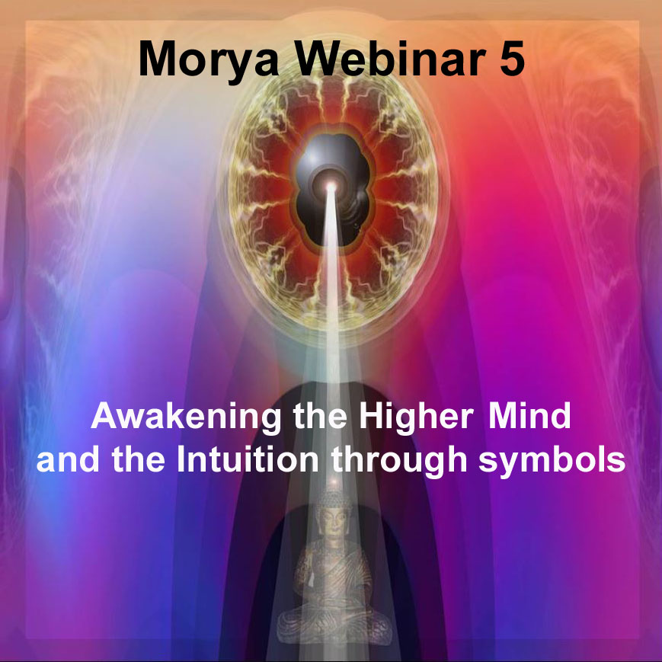

Slide 2

Etheric Evolution
Buddha - mental plane
Jesus overshadowed by the Christ 2000 years ago brought it down to the astral plane.
Christ will bring it down onto physical - etheric levels where the forms are created and reside.
Notes:
Triadic force Buddha Knowledge - Christ Love - Synthesis of all 3 Triad in synthesis.

Slide 3
Recognition of the etheric planes
“As time elapses the work of the Heavenly Men in the cosmic etheric spheres will be better comprehended, and assisted intelligently by those lesser intelligences who—by the study of the physical ethers—will eventually hold the key of the greater manifestation. Science is the handmaiden of wisdom, and opens the door to those infinite reaches and to those cosmic expanses, where stand Those vaster Intelligences, Who manipulate the matter of the higher planes, and bend it to the desired form, causing the vibrations thus set up to be felt at the furthest bounds of the solar ring-pass-not. Automatically then all lesser lives and all the denser materials are swept and carried into the needed channels and forms.”
(TCF 330)

Slide 4
RULE XIII. White Magic
The magician must recognize the shade of violet hue which the Devas exhibit to work with them effectively.
“This means literally that the magician must be in a position to discriminate between the different ethers, and to note the special hue of the different levels, thereby ensuring a balanced building of the "shadow." He "recognises" them in the occult sense; that is, he knows their note and key, and is aware of the particular type of energy they embody. Enough emphasis has not been laid upon the fact that the three higher levels of the etheric planes are in vibratory communication with the three higher planes of the cosmic physical plane, and they (with their ensphering fourth level) have (been called in the occult books "the inverted Tetraktys." (TCF 1025)
Notes:
Show chart showing these correspondences

Slide 5
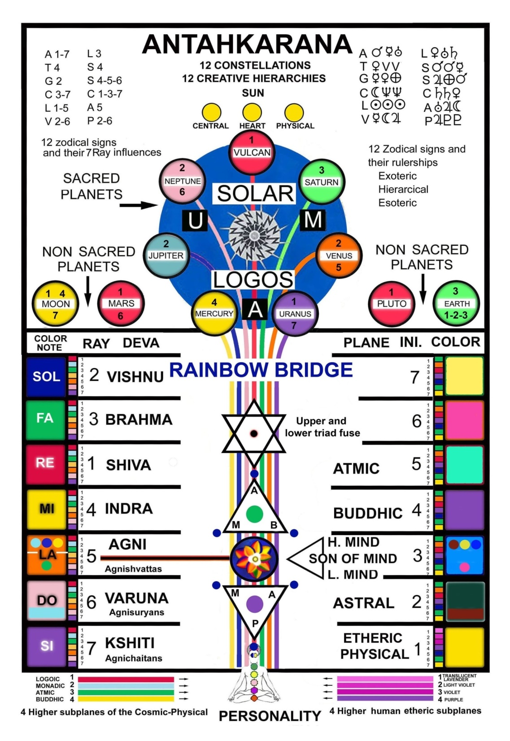
Notes:
We must note their sounds and violet colored hues.

Slide 6
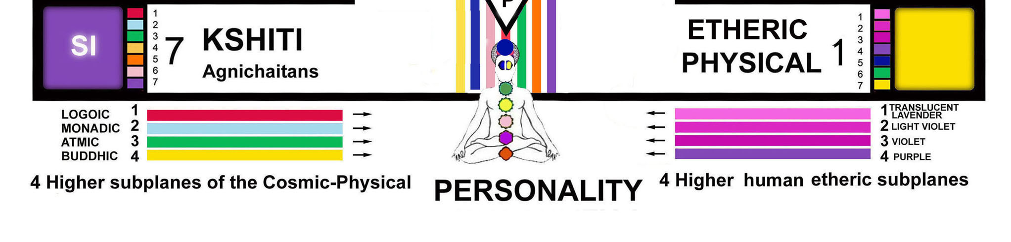
Notes:
4 hues of violet

Slide 7
Study of polarity

Slide 8
A revolution upon the planet
Electricity
"If this treatise (A Treatise on Cosmic Fire) serves no other purpose than to direct the attention of the scientific and philosophic students to the study of force or energy in man and in groups, and to interpret man and the human family in terms of electrical phenomena, much good will have been accomplished. The polarity of a man, of a group, and of a congery of groups, the polarity of the planets and their relationship to each other and to the Sun, the polarity of the solar system and its relationship to other systems, the polarity of one plane to another, and of one principle to another, the polarity of the subtler vehicles, and the scientific application of the laws of electricity to the totality of existence on the physical plane will bring about a revolution upon the planet second only to that effected at the time of individualisation. I would point out here a certain significant fact which students will do well carefully to consider." (715 TCF)

Slide 9
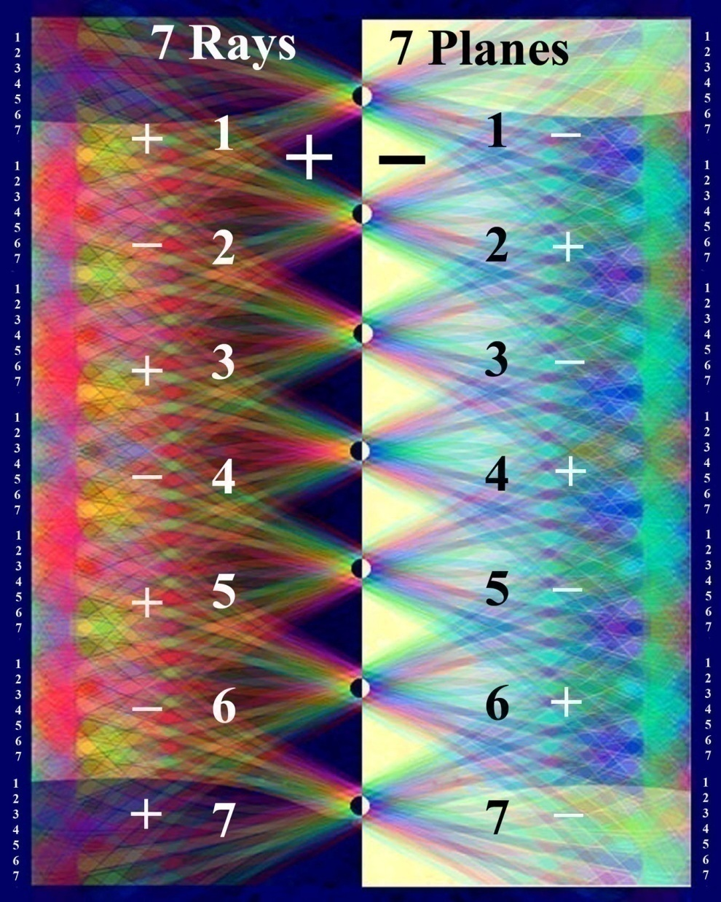
Notes:
Rays and planes seen electrically

Slide 10
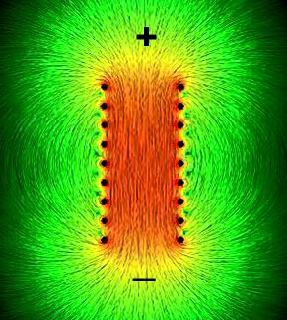
Notes:
Video 2

Slide 11
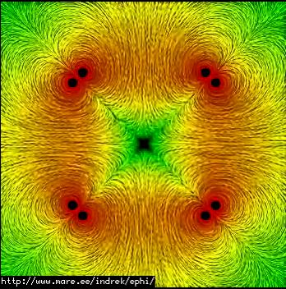

Slide 12
The auric field and the atom

Slide 13
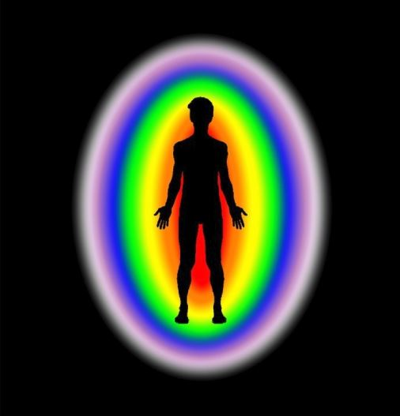
Notes:
Compare superficially the human auric field with its different bodies and the constitution of the atom on subatomic levels

Slide 14
Unlock the mystery of electricity
“It is these Mysteries which Christ will restore upon His reappearance, thus reviving the churches in a new form, and restoring the hidden Mystery which they long have lost through their materialism.... The true Mysteries will also reveal themselves through science and the incentive to search for them there will be given by the Christ. The Mysteries contain, within their formulas and teachings, the key to the science which will unlock the mystery of electricity—the greatest spiritual science and area of divine knowledge in the world, the fringes of which have only just been touched. Only when the Hierarchy is present visibly on Earth and the Mysteries of which the disciples of the Christ are the Custodians are given openly to the world, will the true secret and nature of electrical phenomena be revealed.” (RC 123-4)

Slide 15
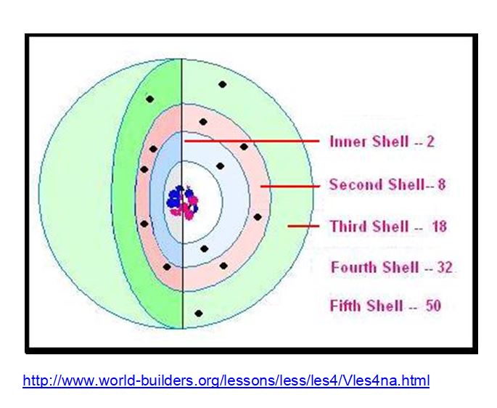
Notes:
An atom with its subatomic particles Nuetrons protons and outer electrons.

Slide 16
The electrons are segregated into "shells"
Every atom is made up of a nucleus (which contains protons and neutrons). The nucleus is the center, and it contains most of the mass of the atom. Outside the nucleus there are electrons, which are extremely small, and which move around the nucleus very quickly. The electrons are segregated into "shells" which are like invisible spheres that go around the atoms. Only two electrons can be in the innermost shell. The next track will take eight atoms. Atoms are often drawn as if they were small solar systems, but the electrons do not move in a flat plane.
Notes:
Every Atom has an inner nucleus of protons and neutrons and the outside electrons which are separated into different shells or clouds. When these shells are sufficiently stimulated the electrons can jump to another higher band.

Slide 17
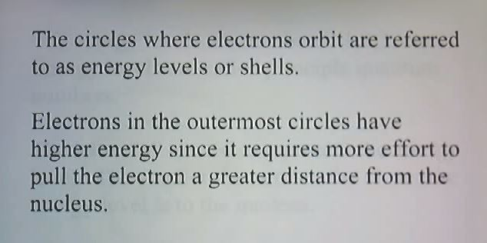
Notes:
Why in 6 stages of building the Antahkarana bridge more then intensions and visualization are required . Why will is required - different levels of elemental and devic substance. Burning ground

Slide 18
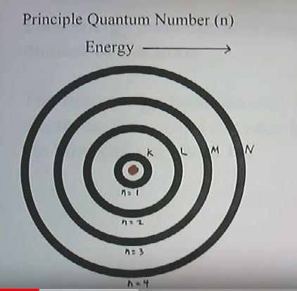
Notes:
Energy levels or bands become more powerful as we move away from the nucleus. These higher energy bands have sub-bands and those bands even more sub-bands. Becoming more complex. (Paradox) Nature of a fractal. - Compare number of chakra petals and energies that work through those center.

Slide 19
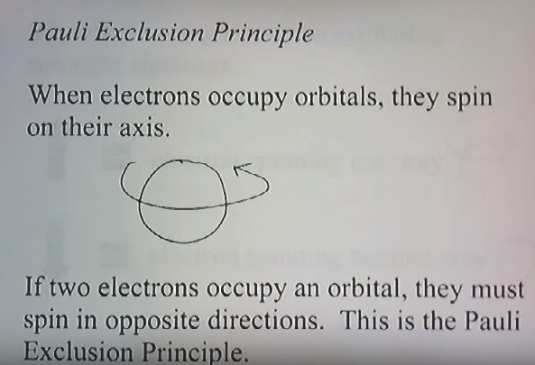
Notes:
2 8 18 32 50 electrons of each band in pairs of two they spin in opposite directions Show ray and plane chart again. Stimulated by laser light electrons can jump from a ground state to an excited state. Called quantum jump

Slide 20
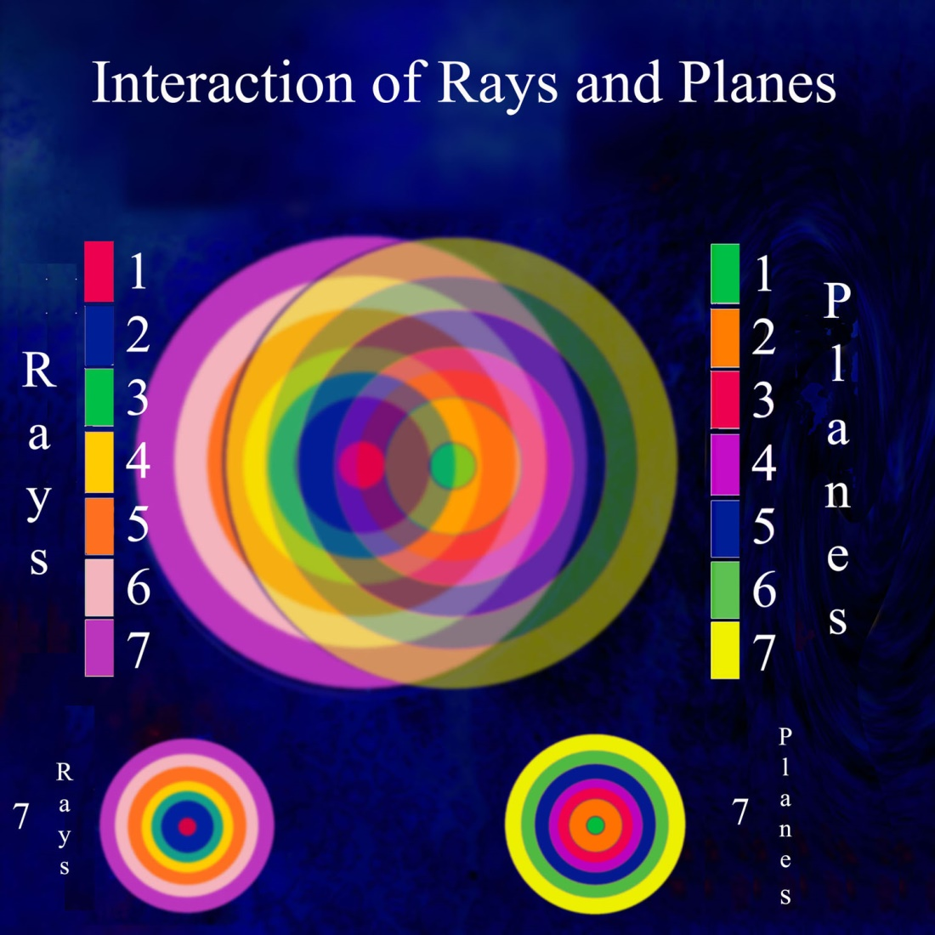

Slide 21
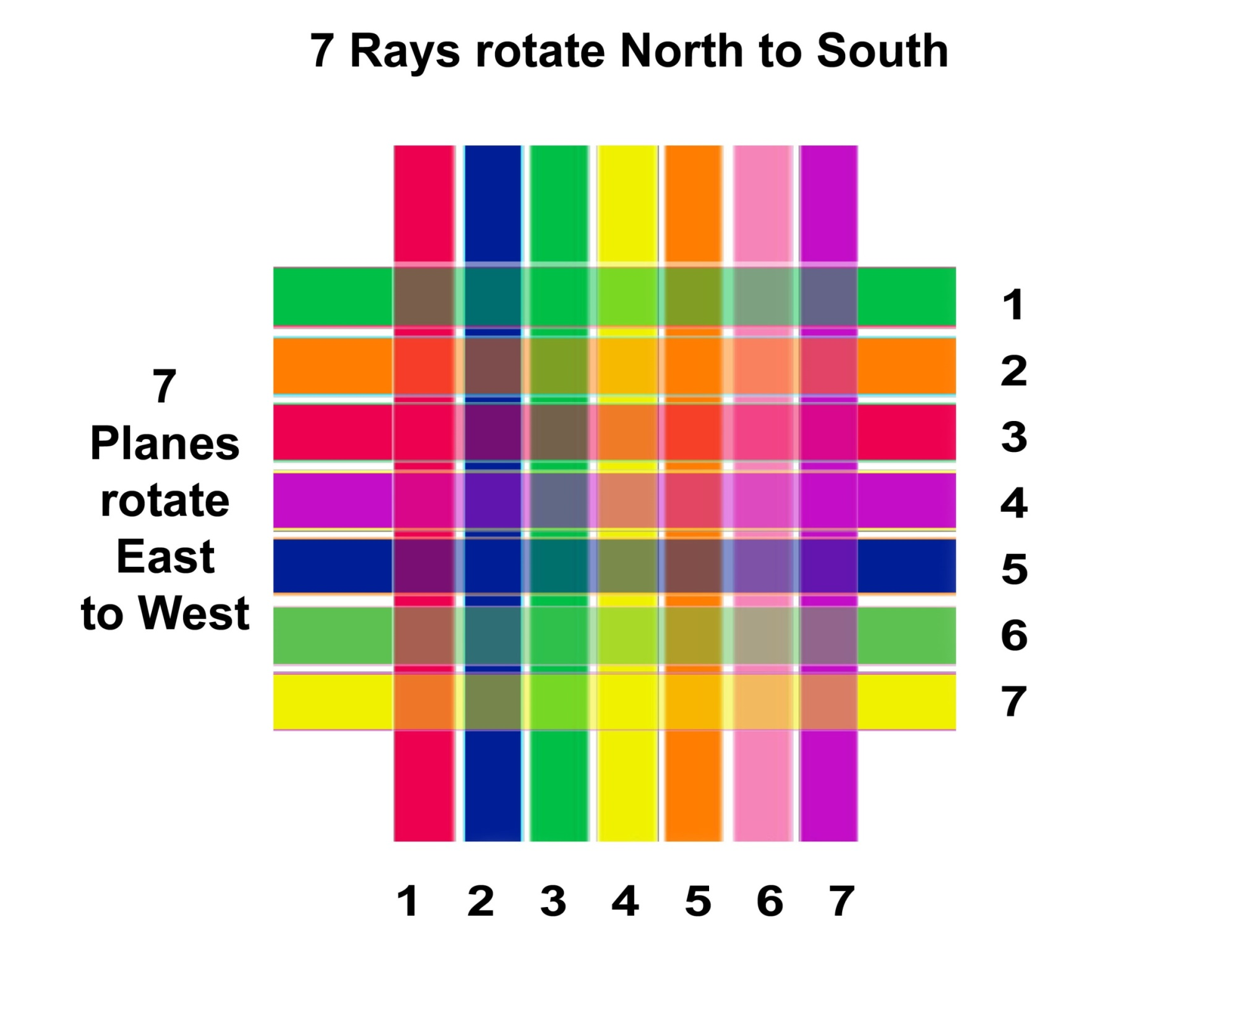

Slide 22
Notes:
Grand mosaic or tapestry of the Gods. Rays and planes seen electrically These electron jumps between bands and happen according to certain relationships or mathematical patterns. Their must be a natural affinity (mathematics) Law of supplementary seven law of analogy

Slide 23
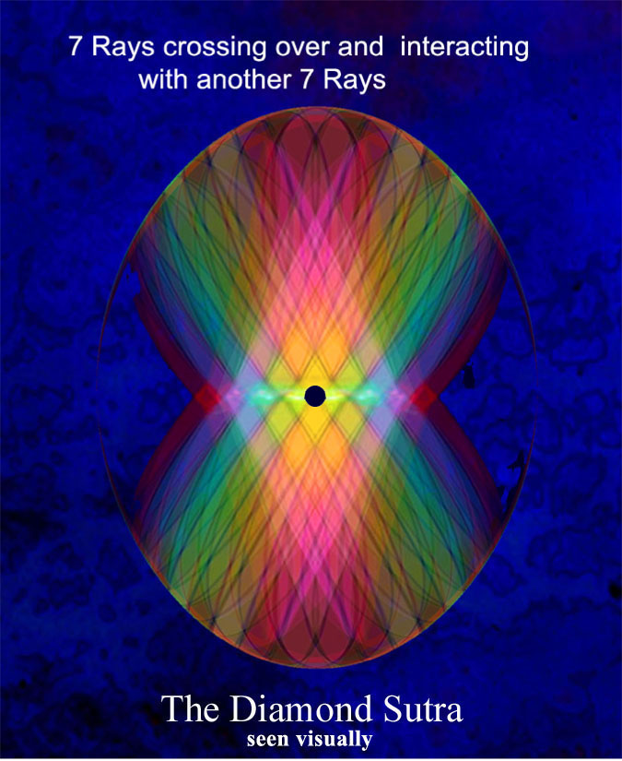

Slide 24
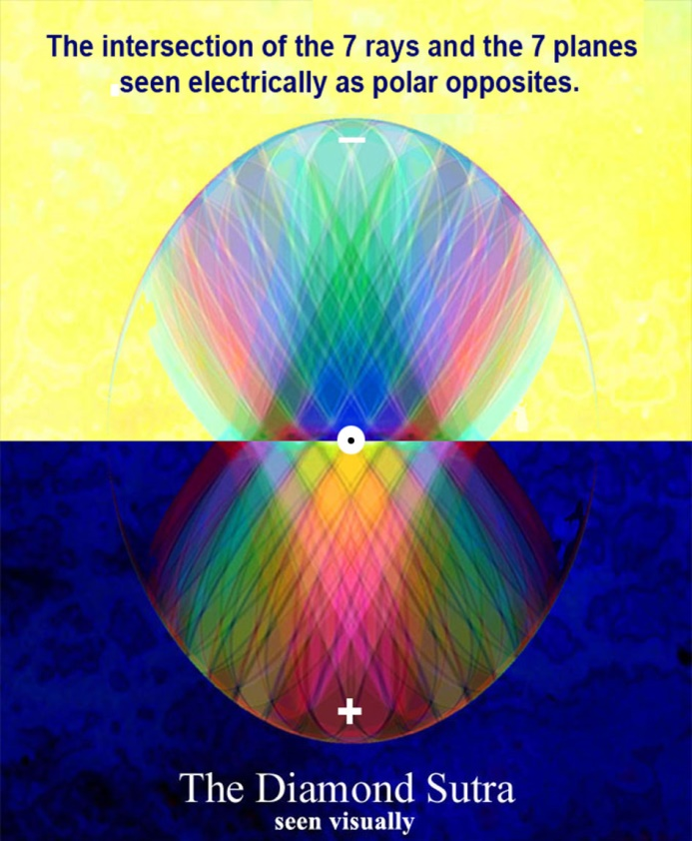
Notes:
Enlargement of previous image Science of triangles. Different polar opposites

Slide 25
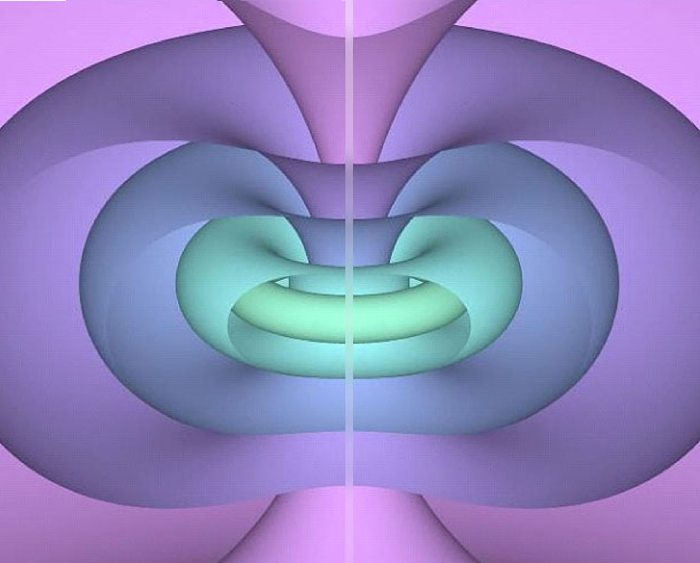
Notes:
Penrose’s twister NEST Jon Depew tubes later

Slide 26
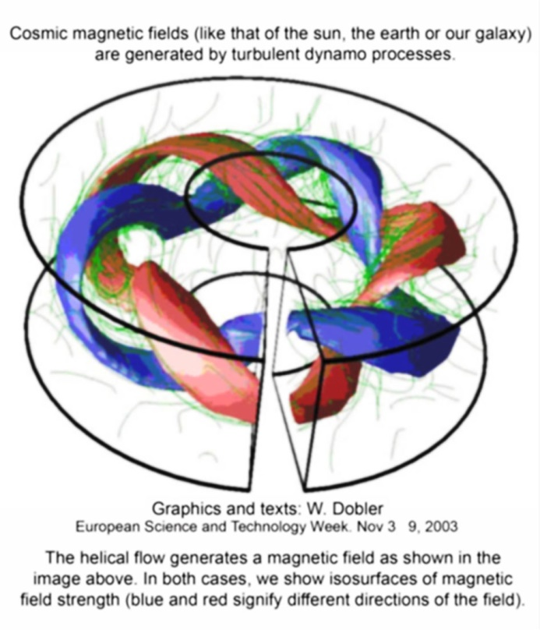

Slide 27
Occult chemistry
Annie Besant and Charles Leadbeater
“In this ultimate state of physical matter two types of units, or Anu, have been observed; they are alike in everything save the direction of their whorls and of the force which pours through them. In the one case force pours in from the "outside", from fourth-dimensional space, the Astral plane, and passing through the Anu, pours into the physical world. In the second, it pours in from the physical world, and out through the Anu into the "outside" again, i.e. vanishes from the physical world.
The one is like a spring, from which water bubbles out; the other is like a hole, into which matter disappears [note: here should be understood some material forces or streams of unknown forces]. We call the Anu from which force comes out positive or male: those through which it disappears, negative or female. All Anu, so far as observed, are of one or other of these two forms“ (p-13)
Notes:
Bubbles of Koilon - Black holes or abstraction

Slide 29
Notes:
Just like physicists electrons.

Slide 30
Heart shaped depression
“Force pours into the heart-shaped depression at the top of the Anu, and issues from the point, and is changed in character by its passage; further, force rushes through every spiral and every spirilla, and the changing shades of colours that flash out from the rapidly revolving and vibrating Anu depend on the several activities of the spirals; sometimes one, sometimes another, is thrown into more energetic action, and with the change of activity from one spiral to another, the colour changes.” (OC C. Leadbeater)

Slide 31
It turns incessantly upon its own axis, spinning like a top
“The Anu has, as observed so far - three proper motions, i.e. motions of its own, independent of any imposed upon it from outside. It turns incessantly upon its own axis, spinning like a top; it describes a small circle; it has a regular pulsation, a contraction and expansion, like the pulsation of the heart. When a force is brought to bear upon it, it dances up and down, flings itself wildly from side to side, performs the most astonishing and rapid gyrations, but the three fundamental motions incessantly persist. If it be made to vibrate, as a whole, at the rate which gives any one of the seven colours, the whorl belonging to that colour glows out brilliantly. An electric current brought to bear upon the Anu checks their proper motions, i.e. render them slower; the Anu exposed to it arrange themselves in parallel lines, and in each line the heart shaped depression receives the flow, which passes out through the apex into the depression of the next, and so on. The Anu always set themselves to the current".

Slide 32
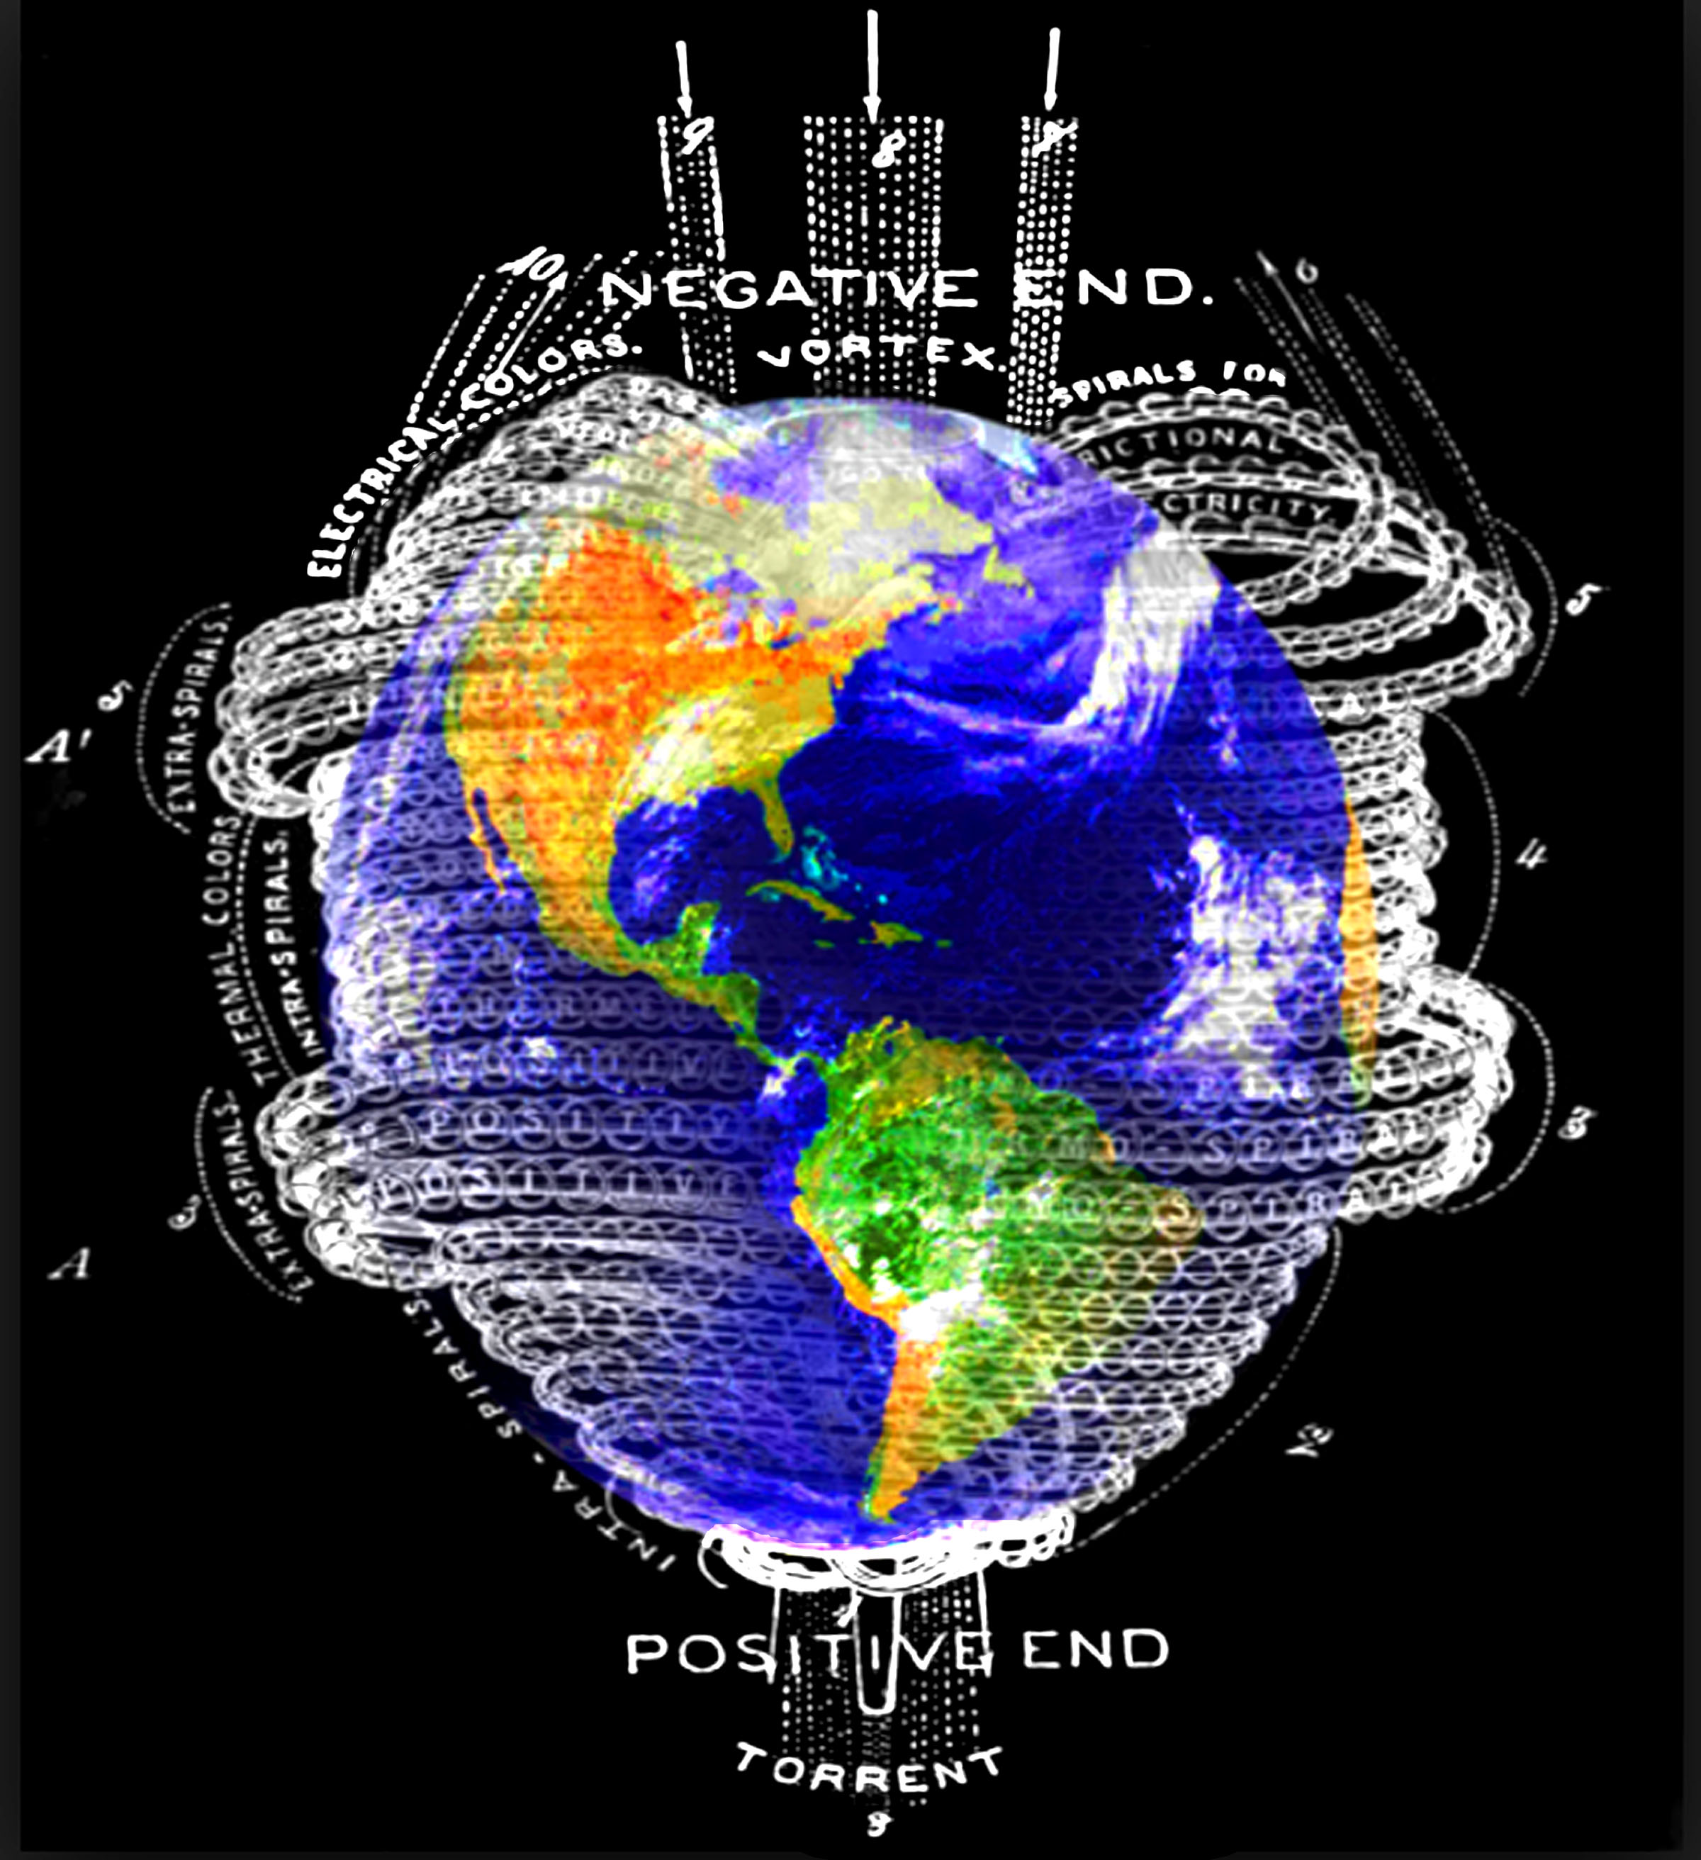

Slide 33
