Slide 1
Synthesis and Astrology
Notes:
For those who are new let me reiterate we are not simply trying to impart information which can be a good base but to go further and create a space for an experience of synthesis Rose BL names of participants.

Slide 2
A distortion of the real
“All that can be said will be after all but the partial statements of the great veiled Truth, and must be offered to the reader and student as simply providing a working hypothesis, and a suggestive explanation. To the open-minded student and the man who keeps the recollection in his mind that the truth is progressively revealed, it will be apparent that the fullest expression of the truth possible at any one time will be seen later to be but a fragment of a whole, later still be recognised to be only portions of a fact and thus in itself a distortion of the real.” (TCF xv)
Notes:
Speaking primarily of the lower mind here and the need to awaken the intuition. Showcase other peoples work who are making major contributions in new and creative ways. Orest Clay Taylor

Slide 3
3D Solar System Charts
“The solar system is more than just a group of planets, but instead is the physical vehicle of our Solar Logos. Planets are both centers in the body of the solar vehicle, and seemingly "separate" Logoic lives in their own right. The orientation and movement of the planets can reflect the energies moving through these solar centers. The newly released free astrology software "Astrolog" version 6.40 introduces 3D solar system charts, which accurately trace the orbits of planets over time (including showing aspects). The following video may be able to hint at the solar dance of life taking place within space and through time.”
Walter Pullen
https://www.youtube.com/watch?v=jFhwfM0FKCo
Notes:
#1 video Lets make it a meditation

Slide 4
An animation of the solar system moving through space over time, such that planet orbits form spiral helix patterns. Unlike similar videos, here the planets are correctly positioned astronomically. Planet distance from the Sun is usually plotted on a logarithmic scale to make the planets roughly evenly distributed. The helix covers ten years of motion, starting with the planets around the year 2010 when the video starts, and animating through the next ten years. Included are the Sun, eight planets, Pluto, Ceres, and Chiron.
Planet positions are generated by Astrolog version 6.40's solar system orbit chart, with a vertical offset defined to produce the helical vortex effect. The output is directed to the program Daedalus, which renders it in first person perspective. The result is the viewer flying among an animating 3D solar system, enjoy! :)
Sphere and Triple Sun Charts
Astrolog 6.40 free download site: http://www.astrolog.org/astrolog.htm
Daedalus 3.3 free download site: http://www.astrolog.org/labyrnth/daed... Walter Pullen
Notes:
Asteroids

Slide 5
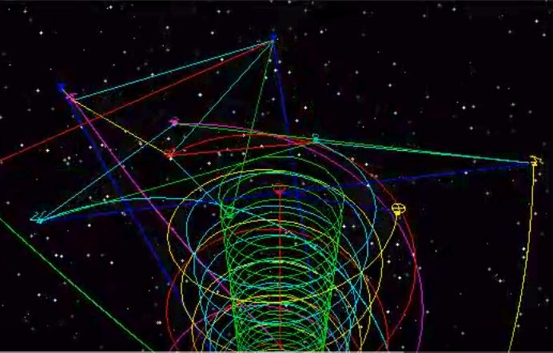
Notes:
Go to video 1 Still picture of a part of the video Could you describe to the lay person what we are seeing here. Picture alignments in motion

Slide 6
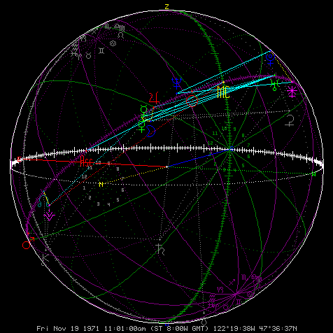
Notes:
Spherical charts GO TO #2 animation We showcased Walters spherical charts in an earlier session. Go to video 2

Slide 7
Notes:
Videos 3 and 4 Go folder on desktop

Slide 8
Registering energies from outside of the Solar System
“It should be noted here, however, that all the energies—zodiacal, systemic, and planetary—have a definite effect upon all the lives in all forms in all kingdoms of nature. Nothing can escape these radiatory and magnetic influences. The goal of evolution for humanity is to become consciously and livingly aware of the nature of these energies and begin to know them and to use them. This is the field of occultism as the Hierarchy has always told men. It might be stated that the disciple has to become consciously aware of the planetary influences and begin to use them for the carrying out of soul purpose. The initiate has to be aware of the zodiacal influences which emanate from outside of the solar system altogether. These can be recognised as
a. A vibration, registered in one or other of the seven centres.
b. A revelation of a particular type of light, conveying a specific colour to the initiate.
c. A peculiar note.
d. A directional sound.” (EA 23-4)
Notes:
Why is all this important because at the 3rd initiation we are orientating ourselves towards those energies and force that emanate from outside of our Solar system. Inner etheric hearing

Slide 9
Laniakea, which means ‘immeasurable heaven’ in Hawaiian.
Notes:
Video 5 folder our gali

Slide 10
. Redrawing the boundaries of the cosmic map
Superclusters – regions of space that are densely packed with galaxies – are the biggest structures in the Universe. But scientists have struggled to define exactly where one supercluster ends and another begins. Now, a team based in Hawaii has come up with a new technique that maps the Universe according to the flow of galaxies across space. Redrawing the boundaries of the cosmic map, they redefine our home supercluster and name it Laniakea, which means ‘immeasurable heaven’ in Hawaiian.
Notes:
Video 5

Slide 11
https://www.youtube.com/watch?v=rENyyRwxpHo
https://www.youtube.com/watch?v=rENyyRwxpHo
Notes:
LINKS PROVIDED IN RECORDING

Slide 12
Proxima Centauri
Proxima Centauri, or Alpha Centauri C, is a red dwarf, a small low-mass star, about 4.25 light-years from the Sun in the constellation of Centaurus. It is the nearest-known star to the Sun
Notes:
David Wilcox 2017

Slide 13
Notes:
David Wilcox Gaia TV

Slide 14
Notes:
A habitable planet in the area. Dangers of UV

Slide 15
Ultra-violet gamut of colours,
“An intensification of the light is going on all the time, and this increase in intensity began on the earth at about the time when man discovered the uses of electricity, which discovery was a direct result of this intensification. The electrification of the planet through the wide-spread use of electricity is one of the things which is inaugurating the new age, and which will aid in bringing about the revelation of the presence of the soul. Before long this intensification will become so great that it will materially assist in the rending of the veil which separates the astral plane from the physical plane; the dividing etheric web will shortly be dissipated, and this will permit a more rapid inflow of the third aspect of light. The light from the astral plane (a starry radiance) and the light of the planet itself will be more closely blended, and the result upon humanity and upon the three other kingdoms in nature cannot be over-emphasized.
It will, for one thing, profoundly affect the human eye and make the present sporadic etheric vision a universal asset. It will bring within the radius of our range of contact the infra-red and ultra-violet gamut of colours, and we shall see what at present is hidden. All this will tend to destroy the platform upon which the materialists stand, and to pave the way, first, for the admission of the soul as a sound hypothesis, and secondly, for the demonstration of its existence. We only need more light, in the esoteric sense, in order to see the soul, and that light will shortly be available and we shall understand the meaning of the words, "And in Thy light shall we see light.“
(EP1 103-4)

Slide 16
Triangles and Astrology
Notes:
Triangles being one of the subsidiary sciences of Astrology should have a little more clarification at this point. In keeping with our main theme of synthesis

Slide 17
Triangles and the web of Light
“I have hinted at the entire structure of living, moving, focussing and transmitting light triangles which should underlie (and eventually will underlie) the manifested universe. I have pointed out certain relations between the various constellations, the esoteric planets and our Earth. I have shifted the approach of the astrological student away from the world of tangible happenings, precipitated events, and personal into the world of conditioning energies, controlling incentives, impulses and causes, and have thus laid down the basis of an inner esoteric astrology which must govern this ancient science in the future. I have emphasised in your consciousness, the web of light and energy which is the recipient of zodiacal and other extra-systemic forces and I have pointed to the first dim outline of the astrology of the soul and of the unfolding consciousness of man.” (EA 497-8)
Notes:
Lets compare this stunning cosmological outline on Super-clusters we just reviewed with several key quotes by the Tibetan that indicate this immense inner spiritual work as seen from the inner dimensions by a 5th degree Master.

Slide 18
Interlacing streams of triadic energy.
“It is useless for students to attempt to unravel this aggregation of interlacing streams of energy. All that is now possible for man with his present equipment is to accept hypothetically these statements anent certain major triangles which affect humanity and seek to prove their effect and to endeavour to arrive at some understanding of that intricate, interwoven network which he himself possesses and to which he gives the name "etheric body." …. Astrologers have begun to grasp a dim idea of the interlocking triangles of energy as far as our Earth is concerned in the rather arbitrary division of the twelve constellations into four triplicities, covered by such qualifying terms as earthy triplicity or fiery triplicity, composed each of a cardinal, a fixed and a mutable sign. They thus divide up the entire zodiac into a fourfold group of interlacing and interrelated triads, each conditioned by one of the basic elements and thus qualified.”

Slide 19
The entire universal pattern
. These constitute a series of basic triangles with a definite reference to our planetary life. Owing to the constant movement everywhere, inherent in the solar system and the zodiac—onward, interior and revolving—some idea can be grasped of the intricacy of the entire pattern. A further aid to the grasping of this essential beauty of coordinated and organised movement and its power to qualify and condition the entire universal pattern can be gained by those students who have studied somewhat the various triangles to be found in the etheric body of man through the inter-relation of the seven centres to which I have referred elsewhere in my various books. These centres, when awakened and alive, are swept finally within the radius of each others' sphere of action; from the point of view of living energy, the circumference of these wheels or vortices of force becomes so enlarged that they eventually overlap and touch, presenting on a tiny scale a condition analogous to the contacting and interlocking series of triangles such as those referred to above. (EA 418-20)
Notes:
Lets now bring this great universal panorama of shifting forces down on to a more microcosmic level. Let us briefly view these triangles DK speaks of and its relation to the human constitution.
Law of analogy and the law of correspondences

Slide 20
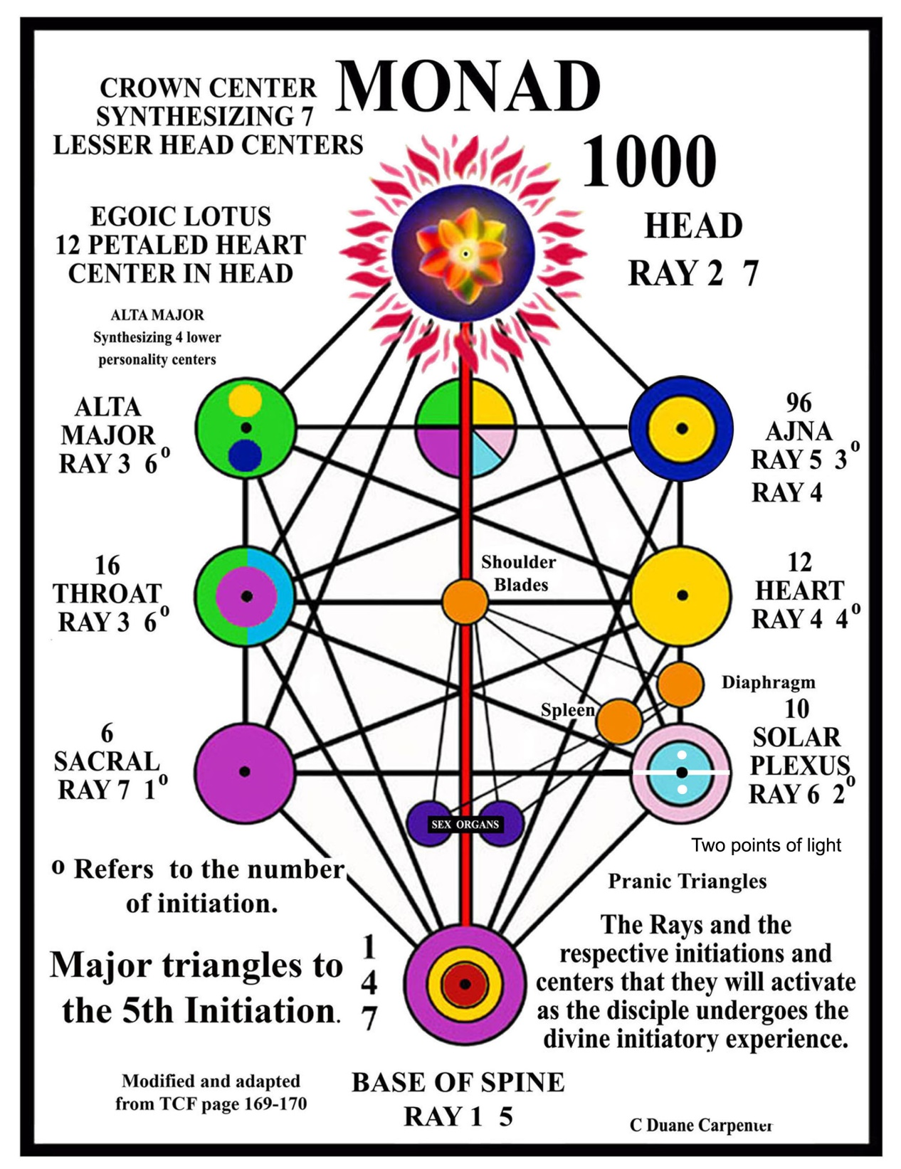

Slide 21
These triangles must be regarded as in rapid movement.
I wonder if you can grasp at least partially and symbolically the fact that these triangles must not be thought of as placed, static and eternally the same, or even as three dimensional. They must be regarded as in rapid movement, revolving eternally in space and ceaselessly moving onward and as of fourth and fifth dimensional extension. There is no way of depicting them or of bringing them visually to your attention, for only the inner eye of vision can imagine their progression, position or appearance. ….Therefore the entire cosmic web and solar system is an intricate, constantly moving, interwoven series of triangles wherein each point of a triangle emanates three lines or streams of energy (nine in all); it is likewise responsive to and receptive of the energies—likewise triple in nature—which lie within its periphery or sphere of influence and vibratory activity.

Slide 22
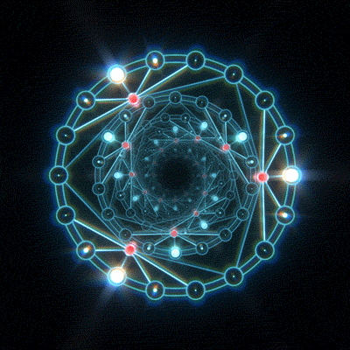
Notes:
Go to video green triangle #6 How rotary motion moves into cyclic - spiral Lets get an intuitive understanding of these linking principals through the next animation Note that the multi dimensional triangles when speeded up become the vortex.

