Slide 1
Notes:
Esoteric astrology and where we left off.

Slide 2
https://www.facebook.com/groups/2167738123497445/

Slide 3
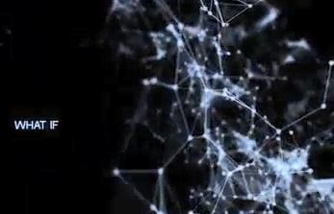
Notes:
GO Video 0 Nasseim Haramein pionering work in fusing ancient world religion and Quantum Mechanics

Slide 4
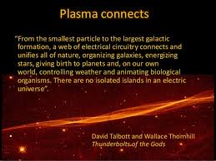
Notes:
Parallels discoveries in modern day cosmology and physics that we live in a connected universe. Electrical tendrils connecting all stars and constellations into one organic web .(Plasma 4th state of matter)

Slide 5
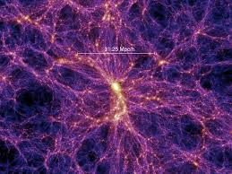

Slide 6
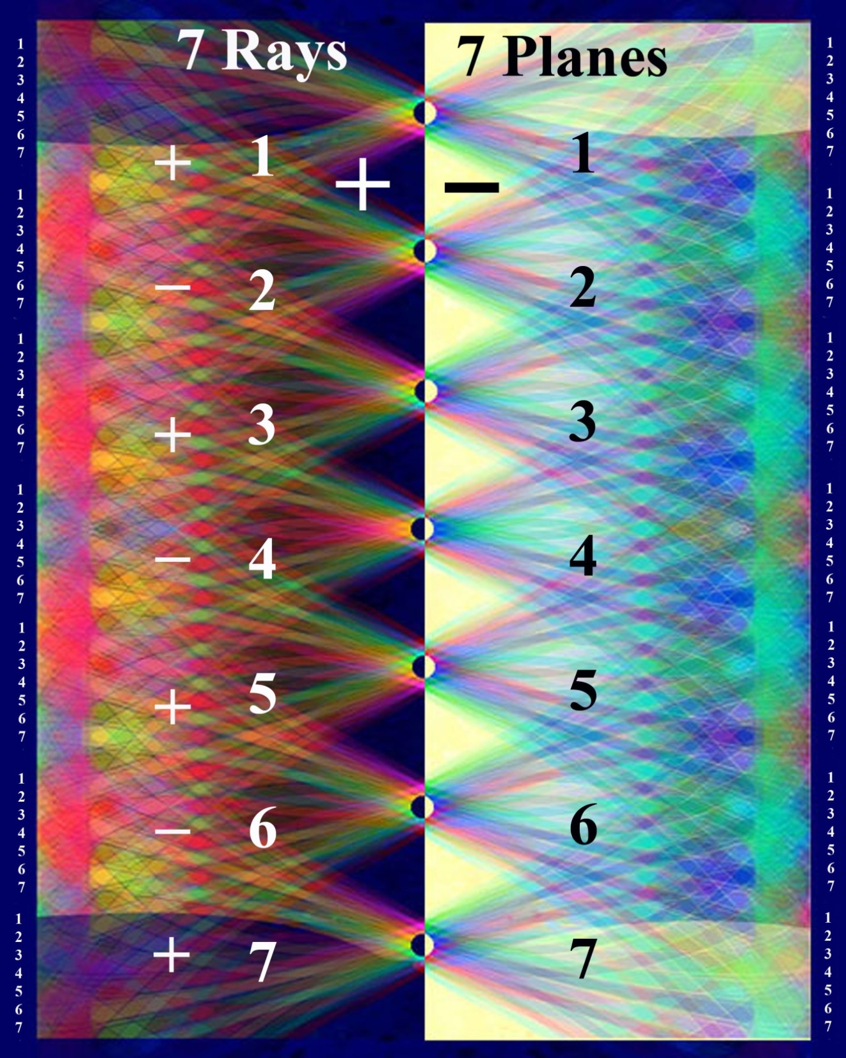
Notes:
Secondary polarities On the theme of the connection between the astral and buddhic planes from the previous quote lets review this simple chart that shows the geometric relationship through triangles. Fohat connection. These are the major polarities electrically speaking. 2-4-6 line of feminine descent or on the right the masculine descent. Don’t have to know all these technicalities -but Aquarian super human physics.

Slide 7
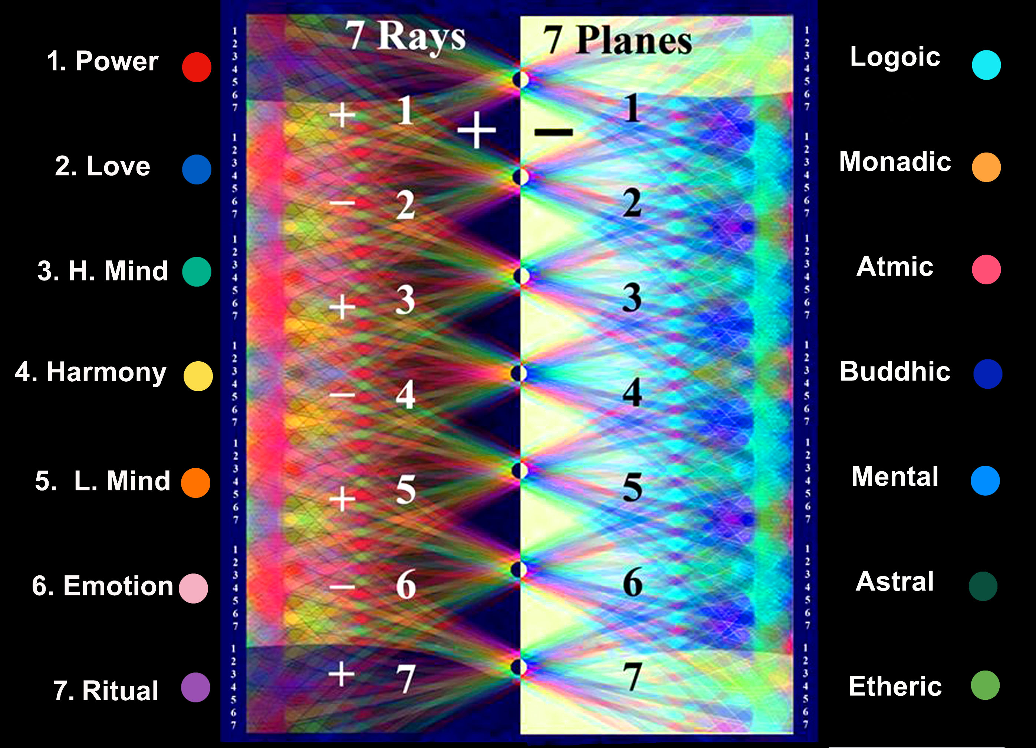
Notes:
SECONDAR Y POLARITY RELATIONSHIPS How they are connected through there color sound and numerical relationships

Slide 8
Rapidly moving triangle Palpitating with every color
By the time the third Initiation is reached, a wondrous transformation has transpired. The outer sphere is palpitating with every colour in the rainbow, and is of wide radius; the streams of electrical energy circulating in it are so powerful that they are escaping beyond the periphery of the circle, resembling the rays of the sun. The nine petals are fully unfolded, forming a gracious setting for the central jewel, and their orange hue is now of a gorgeous translucence, shot with many colours, that of the egoic ray predominating. The triangle at the base is now quickened and scintillating, and the three points are small blazing fires, showing to the eye of the clairvoyant as sevenfold whorls of light, circulating their light from point to point of a rapidly moving triangle.” (TCF 764)
Notes:
Having just viewed a rapidly series of rotating triangles lets give another quote by the Tibetan that can expand this idea of the 3rd initiation and what takes place or transpires from an inner perspective.

Slide 9
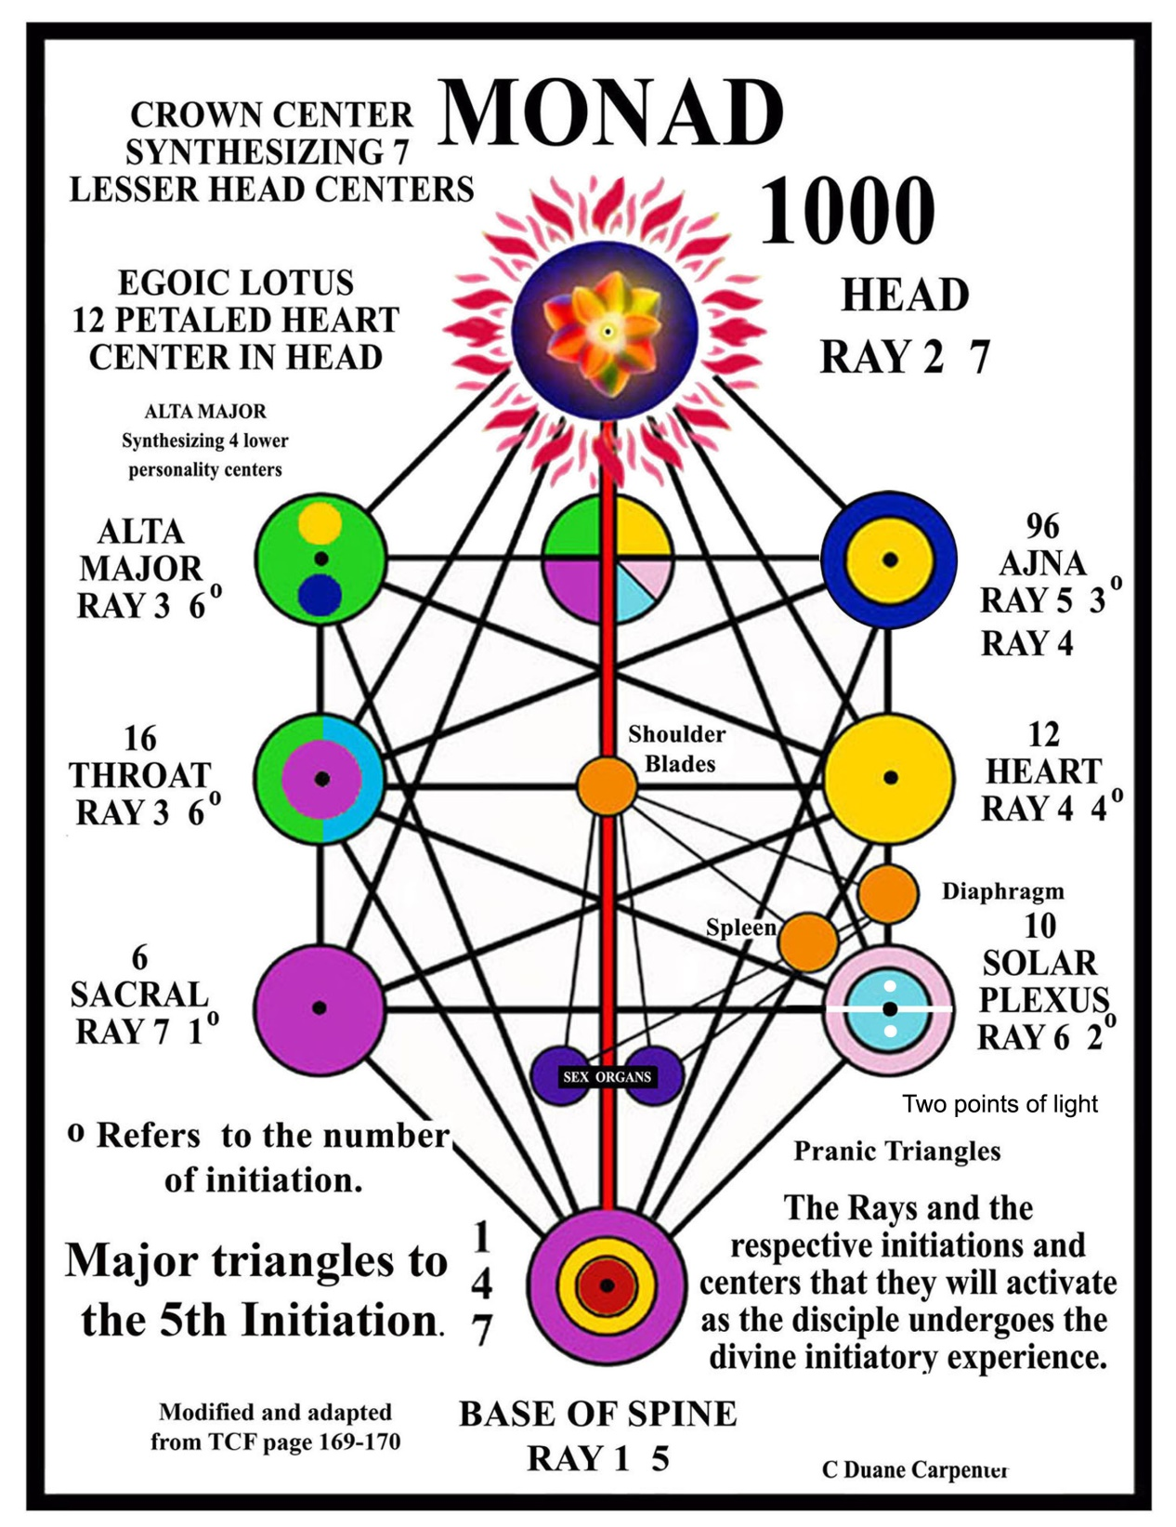
Notes:
Sacral to the throat switch polarities reversed 1st initiation occurs.

Slide 10
Notes:
Chart 2 main poles BS and Crown -- Shifting and evolving dualities and polarities.--------- Tension – Crises – Emergence Devas light-color – sound - vibration - number ----- Formula OLP Objective – location procedure

Slide 12
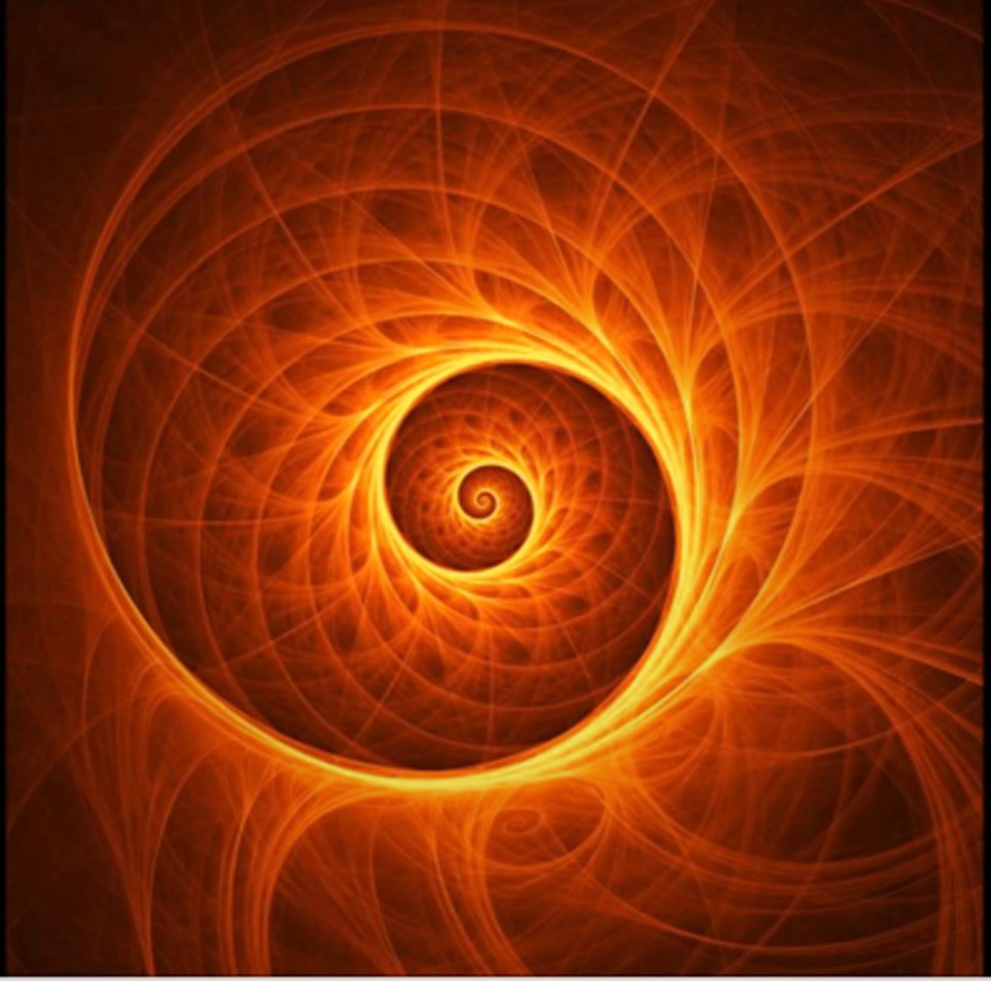
Notes:
The moving triangles that are alive and organic. Entire cosmic web quote

Slide 13
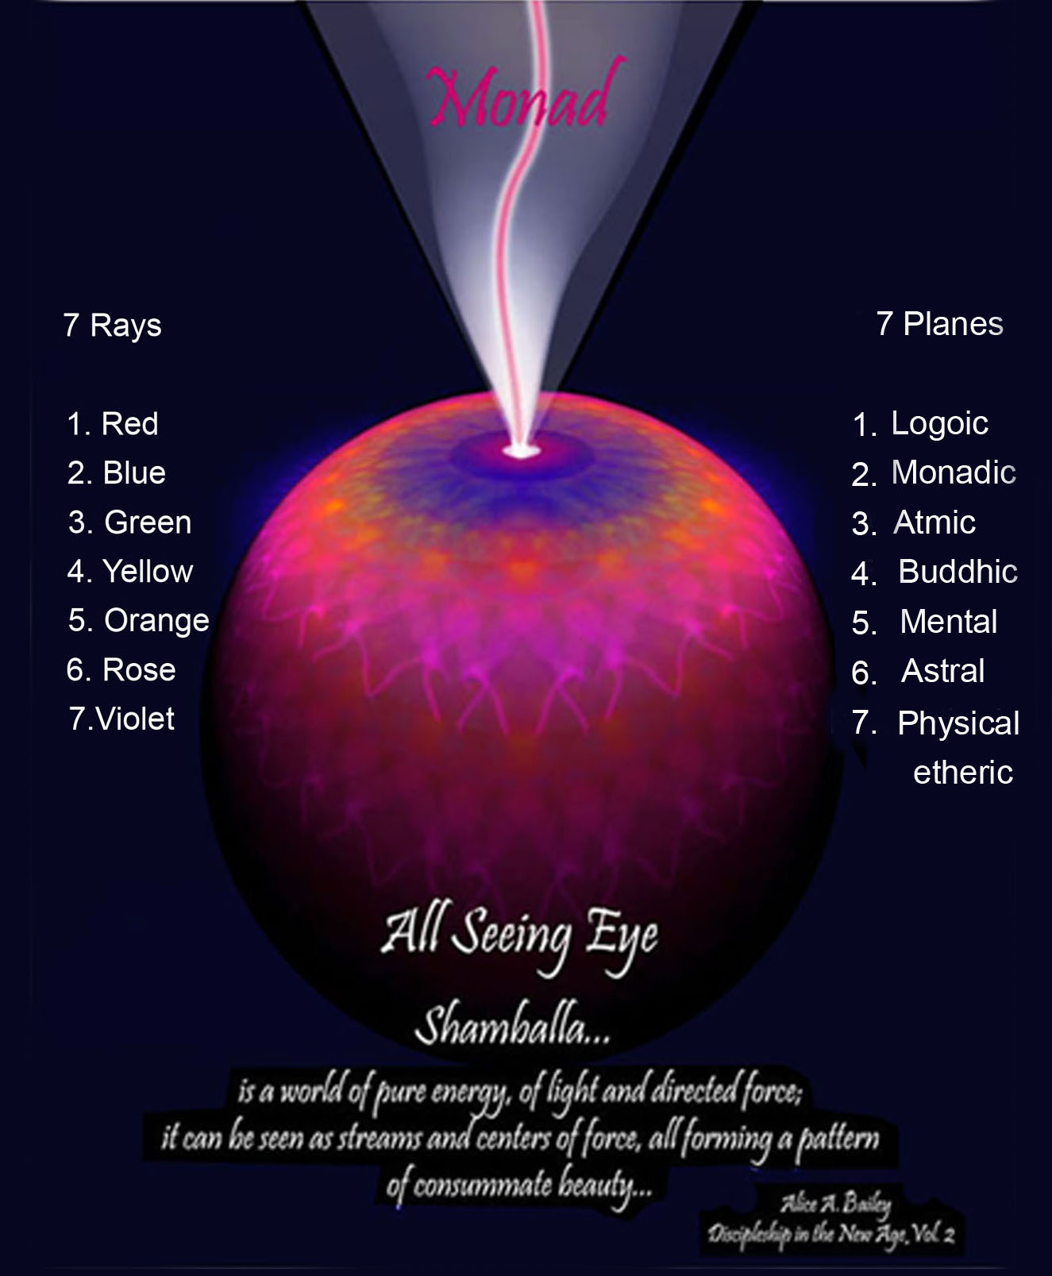
Notes:
Use lit cursor rose to show triangles

Slide 14
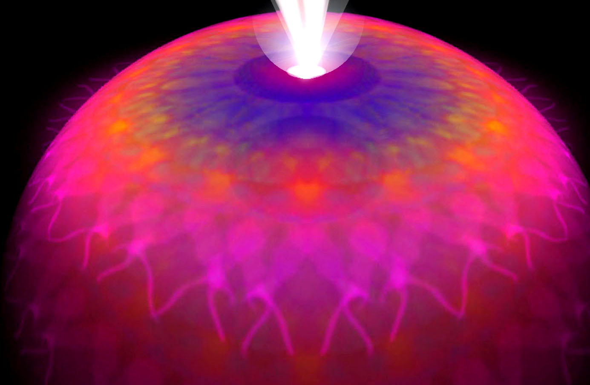
Notes:
More in the nature of dancing flames then something ridged or tangible. Dancing triangles where flames transition over to become triangles yet they are both a part of the one life.

Slide 15
Interlacing streams of triadic energy.
“It is useless for students to attempt to unravel this aggregation of interlacing streams of energy. All that is now possible for man with his present equipment is to accept hypothetically these statements anent certain major triangles which affect humanity and seek to prove their effect and to endeavour to arrive at some understanding of that intricate, interwoven network which he himself possesses and to which he gives the name "etheric body." …. Astrologers have begun to grasp a dim idea of the interlocking triangles of energy as far as our Earth is concerned in the rather arbitrary division of the twelve constellations into four triplicities, covered by such qualifying terms as earthy triplicity or fiery triplicity, composed each of a cardinal, a fixed and a mutable sign. They thus divide up the entire zodiac into a fourfold group of interlacing and interrelated triads, each conditioned by one of the basic elements and thus qualified.”

Slide 16
Ordered geometric rising of the fire.
“It would repay the student to contemplate the interesting succession of triangles that are to be found and the way in which they must be linked by the progression of the fire before that fire can perfectly vivify them, and thence pass on to other transmutations. We might enumerate some of these triangles, bearing always in mind that according to the ray so will proceed the geometric rising of the fire, and according to the ray so will the points be touched in ordered sequence. Herein lies one of the secrets of initiation….” (TCF)
“Each life that the Personality leads is, at the close, represented by some geometrical figure, some utilisation of the lines of the cube, and their demonstration in a form of some kind. Intricate and uncertain in outline and crude in design are the forms of the earlier lives; definite and clear in outline are the forms built by the average advanced man of this generation. But when he steps upon the Path of Discipleship, the purpose consists in merging all these many lines into one line, and gradually this consummation is achieved.” (LOM 6)

Slide 17
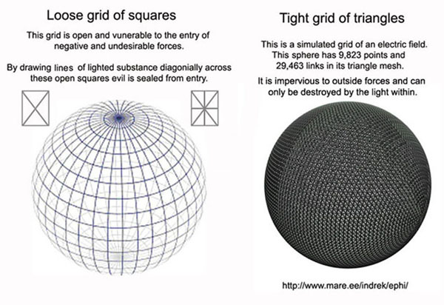

Slide 18
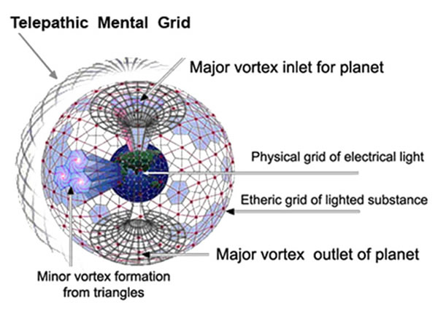

Slide 19
The whole etheric body is in constant motion
“It is well-nigh impossible for man to draw or make a picture of the network of triangles and, at the same time, see them taking the circular form in their totality of the etheric body of the planetary sphere. The reason is that the whole etheric body is in constant motion and ceaseless transformation, and the energies of which it is composed are in a state of constant change and circulation.” (TEV 165)

Slide 20
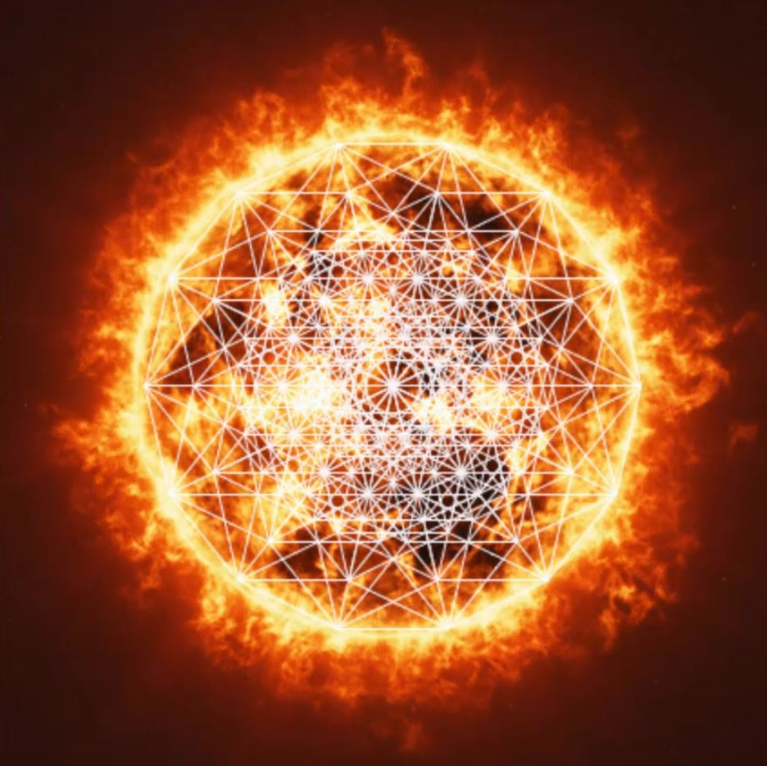
Notes:
Video 1 Relevance to all the astrological signs

Slide 21
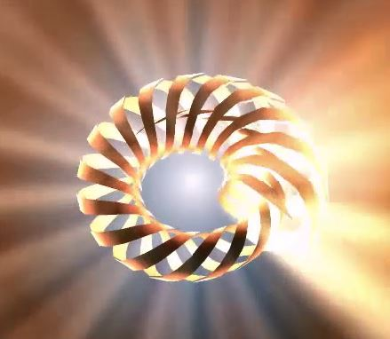
Notes:
Video 1 Relevance to all the astrological signs

