Slide 2
7 Spherical lives each one nesting seamlessly one within the other.
Electrons, which are the bases of electricity move in discreet parallel bands through pure mediums when their is no resistance to their flow and their is a complete and unobstructed circuit or circle back to the source from which they originally came.
Here is an image of one of the auric bodies or atoms each living organism is made up of when seen clairvoyantly. When we see how electricity in its different grades passes back and forth through 7 of these spherical lives we will understand how this science of electricity controls and implements the divine initiatory experiences.
In the New Aquarian teachings which are emerging at this time this science of electricity will explained in greater detail how this whole process and science works.

Slide 3
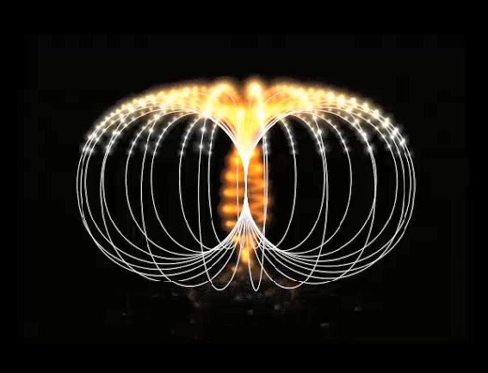
Click the link below to go to the video
Awakening-9-Golden-Vortex
Notes:
VIDEO 1 Opening and closing meditation Prepare the field. Shared with Anna Scalar. Breathe on two or three counts. Access symbols concentration and Breathe

Slide 4
Synthesis and Astrology
Notes:
Paralleling two systems DK dual polarities 12 into the 6 into the 1 Agni Yoga Master M
SERENE EXSPECTANCY. Raja Yoga Meditation with seed - meditation without seed. A lot of questions about how this transition takes place. Active visualization to active passive.

Slide 5
Agni Yoga, 361. There are two kinds of Logic
“There are two kinds of logic: the logic of external reasoning, which one attempts to learn from textbooks, and that of mental synthesis, by which one collects and links the sparks of spatial thought. These sparks may seem to be a happy accident, even though this "accident" may have been ripening in space for an entire century. The broadened consciousness provides the best possibility of grasping the nodes of spatial thought.
As rings of the spiral show to the observer the outer turns and conceal the inner turns, so mental logic proceeds according to the limits of the outer turns while the inner turns are still merged in the streams of collective thought in space. Hence, We take such care about the broadening of the consciousness, in order that union with spatial thought may be approached.”

Slide 6
The combination of two dodecahedrons is useful for promoting the rhythm of fire.
Equally simple should be the idea of the spiral nature of all that exists, and of creative explosions. Thus the breath of the Cosmos will be realized as an ascending spiral.
We all rejoice if you are applying the rhythms indicated to you. Of course the rhythms vary with each individual, and the current condition of one's organism determines the results. One should accept the transmissions from space into the open Chalice. This is the guarantee of synthesis. Likewise, one must follow one's inner rhythm, because the developed consciousness cannot be without rhythm.
The combination of two dodecahedrons is useful for promoting the rhythm of fire. When enough energy has been accumulated, I shall demonstrate it, because this fleeting rhythm is necessary for the approach to Agni Yoga.

Slide 7
Notes:
Mirror image of each other. Direction color

Slide 8
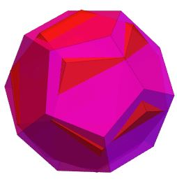
Click the link below to go to the video
Awakening-9-Dodecahedron-with-music
Notes:
VIDEO 2 Shared by Walter Pullin Please send in any Serene expectancy. Raja Yoga . Lower thought forms dissipated Cycles big Breathing in and out. - The beating of the heart of the system. Put on loop at home. Not given any instructions . Breathe into this symbol making your breath rhythmic and deep Rays 1 and 7

Slide 9
Mystical Geometry and Esoteric Astrology
“When, therefore, the esoteric side of astrology, and of mystical geometry, has been studied, and alliance has been made between these two sciences, a flood of light will be thrown upon this matter of the intelligent principle; …. At the present time it is not possible to do more than point out the direction of the path which must be trodden before this abstruse matter can be made clear, and to indicate certain lines of investigation which might (if strenuously and scientifically followed) yield to the student a rich reward of knowledge. Until the intuition is better developed in the average man, the very principle of manas itself forms a barrier to its due understanding. “ (TCF 396-7)
Notes:
The paradox of using the mind to go beyond the mind. L. Mind needed as an interpreting and grounding agent. You will never understand the place of manas or mind

Slide 10
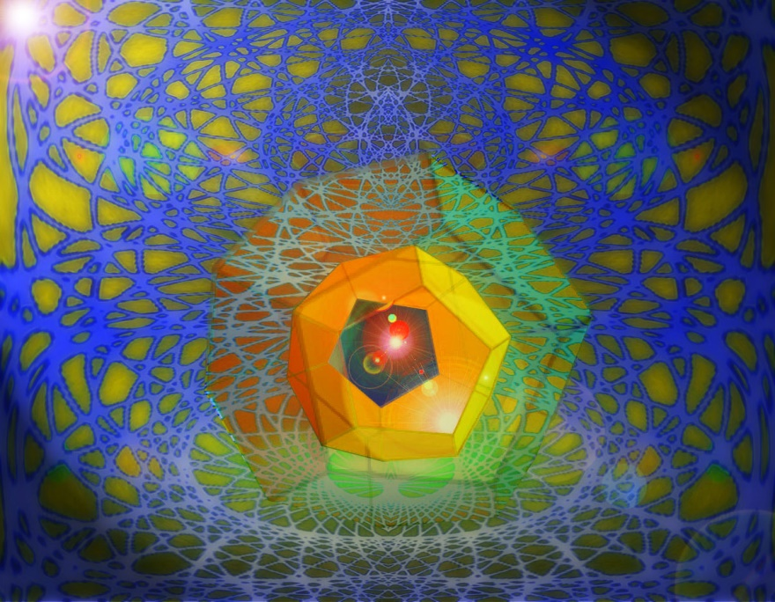

Slide 12
Is the universe shaped as a Dodecahedron?
Some recent research is suggesting that the universe is the shape of a dodecahedron (12-faced polyhedron).
Research is based upon data collected by an American satellite called the Wilkinson Microwave Anisotropy Probe (WMAP). This satellite collects data relating to microwave radiation, energy whose source is supposed to be the big bang. The conclusions of this data alluding to the universe being shaped as a dodecahedron.
The wavelength of this radiation is remarkably pure, but like a musical note it has harmonics associated with it. These harmonics, like those of a note, reflect the shape of the object in which the waves were generated. In the case of the note, that object is a musical instrument. In the case of the microwave background, that object is the universe itself. (Astrophysicist Jean-Pierre Luminet.)
Notes:
Microwave – radiation – background.

Slide 14
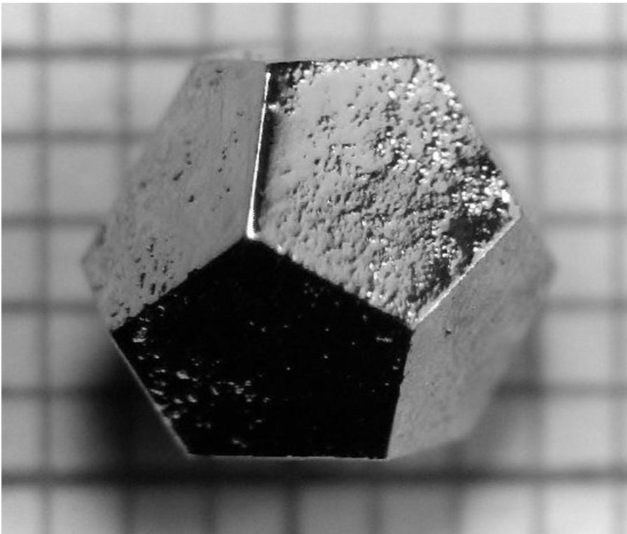
Notes:
Pyrite crystal naturally formed - Influence of etheric patterns

Slide 15
Dodecahedral quasi-crystal grown
Ho-Mg-ZnQuasicrystalPublic Domain
AMES lab., US Department of Energy - http://cmp.ameslab.gov/personnel/canfield/photos.html#
Ho-Mg-Zn dodecahedral quasicrystal, grown by using the self-flux method (excess Mg), and slowly cooling from 700 C to 480 C. The R-Mg-Zn family is the first rare-earth containing quasicrystal structure, which allows the study of localized magnetic moments in a quasiperiodic environment. Or: Photograph of a single-grain icosahedral Ho-Mg-Zn quasicrystal grown from the ternary melt. Shown over a mm scale, the edges are 2.2 mm long. Note the clearly deﬁned pentagonal facets, and the dodecahedral morphology. [in: Phys. Rev. B 59, 308–321 (1999)]

Slide 16
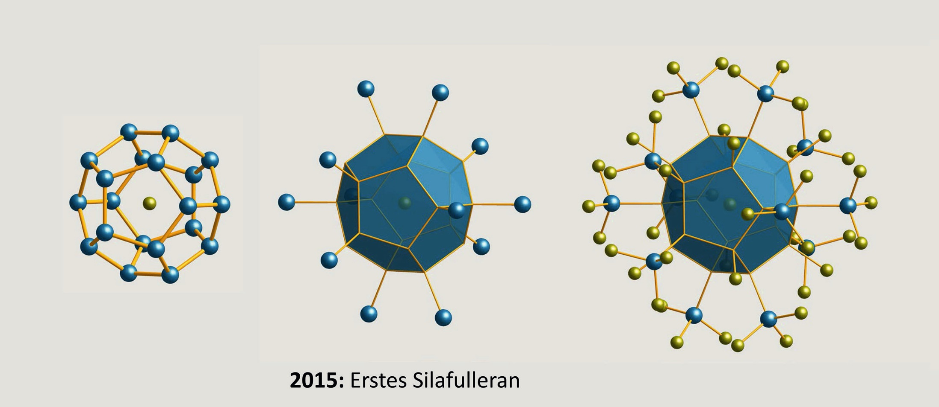
Notes:
Silicon dodecahedron fullarenes in molecular electronics.

Slide 17
Notes:
Our Solar Logos is the Heart Center of an even greater being we designate the One whom not may be said. Agni Heart Era of the New woman Mother of the World

Slide 18
Truth veiled in Symbols
”Truth is veiled in symbols, but The mind cannot comprehend their relevance to life, and their meaning must be revealed by everyday events. People need familiar images, and by these images is the spirit uplifted to its True Dwelling.”
(The Call, 130, Agni Yoga Society)

Slide 19
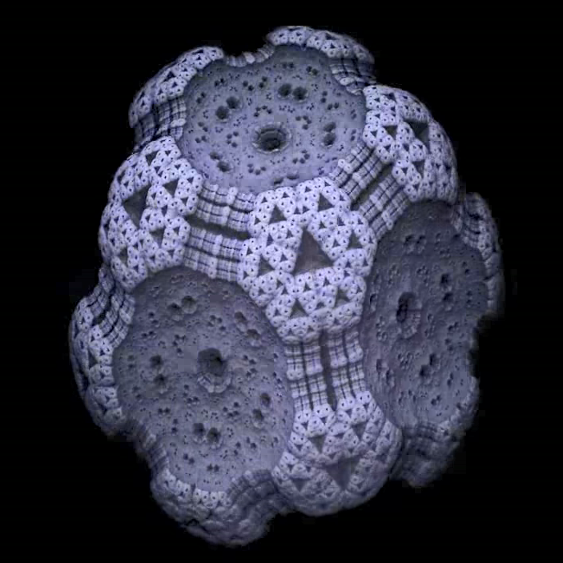
Click the link below to go to the video
Awakening-9-Dodecahedron
Notes:
Video 3 organic moving Forms in nature Cauliflower Broccoli Dodecahedron many shapes and forms.

Slide 20
Light Blazes fourth at the 3rd
“The electrical energy of the mind now creates the door for the third initiation, and the obstruction which confronts the initiate is that of the electrical figments of his own thinking, shining with a light which is all their own (for they are of the highest order and type), but veiling the pure light which shines behind them. They constitute the sumtotal of illusion. This "door" is formed by the coming together of the three types of energy: fire by friction, solar fire (playing in full force at this third initiation), and electrical fire from the Spiritual Triad, making its first impact on the other two fires, for all three are in full activity at this initiatory crisis. All are localised and concentrated in that symbol of progress, the "door of initiation.“ (RI vol. 4 354)

Slide 21
Egoic Lotus at the 3rd
“By the time the third Initiation is reached, a wondrous transformation has transpired. The outer sphere is palpitating with every colour in the rainbow, and is of wide radius; the streams of electrical energy circulating in it are so powerful that they are escaping beyond the periphery of the circle, resembling the rays of the sun. The nine petals are fully unfolded, forming a gracious setting for the central jewel, and their orange hue is now of a gorgeous translucence, shot with many colours, that of the egoic ray predominating. The triangle at the base is now quickened and scintillating, and the three points are small blazing fires, showing to the eye of the clairvoyant as sevenfold whorls of light, circulating their light from point to point of a rapidly moving triangle.” (TCF 764)

Slide 22
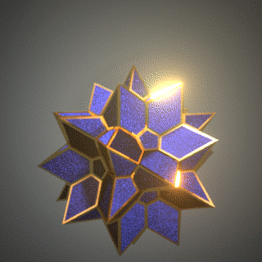
Click the link below to go to the video
Awakening-9-Blue-Dodecahedron
Notes:
Video 5 palpitates flashes fourth rotates “The vibrant palpitating wheels turned over. Life, in its many stages and in its many grades commenced the process of unfolding”

