Slide 2
The Master’s ashram is not on the mental plane.
“We have to learn to use the intuition because the Master’s ashram is not on the mental plane. The plane on which we shall some day eventually work is not the mental plane. One of the things we have to learn to do in this new era is to get off the mental plane with all the knowledge and detail and technicalities that we have so painstakingly acquired and begin to develop that something that we call the intuition, which is the source of illumination...”
March 5, 1943, Friday Evening Address by Alice Bailey

Slide 3
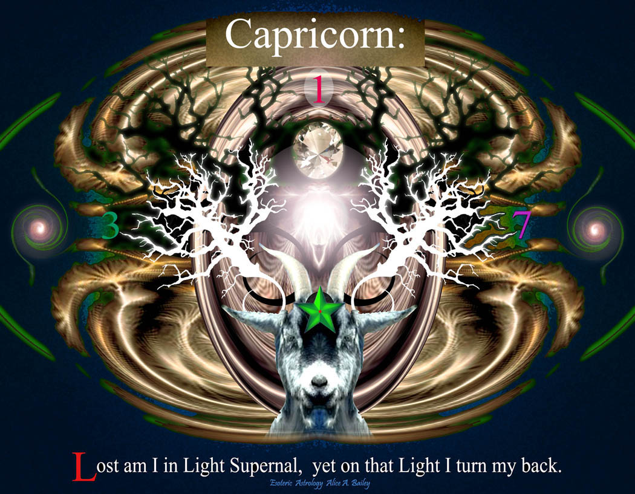
Notes:
The mountain of initiation. The goat cragged peaks.

Slide 4
Capricorn Full Moon and Winter Solstice

Slide 5
The Dual vortex and the 2 horns
The two horns mentioned here by DK are symbols of duality and esoterically relate the right and left channels of the great Kundalini force Ida and Pingala. These two force centers or channels run up and down to the right and left side of the disciple's etheric body. When both can become linked and fused there is now a free flow of energy and force from the highest levels to the lowest and the higher initiations can be taken.
This fusion is facilitated by the dynamic release of the great Kundalini force that begins at the 3rd initiation and climaxes at the 6th. The central channel of the kundalini fire, or sushumna, is symbolized by the unicorn's golden horn to which DK refers. The sinuous twisting of the great serpent Fire parallels in many respects rotary, spiral-cyclic motion as it makes its ascent up the spine and out the top of the head. The unicorn's golden horn best approximates exoterically these hidden and esoteric truths. The horn is "golden" because it is only through the great 4th ray of buddhic-love that this whole process can proceed with any degree of safety and according to occult law. The buddhic plane and the 4th ray occupy the position of divine mediators between spirit and matter.
We are told by DK that the 7th ray works through the base center in average humanity, through the 1st ray in advanced disciples, and the 4th ray through the base of the spine in advanced initiates. This is also the basis of the great enunciation by the Christ "that no man goes to the Father (Spirit), but by way of the Son/Sun." It is Mercury, which transmits this great 4th ray to humanity.
Notes:
Amongst other important developments if you are working on the 3rd initiation you will be having spontaneous movements of this Kundalini Fire.

Slide 6
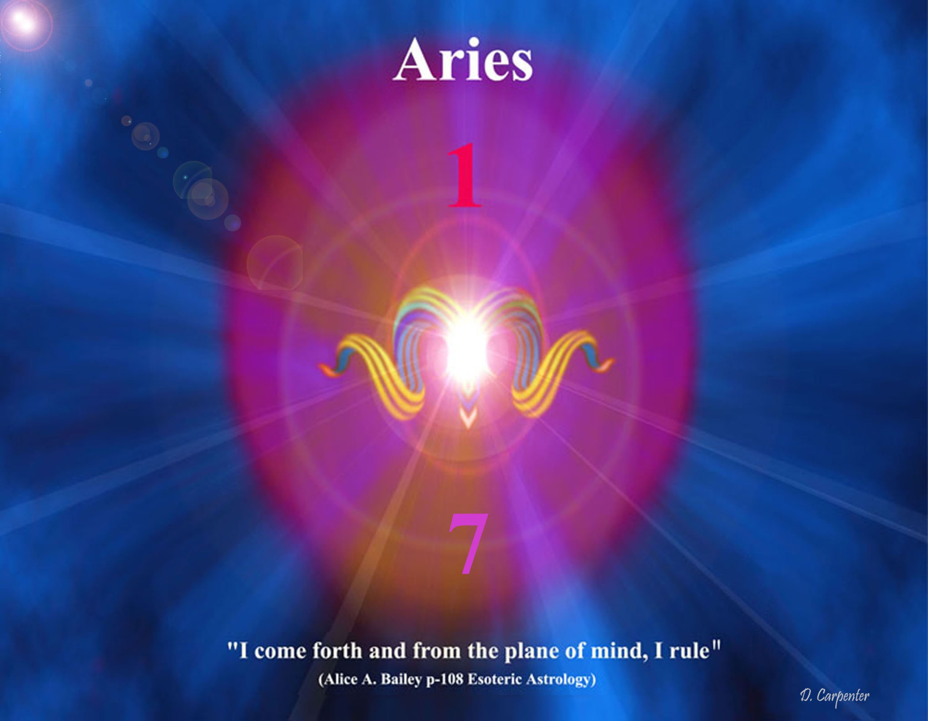
Notes:
Dual rotary motion of the sphere with the dual vortex of inlet and outlet.

Slide 7
Mountain Top of Initiation
What is the mountain top of initiation so frequently referred to in esoteric literature but another symbol of the vortex-cone that each disciple must create in the meditative state in its different stages to reach perfection? What is the long horn of the unicorn but a symbol of rotary spiral-cyclic motion that climaxes in a searing point of piercing Will -- an inner trumpet out of the throat of which issues forth the sounds of God's hidden Purpose and Will, not language as we understand it, but pure first subplane devic fire.
What distinguishes the new Agni Yoga teachings from all past work? The revelation that at the heart of each occult organism, chakra or force center, whether cosmic, systemic, or planetary, all are connected and fused by that point of Divine Will. It is this identification that brings all diverse principles and laws into one synthetic whole.

Slide 8
Human and Deva Evolution
“In the present system, the second, there are two dominant evolutions, the human and the deva; there are—as earlier stated—sixty thousand million human monads. Add to this the feminine evolution of the devas, consisting of 140 thousand million, and you have the necessary two hundred thousand million. This elucidates my statement anent this being a feminine system.” (EH 110)
Notes:
Human and Deva Specs drawn into the formation of some greater entity Planetary solar or cosmic. Drawn into the dance

Slide 9
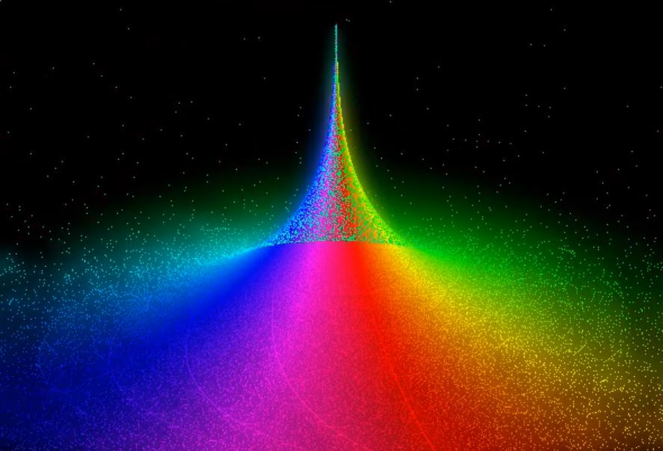
Notes:
Video 1

Slide 10
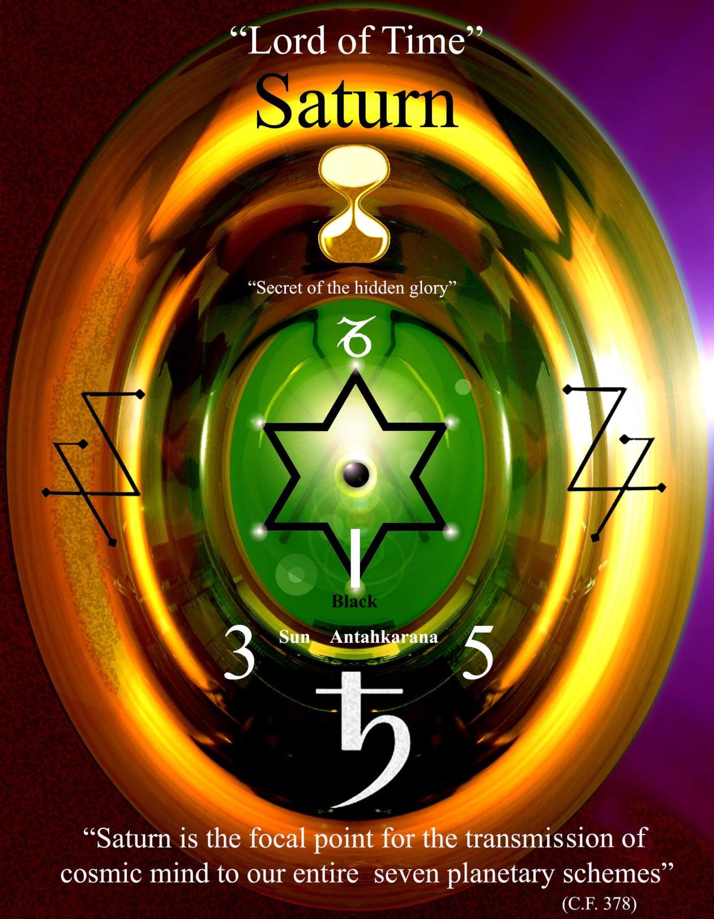
Notes:
Lead into gold alchemy Venus 2&5

Slide 11
Saturn’s bridge between the old and the new
“It is a triple energy and there is an esoteric connection between this triple energy, and Saturn's rings.
The old Commentary expresses this truth about an interesting group of sons of manas as follows:
"These Sons of mind clung to the old and dying form, and refused to leave their Mother. They chose to pass into dissolution with her, but a younger son (Saturn) sought to rescue his brothers, and to this end he built a triple bridge between the old and new. This bridge persists, and forms a path whereon escape is possible.
Some escaped and came to the help of the incarnating Sons of Mind who had left the Mother for the Father.
(This latter clause, refers to the building of the antaskarana.”
(TCF 1149)
Notes:
Manas previous SS H ruler Venus H ruler 3 aspects of the mind

Slide 12
Saturn and the first 5 initiations
“At the fourth initiation, Mercury and Saturn again bring about great changes and unique revelation, but their effect is very different to the earlier experience.” (EA 71)
“Mars and Saturn.—Both these planets are exceedingly potent in connection with initiation into the life of the Hierarchy; Mars is potent in relation to Scorpio and Saturn in relation to Capricorn. This involves the intensified activity of the 6th and the 3rd rays and their energies, and when these are rightly employed there comes liberation from form control and the release of the conscious individual.”
(EA 200)
Notes:
Saturn up to and including the 3rd initiation 4th and 5th Venus at the fourth.

Slide 13
The 3 Astrological Crosses

Slide 14
Teachings on the Astrological Crosses will require a whole new sensitivity.
"This Treatise, like The Secret Doctrine, is designed to instigate research and the power to delve and seek, because that process has a definite effect upon the cells of the brain and leads to a needed stimulation.
In the study of the Crosses, the true meaning of their influence will only appear as you begin to think in terms of synthesis or of the relation of the four streams of energy, flowing unitedly upon and through any form of divine manifestation. This is by no means an easy thing to do, for the ability to think synthetically is only just beginning to appear in the foremost minds of the race."(DK)
Notes:
Paradox lower mind higher mind intuition

Slide 15
The 3 Astrological Crosses
The Mutable cross, Gemini—Virgo—Sagittarius—Pisces.
The Fixed cross, Taurus—Leo—Scorpio—Aquarius.
The Cardinal cross of Aries— Libra— Capricorn— Cancer.
“These three Crosses are, in their totality of manifestation, related to the three basic energies which brought the solar system into being; they constitute the three major and synthetic expressions of the supernal Will, motivated by love and expressed through activity. Upon these Crosses, the ability to see the whole, purpose-motive-expression, life-quality- appearance, shifts and changes.” (EA 558)
Notes:
Earth -air – water - fire

Slide 16
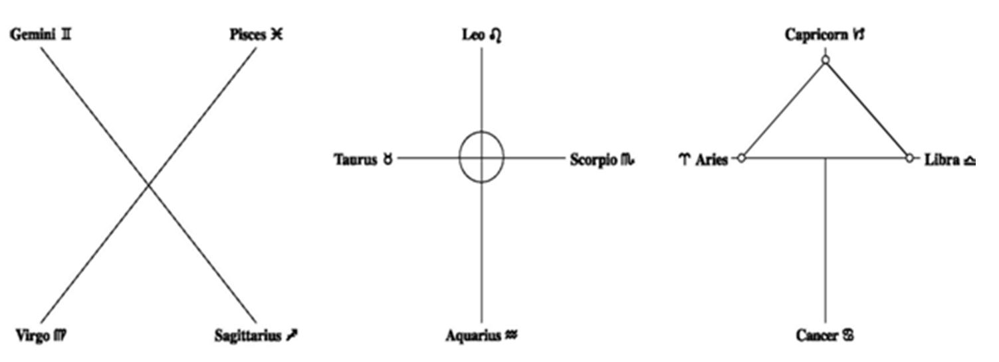
Notes:
Talk a little about the three crosses. Mutable , Fixed and Cardinal. All deal with four energies. Polarities of opposites All based on 4 energies

Slide 17
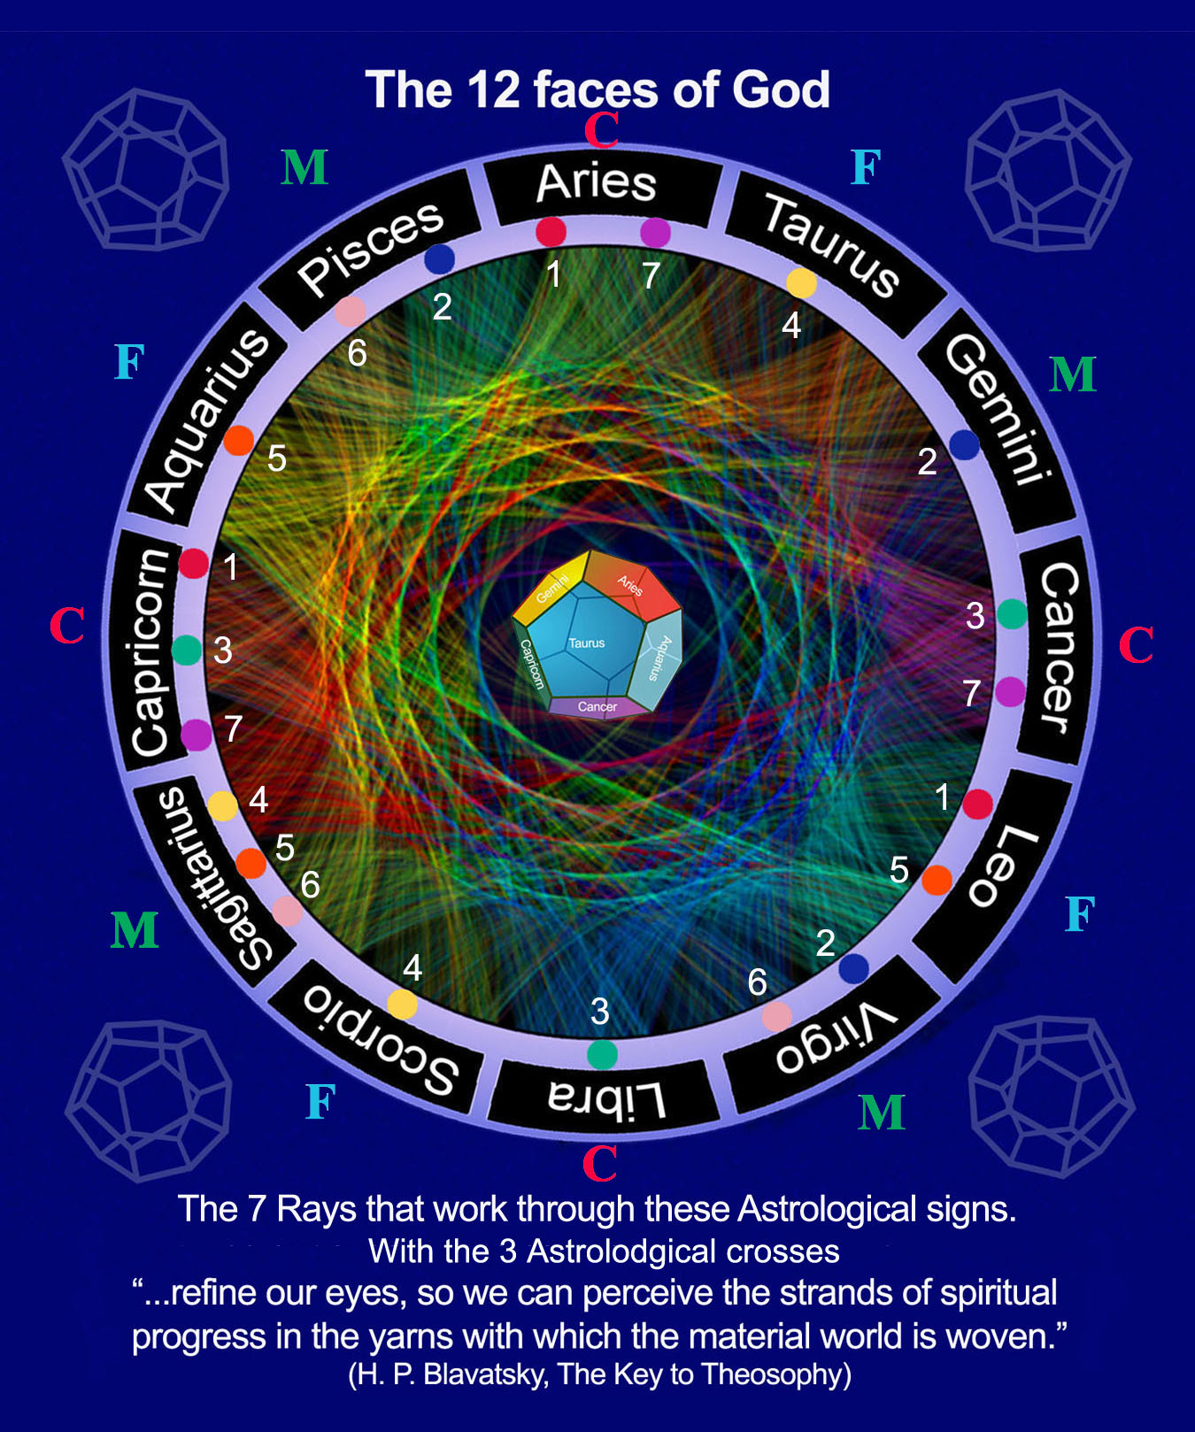
Notes:
3 crosses on an astrological wheel of all the signs Earth - air - fire and water

Slide 18
Rays and Planes as rotating spheres
In connection with these two types of spheres we might, by way of illustration and for the sake of clarity, say that:
a. The planes rotate from east to west.
b. The rays rotate from north to south.
….. by means of this very interaction, the work of the four Maharajahs or Lords of Karma, is made possible; the quaternary and all sumtotals of four can be seen as one of the basic combinations of matter, produced by the dual revolutions of planes and rays.
The seven planes, likewise atoms, rotate on their own axis, and conform to that which is required of all atomic lives.
The seven spheres of any one plane, which we call subplanes, equally correspond to the system; each has its seven revolving wheels or planes that rotate through their own innate ability, due to latent heat—the heat of the matter of which they are formed.” (153 TCF)
Notes:
To explain the spherical nature of the crosses and how energy move through them lets regress slightly here to show how spheres come into existence

Slide 19
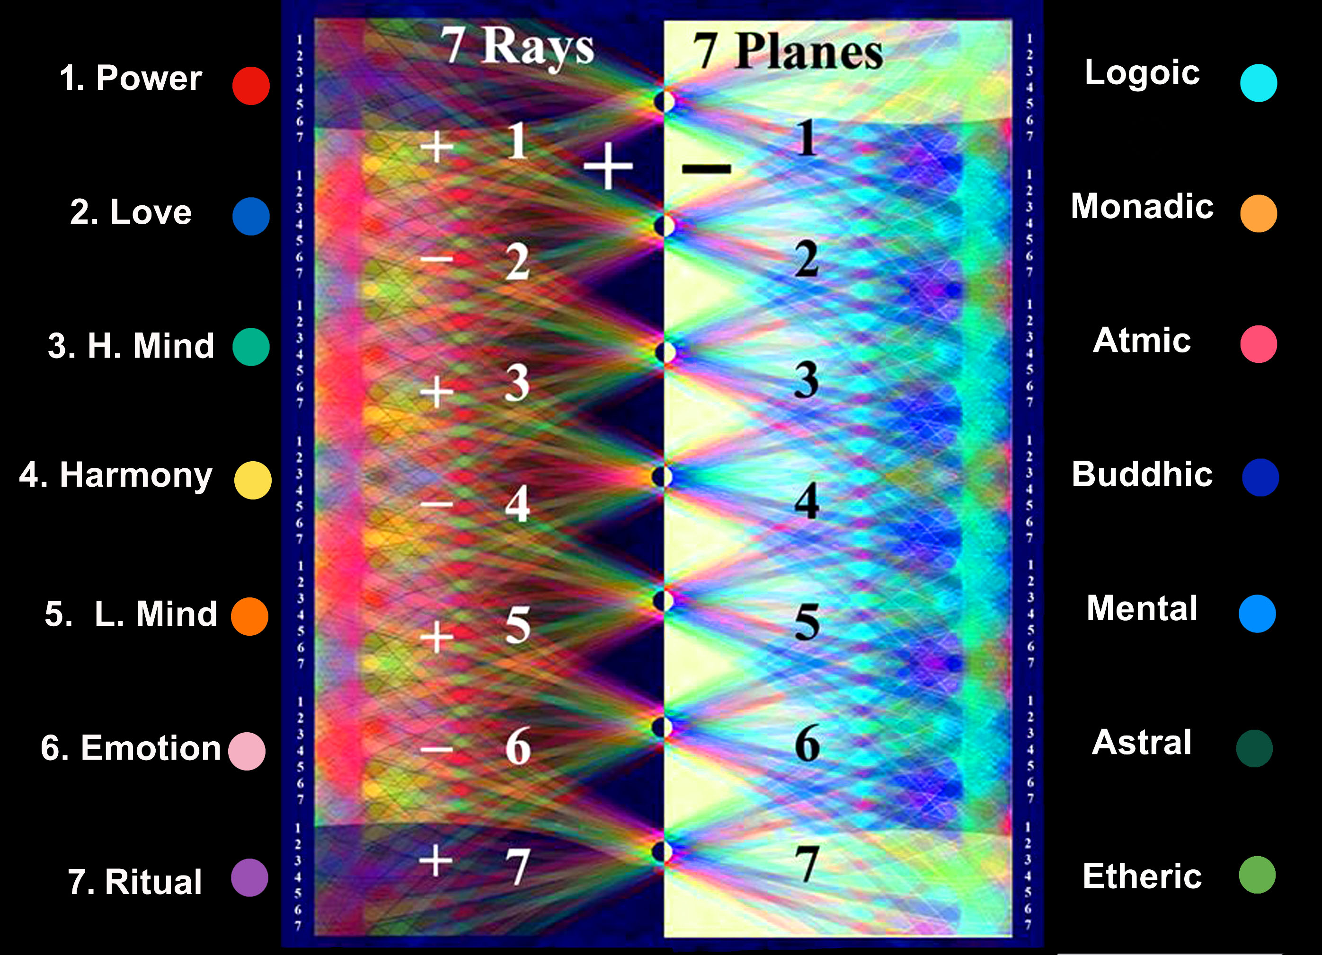
Notes:
Make changes to planes + -

Slide 20
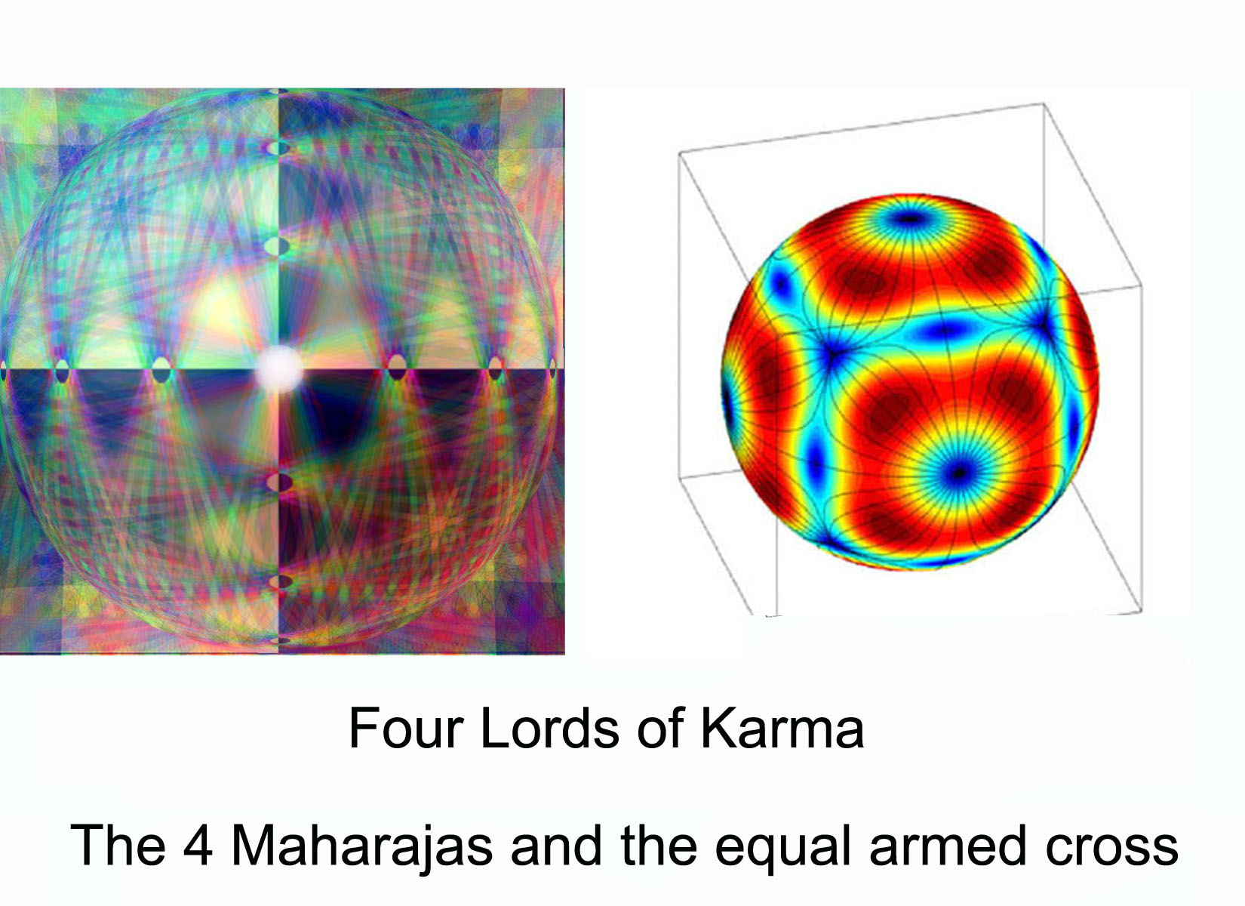

Slide 21
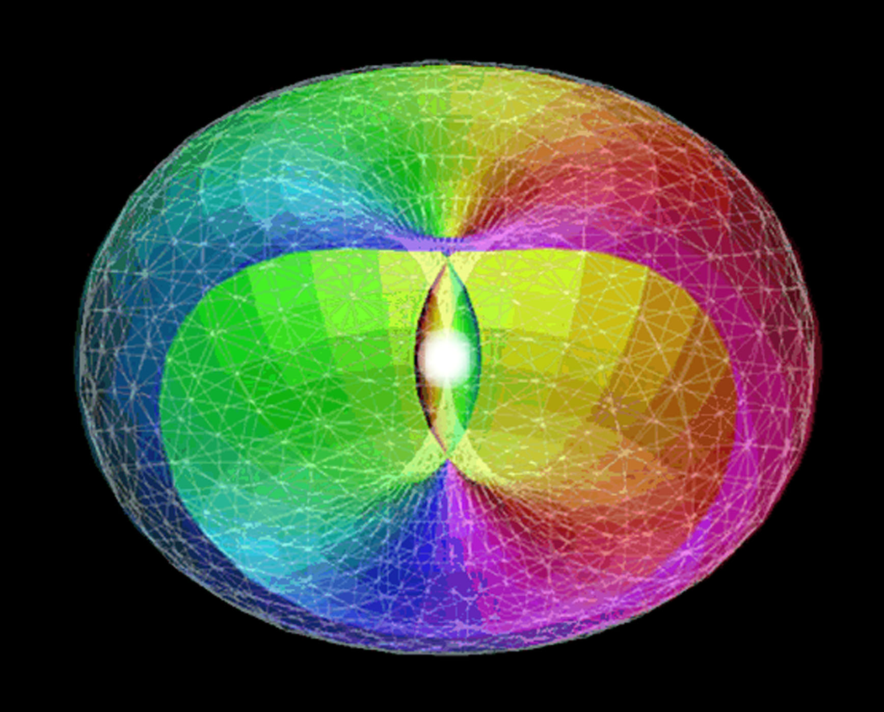

Slide 22
Triangles are in a state of constant change and circulation.
The Changing Pattern of the Planetary Etheric Body
It is well-nigh impossible for man to draw or make a picture of the network of triangles and, at the same time, see them taking the circular form in their totality of the etheric body of the planetary sphere. The reason is that the whole etheric body is in constant motion and ceaseless transformation, and the energies of which it is composed are in a state of constant change and circulation. (TE 165)

Slide 23
Notes:
How do we go from a cross to a wheel

Slide 24
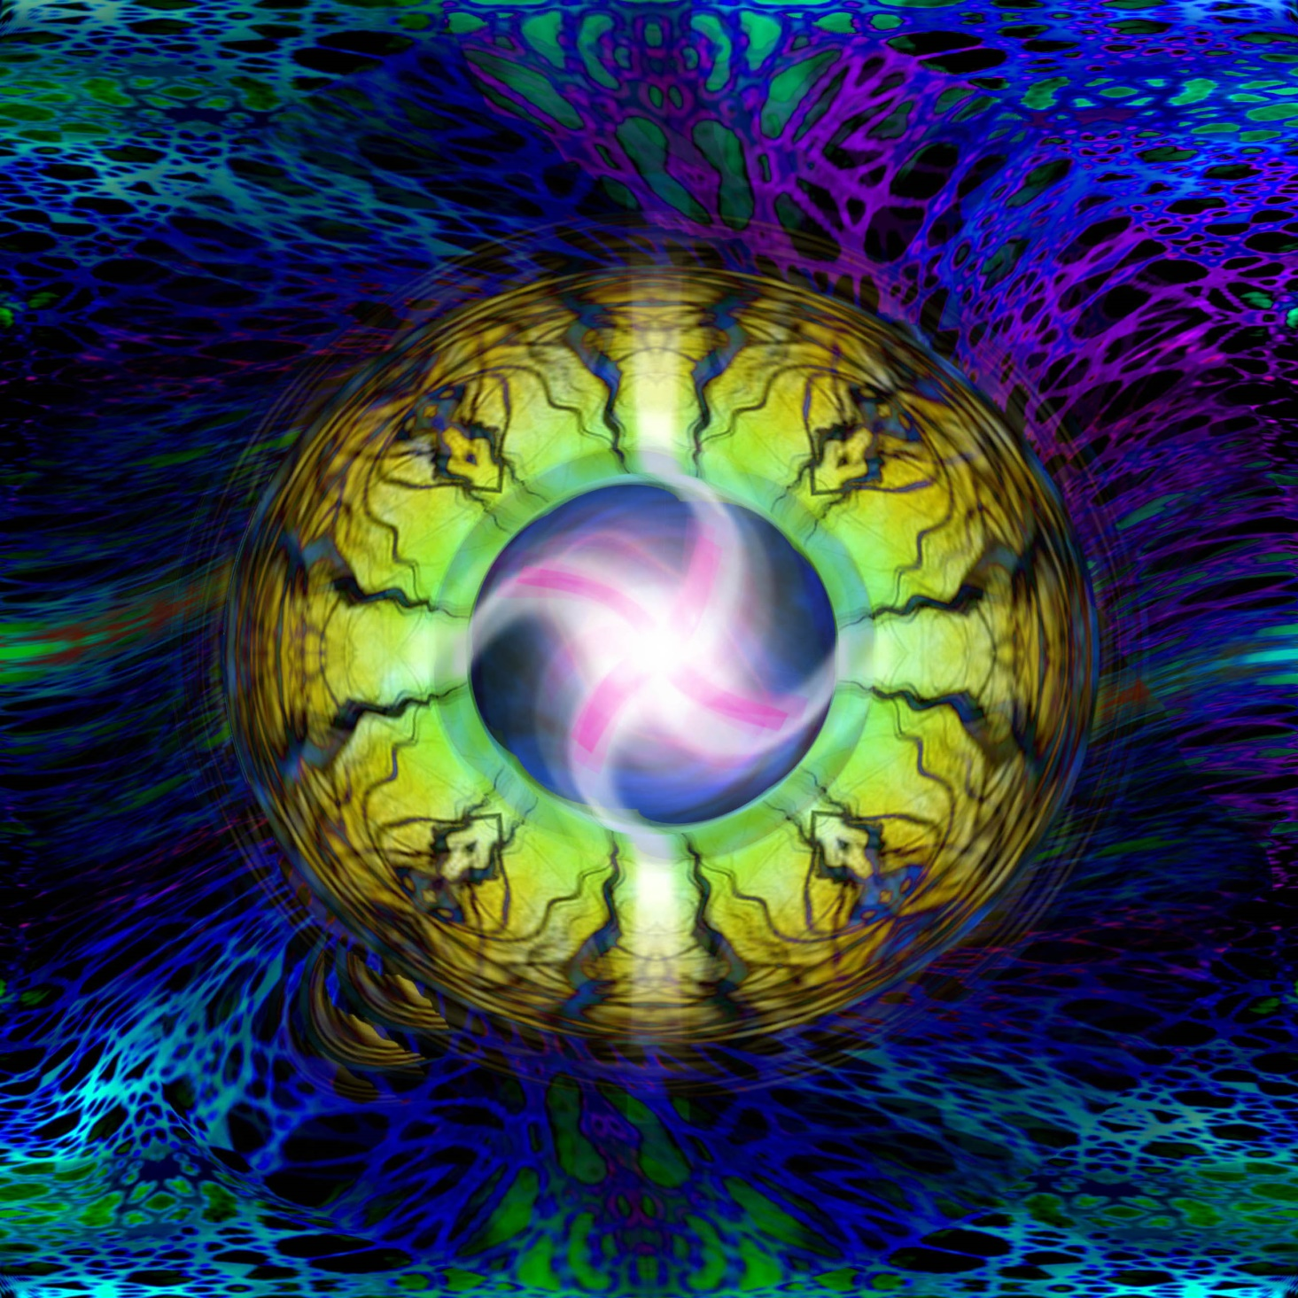

Slide 25
“Radiant Point of Power."
“This Treatise, like The Secret Doctrine, is designed to instigate research and the power to delve and seek, because that process has a definite effect upon the cells of the brain and leads to a needed stimulation. In the study of the Crosses, the true meaning of their influence will only appear as you begin to think in terms of synthesis or of the relation of the four streams of energy, flowing unitedly upon and through any form of divine manifestation. This is by no means an easy thing to do, for the ability to think synthetically is only just beginning to appear in the foremost minds of the race.”
Until Clairvoyance in its higher aspect is awakened this profound visualization DK speaks of can only be approached by symbols such as these but an animation can help us be released from the lower mind and awaken the latent imagination.
It can be illustrated, and then only analytically (which ever negates synthesis) by remarking in connection with the Mutable Cross, for instance, that the synthesis of evolution, its problem and its goal all appear in a united, whole presentation when the influences are viewed as follows:
Gemini — Sagittarius Virgo — Pisces
This culminating radiance is the result of the focus of life, intention, and energy into a "radiant point of power." You have been told that in connection with the Mutable Cross at this time the sign Pisces is the most potent and when the work of the Mutable Cross has been accomplished, the acquiescing disciple passes onto the Fixed Cross and prepares for the tests and trials of initiation." (Esoteric Astrology 561-562)
Notes:
Paradox 1st talking about stimulation of thye brain cells through the lower mind then look at your own chart and see the polarities - friction in early stages

Slide 26
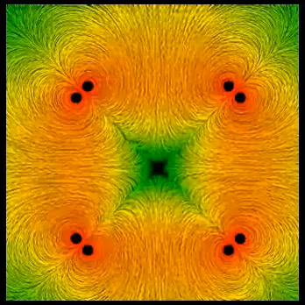
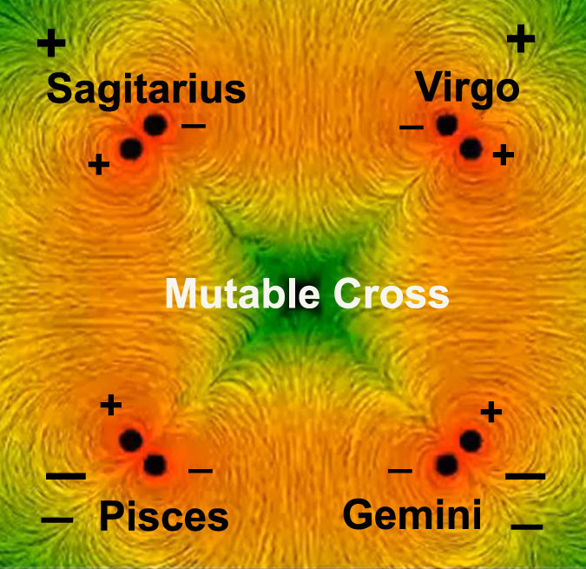
Notes:
Pisces needs to be positive and virgo

