Slide 2
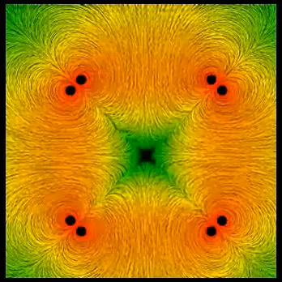
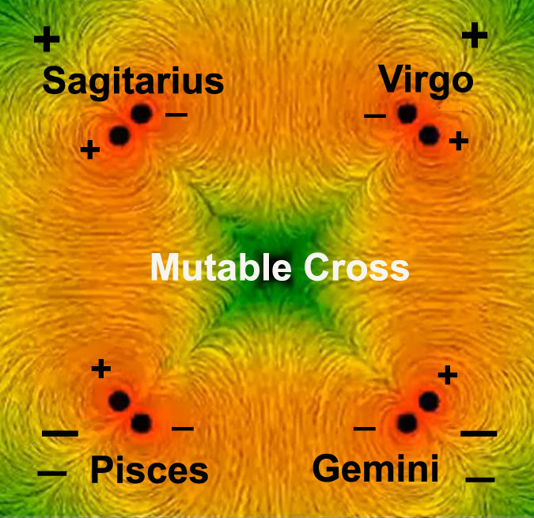
Notes:
Pisces needs to be positive and virgo Cross section electrically to one more spherically

Slide 3
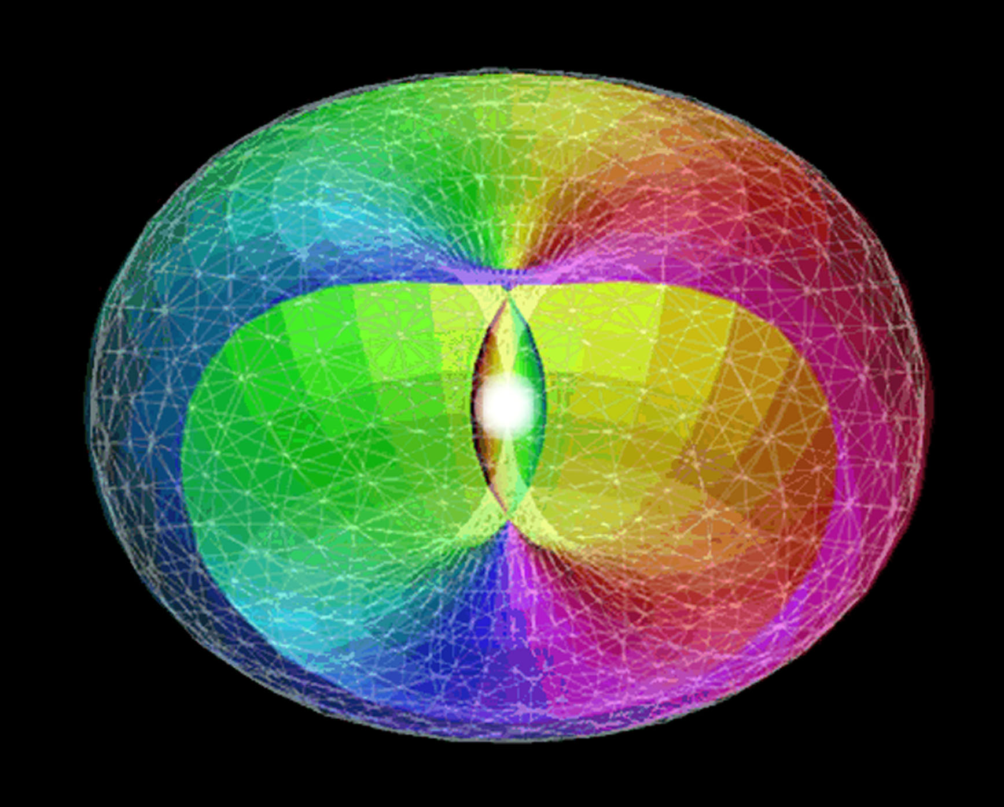
Notes:
Wells up we reviewed not big bank

Slide 4
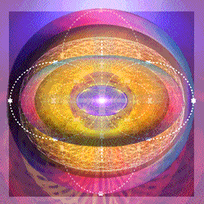
Notes:
Cutting in at right angles creates 4 Quadrants or the equal armed cross. This is in the background show vortex DS link

Slide 5
The Sphere at the Summit
In our last series of instructions I summed up or summarised all the meditations (seven in number) which I have given to the group. I tried to show you the sequence of critical points in the life of the man in training for initiation. The last of these meditations was called The Cross as the Expression of the Vertical and the Horizontal Life. This was portrayed by the two crosses:
You will notice also, in this symbol, that the secondary point of focus appears where all the lines meet and cross each other. This point represents the disciple's personality, into which the higher radiance must pour and from which spiritual energy reaches out on all sides.
3. The long limb of the triple cross symbolises to the disciple that he must go down into the very depths of human life in order to prepare the masses for the reappearance of the Christ and for the externalisation of the Hierarchy.
4. The sphere at the summit of the cross portrays the "place of the disciple's consciousness." His life of reflection, of constant awareness, and the steady focus of his attention is higher than the vertical life of the aspirant, than his horizontal life of service, and indicates the measure of his conscious activity in the Ashram. Forget not that an Ashram in the Hierarchy is on a higher plane than that of the soul. (DINA 2 193

Slide 6
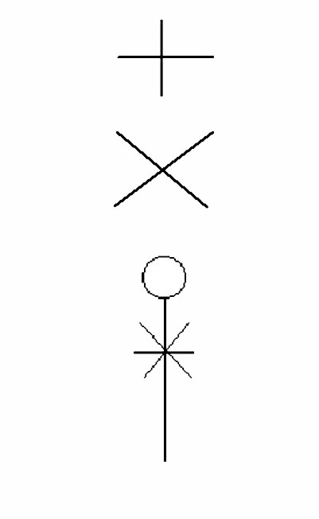

Slide 7
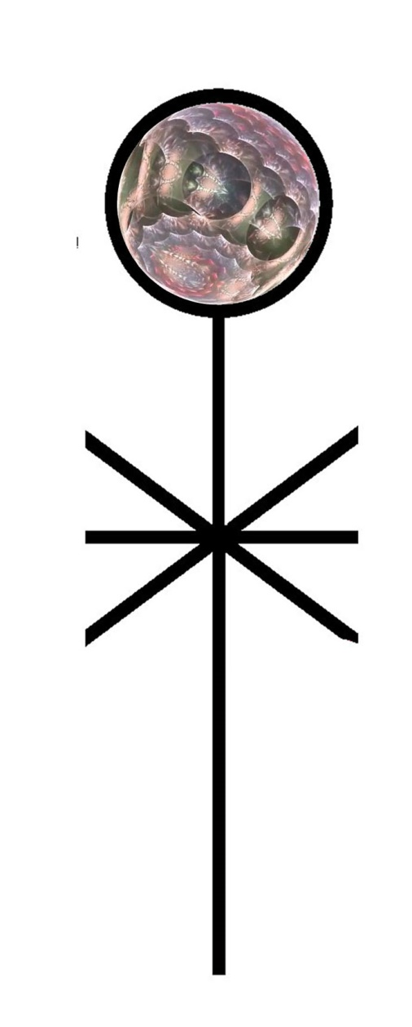
Notes:
Closer look at sphere based on 7

Slide 8
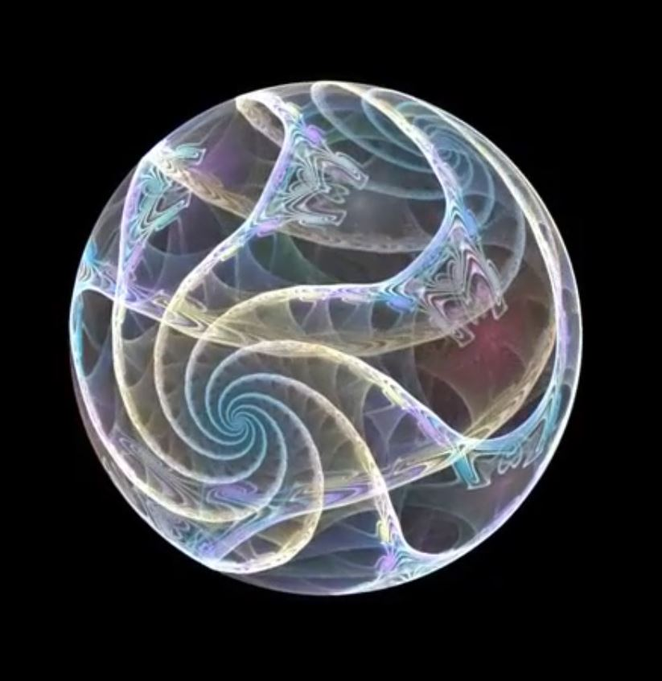
Notes:
Based on 7 and 5 cycles Much that we have presented can be summarized in this one animation

Slide 9
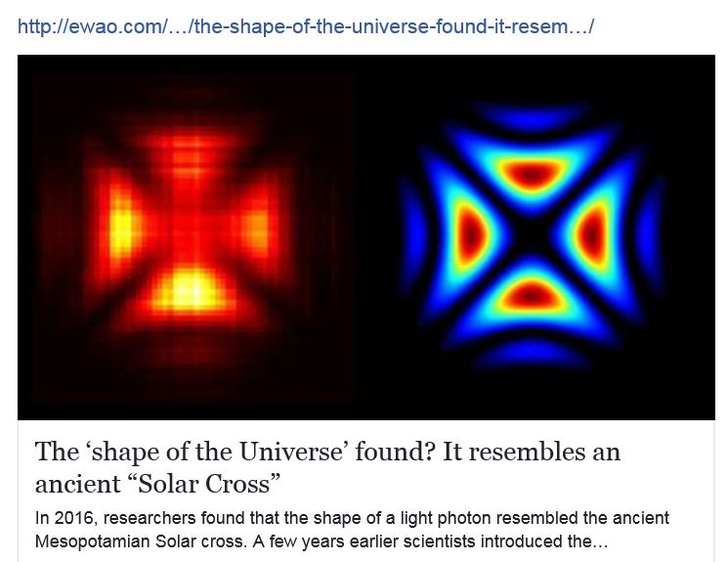
Notes:
Not shape of universe but a photon??? REDUE

Slide 10
Notes:
Add right and left pos and negaitve additon

Slide 11
