Slide 1
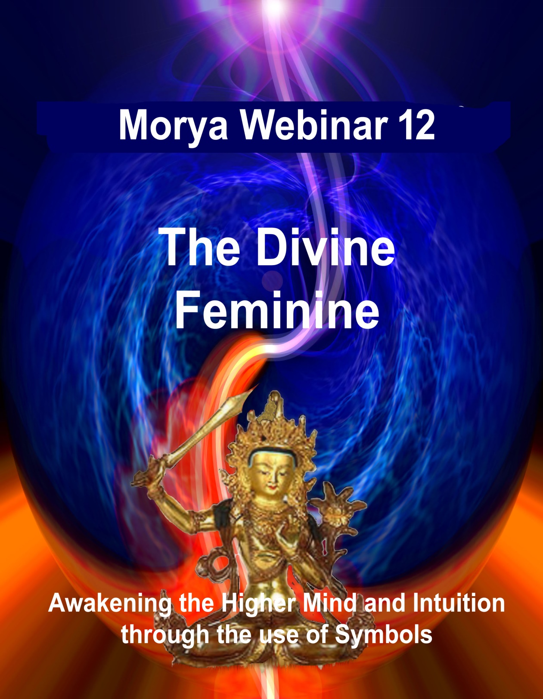
Notes:
Quick note on the opening symbol. Why we have a rather fierce representative at the gate of initiation, female warrior , Yogini, 1st ray Maha Deva. Symbolically she stands at the gate and slays all glamor and illusion that might try to enter into the Ashram with her sword of power and justice. (As we shall explore there is a masculine side to feminine energy and a feminine side to every Masculine.

Slide 2
Goals
One of our immediate goals is to see any esoteric truths emerging through the mainstream. (Our responsibility to Bridge)
One of our long-term goals is to invoke the Divine Will side of our nature. (N)
Why are the posting on Facebook often so mental.
Show of hands how many were able to see this video
DINA books practical outlines balance.
Notes:
L –Mind to higher mind -------Astral to buddhic Atlantian and Aryan Find balance

Slide 3
Lord of the Rings Trilogy Violence - Lower Magic Modified
Story around a ring of power to rule middle Earth.
Parallels between lower elemental forces and our higher solar angels.
New feminine energies emerging.
Fodo Baggins and his companions are not highly intelligent but have a simple devotion to doing good.
Notes:
Male dominated Ring of Power Why so mental two approaches Find balance

Slide 4
Enya
May it be an evening star shine down upon you.
May it be when darkness falls,
your heart will be true
You will walk a lonely road.
Oh! How far you are from home.
Darkness has come,
believe and you will find your way. (ENYA)
Notes:
Belief vs intension Use both

Slide 5
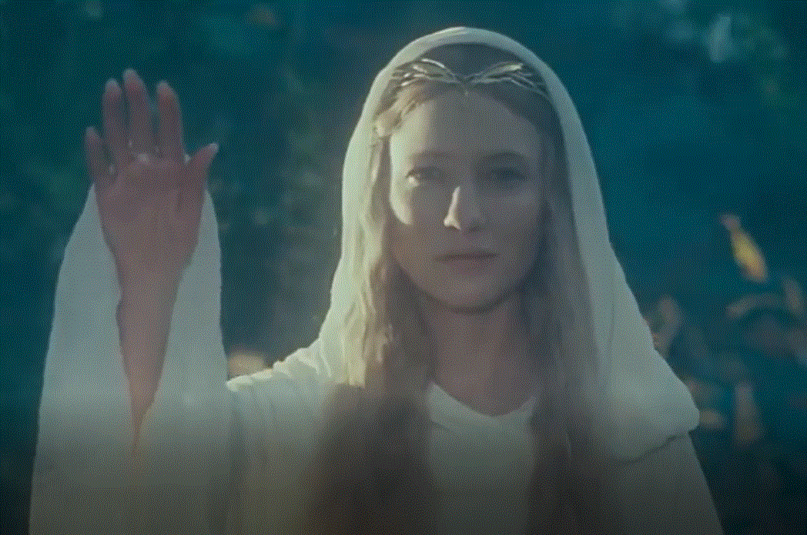

Slide 6
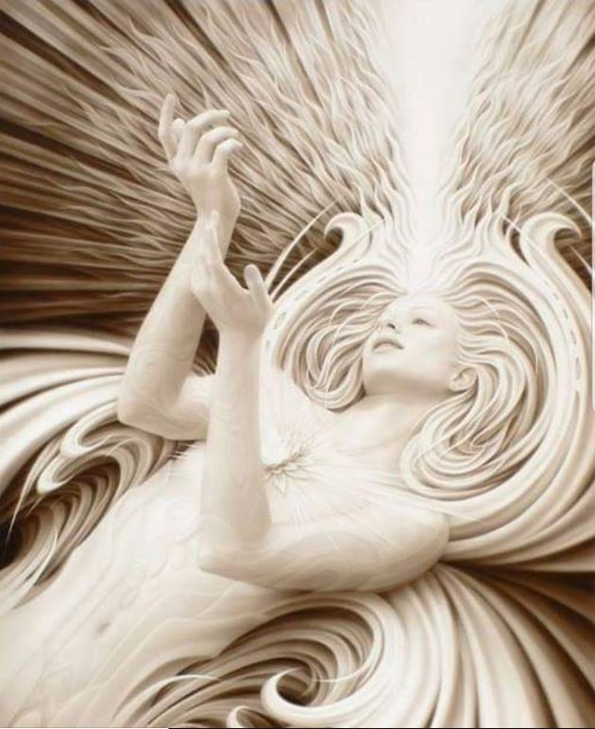

Slide 7
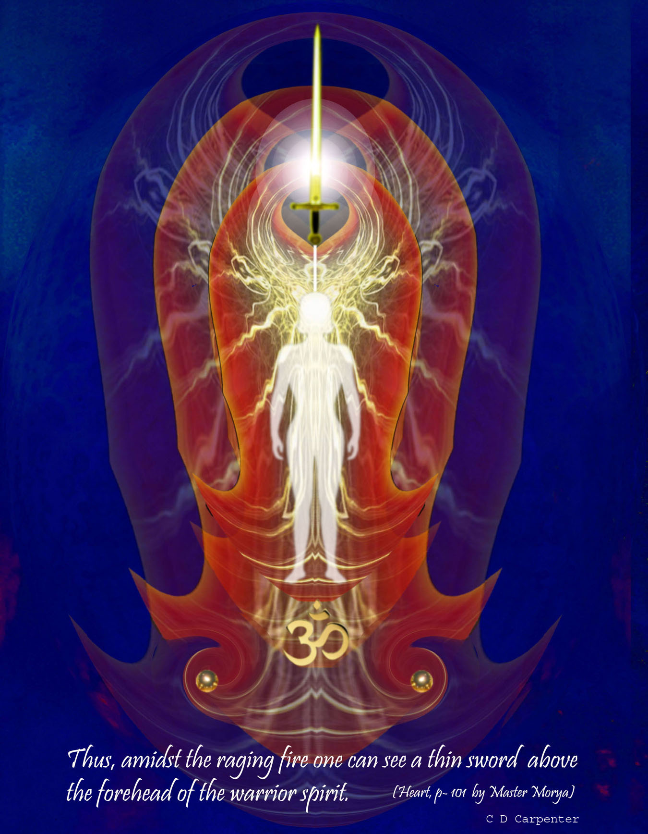

Slide 9
Astral Stability.
“The student of magic aims, above all, to purify his desires, and so to transmute his emotions….. Every magician has to learn the fact that, in this solar system, during the cycle of humanity, the astral body is the pivotal point of endeavour, having a reflex effect on both the other sheaths, the physical and the mental. He, therefore, aims at transmuting (as has often been said) lower desire into aspiration; at changing the lower cruder colors which distinguish the astral body of average man, for the clearer, purer tones of the spiritual man, and of transforming its normal chaotic vibration, and the "stormy sea of life," for the steady rhythmic response to that which is highest and the centre of peace. These things he effects by constant watchfulness, unremitting control, and steady meditation.” (TCF 996)
Notes:
Mental clarity emotional stability.

Slide 10
How a vortex is established
Old Commentary phrases as follows:
"Those who are demanding to be saved have cried aloud. Their voices penetrate into the formless world and there evoke response.
"Those who in distant aeons have pledged themselves to save and serve respond. Their cry too rings forth and, ringing, penetrates into the dark and distant places within the worlds of form.
"And thus a vortex is established and kept alive by that constant dual sound. And then a touch is made and for a space and during time, the two are one—the Saving Souls and the Units to be served.
"Slowly the vision of the Saving One becomes a light which guides the Crying Ones into the place of light."
(EA 327)
Notes:
Old Commentar amd Stanzas poetic Kundalini: no man goes to the father but by way of the son….. Soul awareness the divine Mother 3rd initiation and after.
Science of In-Evocation through vortex sound

Slide 11
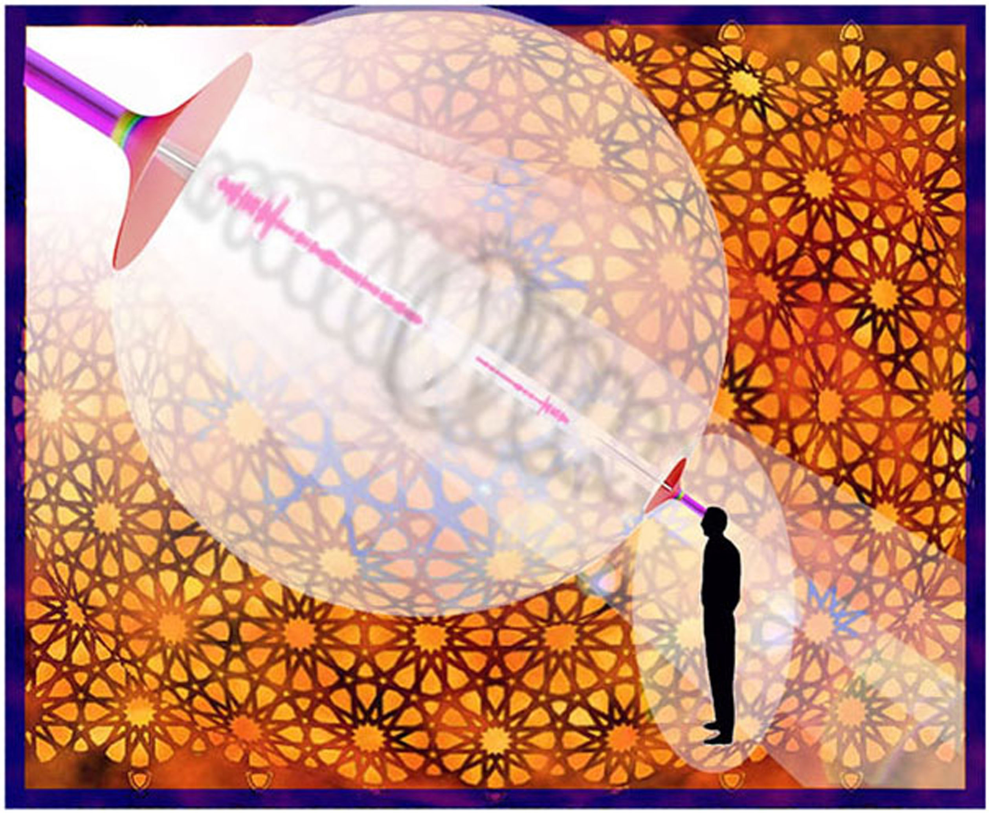

Slide 12
Will and Desire
Rule 10
“One of the fundamental concepts which is grasped by all magical workers, is that both will and desire are force emanations. They differ in quality and vibration, but are essentially currents of energy, one forming an initial vortex or centre of activity, being centrifugal, and the other being centripetal, and the main factor in the accretion of matter into a form around the central vortex….
The analogy in all form building holds good for gods, men and atoms. The solar system is (from the higher cosmic planes), seen as a vast blue lotus, and so on down the scale; even the tiny atom of substance can be so considered….
(TCF 1018-19)

Slide 13
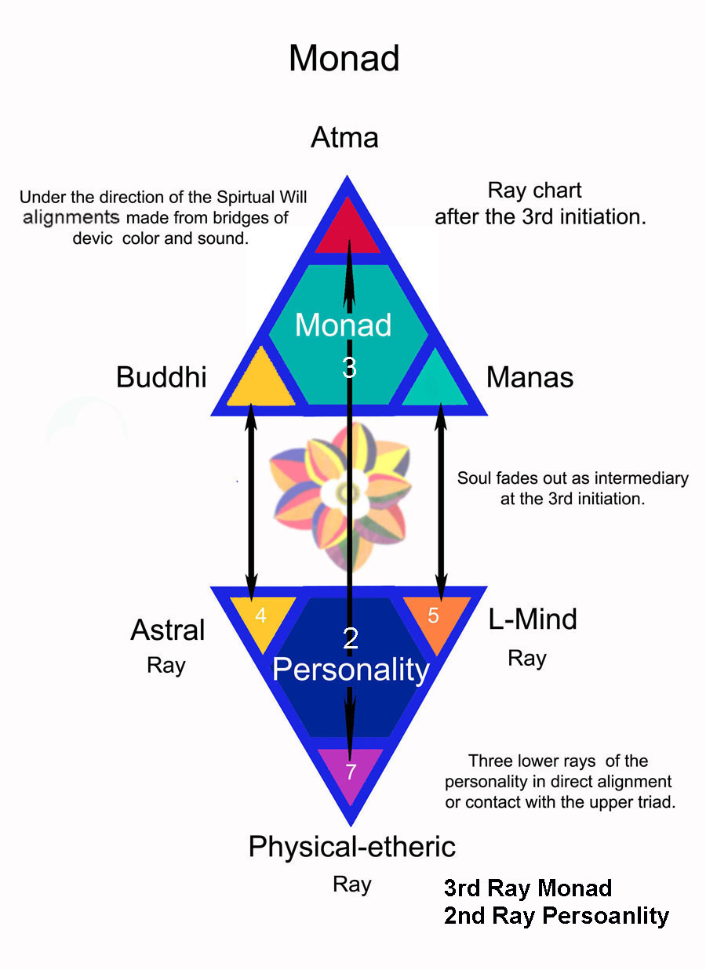
Notes:
Upper triad is masculine the lower femine bridges of color sound and vbration base not. Review from an energy point these two triads

Slide 14
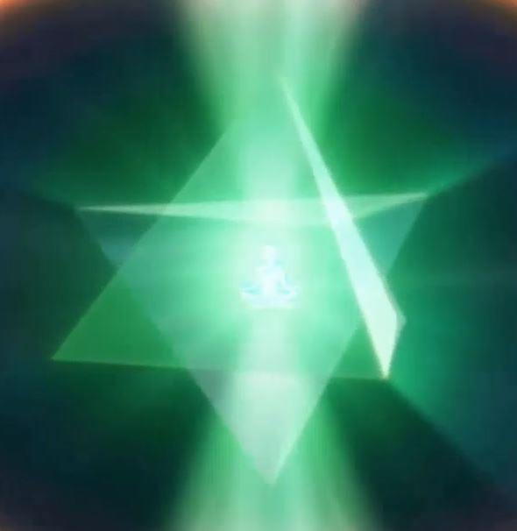
Notes:
Video 2

Slide 15
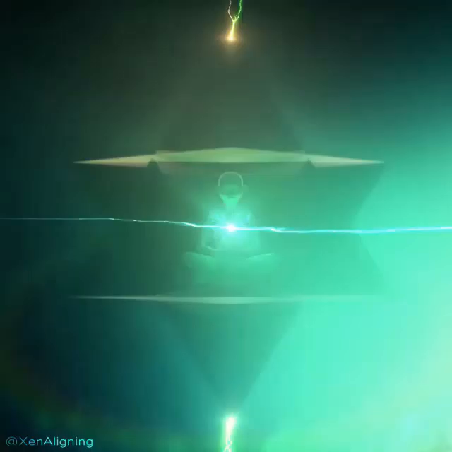
Notes:
Video 3

Slide 16
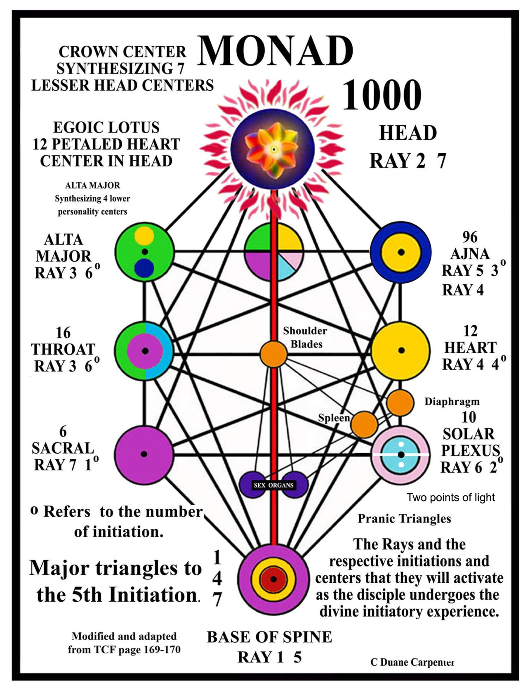
Notes:
Kundalini base of the spine top of the Head connection. Looks like in a more three dimensional image. Remember infinite geometric shapes. DK pointed out at end of incarnation

Slide 17
“The star will shine forth” Future astrology and a new branch of psychology
Astrologers will eventually find it necessary to cast three horoscopes. 1. Physical…. 2. Emotional…. 3. Mental….
It will be found that these three charts will take certain geometrical lines, the lines of energies will form patterns. These three charts, superimposed one upon the other, will give the personality diagram, the individual life pattern. Amazing symbolic charts and lineal forms will be found to emerge when this is done, and the "geometry of the individual" will grow out of this, for it will be found that each line will function in relation to another line, and the trends of the life energies will become apparent. Eventually, even in this department of knowledge, "the star will shine forth." This will constitute a new branch of psychology and its true exponent for our age will duly be found. I but indicate the lines of the future astrology in order to safeguard the present. (TWM 440-41)
Notes:
Why a future astrology and new branch of psychology because it appeals to the intuition and not just the lower mind. (My astrology charts circular) Walter Pullen 3-d charts showcased
Not with astrology here so much as triangles which are activated by astrological influences

Slide 18
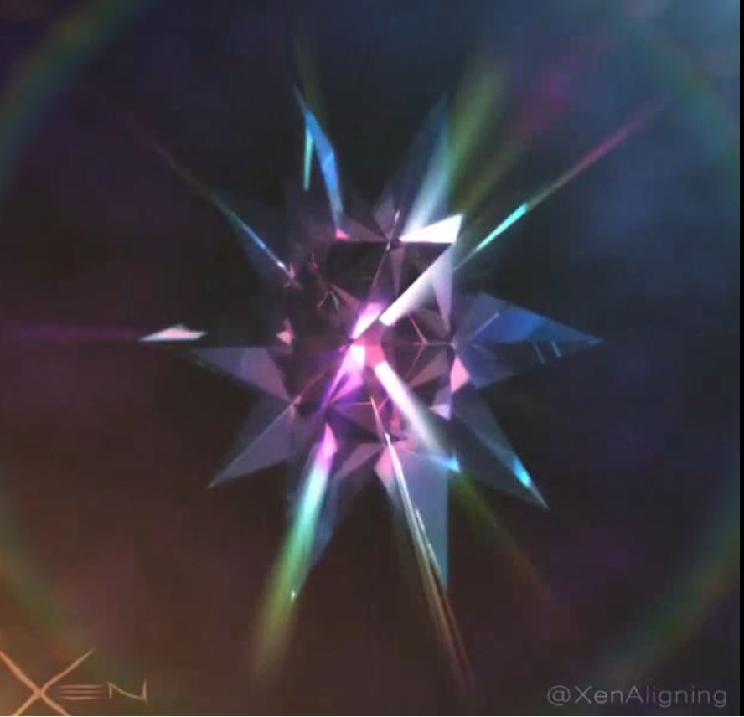
Notes:
Video 4

