Slide 2
Individual Ray Charts

Slide 3
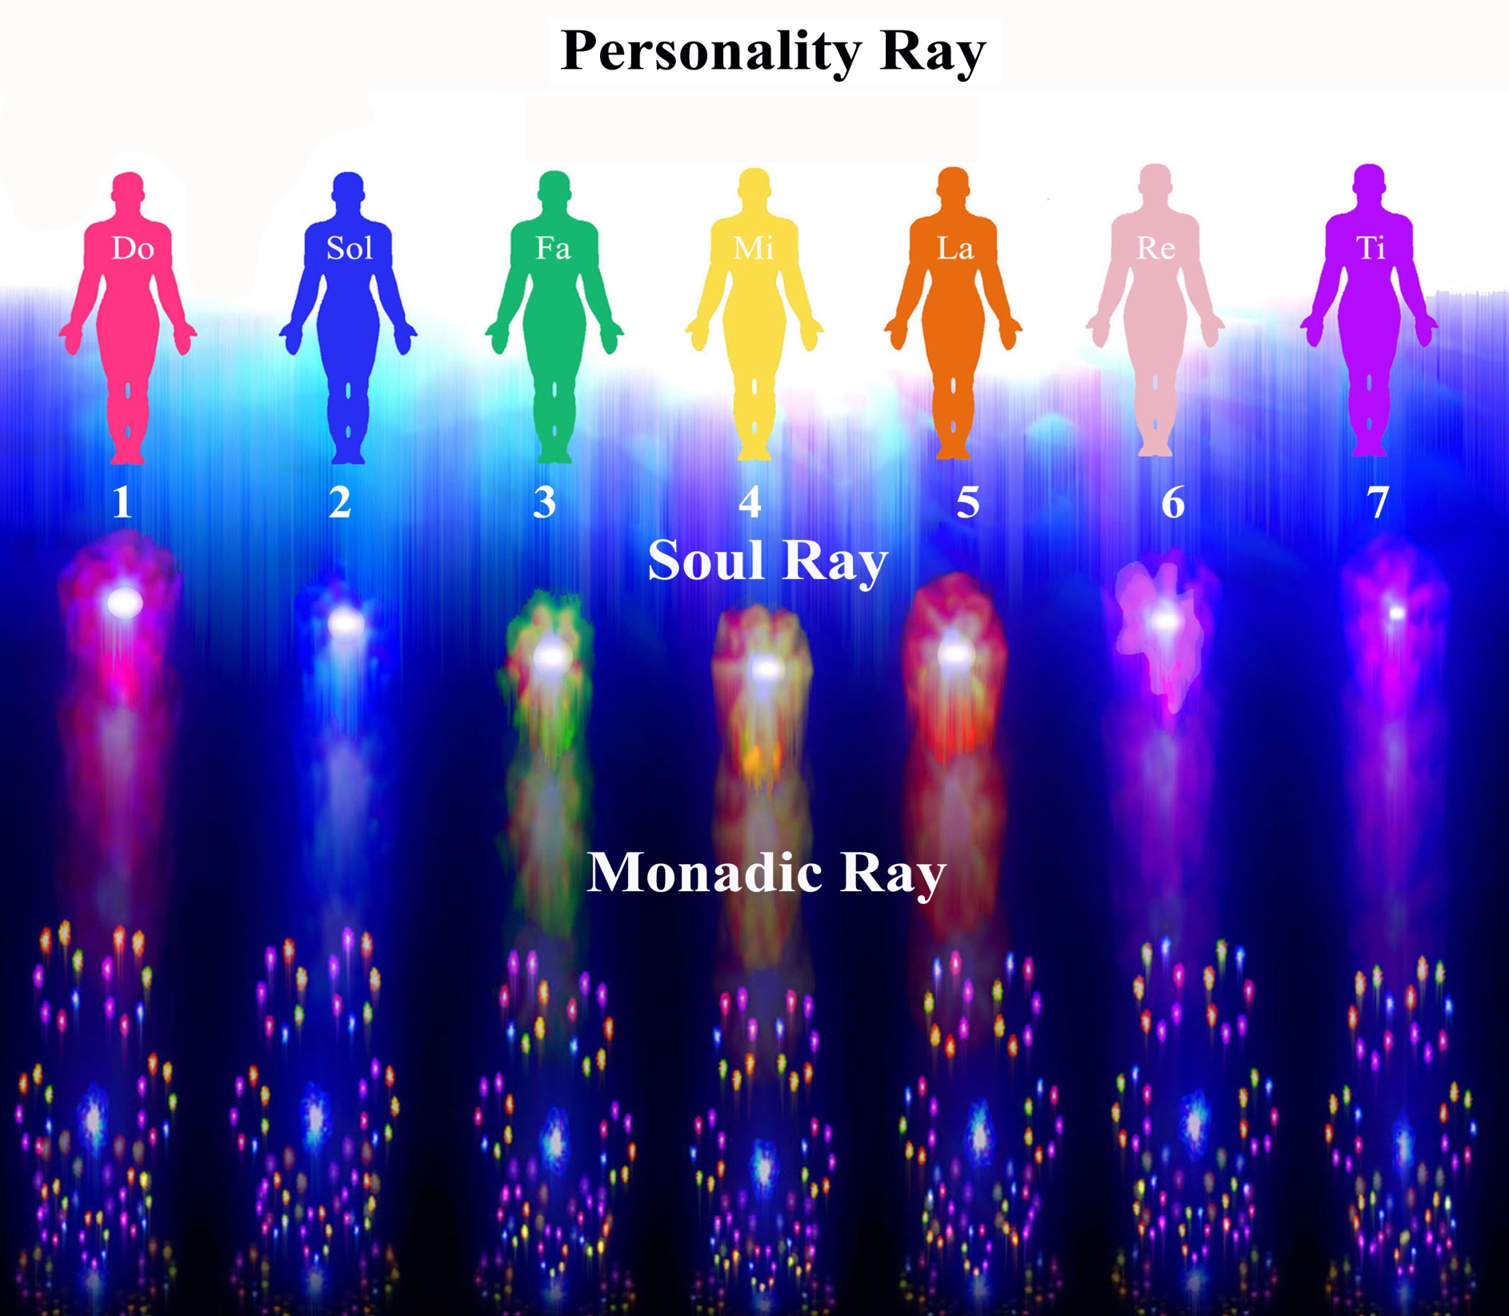
Notes:
Now

Slide 4
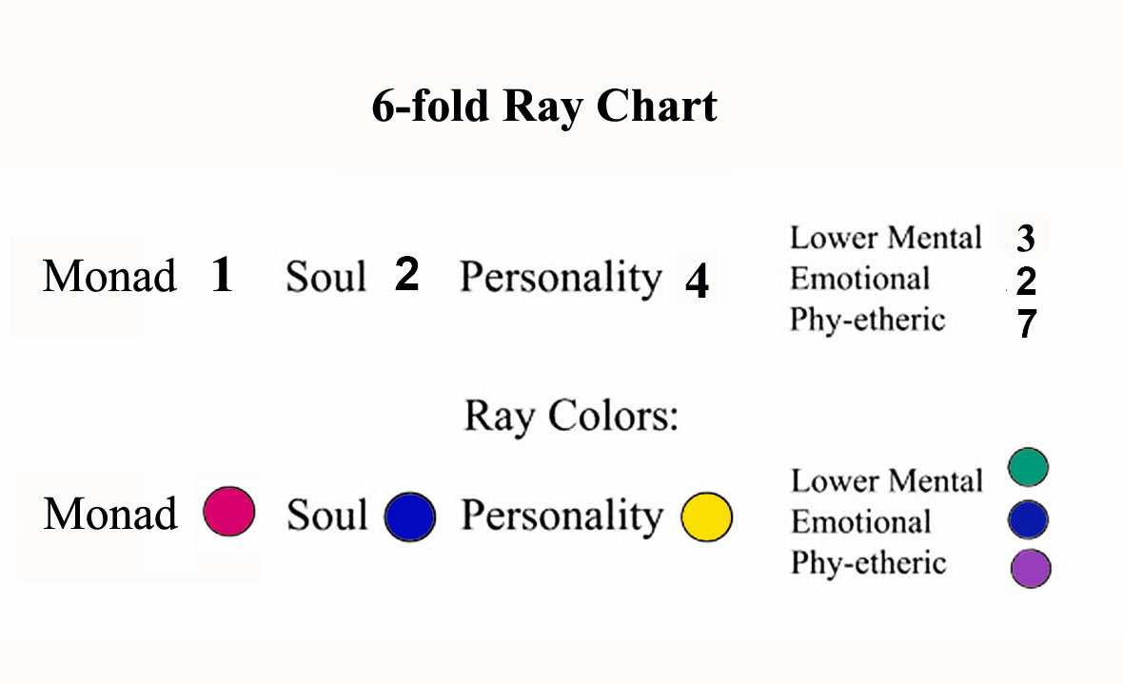
Notes:
How many people know their ray charts and astrological influences. Of what value has it been for them.

Slide 6
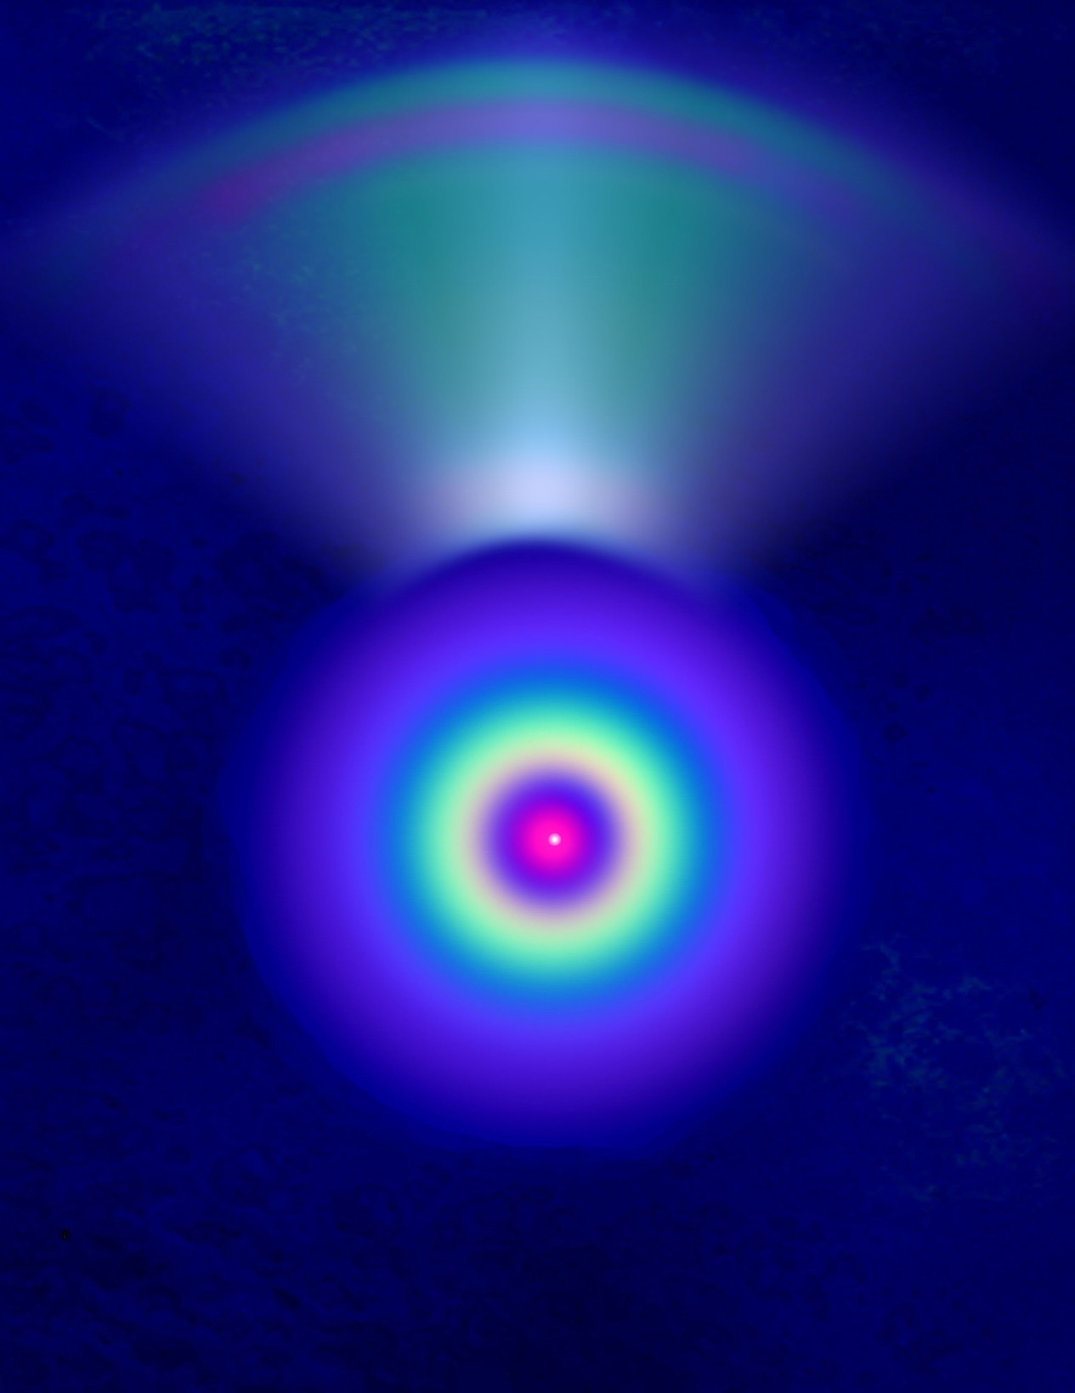

Slide 7
A contraction followed by an outgoing expansive display of energy.
“The positive nuclei in each case are affected by this flashing forth of electric fire, or energy. Each point concerned responds by a primary contraction followed by an outgoing or expansive display of energy. Each Identity concerned proceeds to sound a WORD. This sound expands into a mantram and the solar angels vibrate in response.” (TCF721-3)
Notes:
PERMANENT ATOMS A soul body Expansion and contraction .----In breath out breath seen in the animations seen in videos. Why the contraction
Dual rotary motion

Slide 8
Notes:
Video 2 Rose different cycles of ray development seen visually.

Slide 9
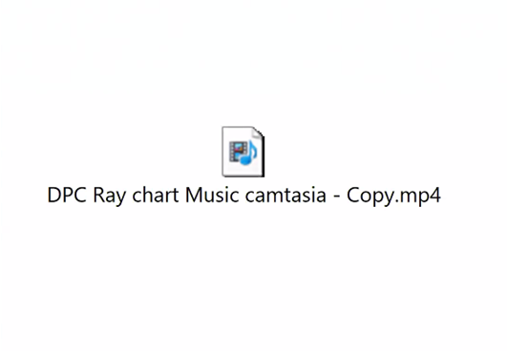
Deva Premal “Mantra of Love”

Slide 10
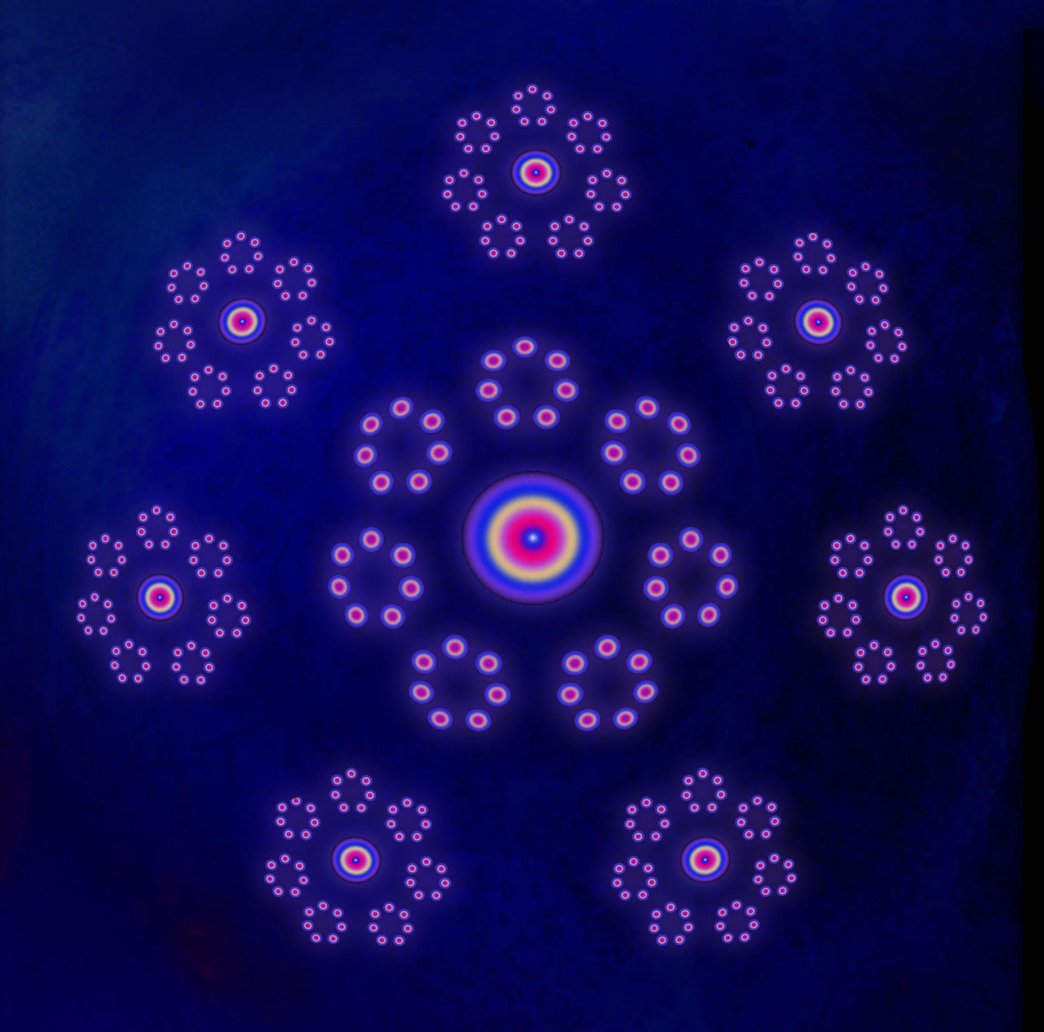
Notes:
7 masters Ashrams

Slide 11
These multitudes of egoic groups form a radiant interlocking whole.
“These multitudes of egoic groups form a radiant interlocking whole, though all are diverse and differing, both as to their point of development, and their secondary colouring. Just as the petals in the egoic lotus of the incarnating jivas unfold in differing order and at different periods, so the egoic groups also unfold diversely as to time and sequence. This produces a wonderful appearance. Again just as the Master can (by [Page 770] studying the group or larger lotus of which He is a part), ascertain the condition of the human units who go to its constitution, so the planetary Logos can ascertain through conscious identification (note the term) the condition of the various groups through whom His work must be accomplished.” (TCF 770-71)

Slide 12
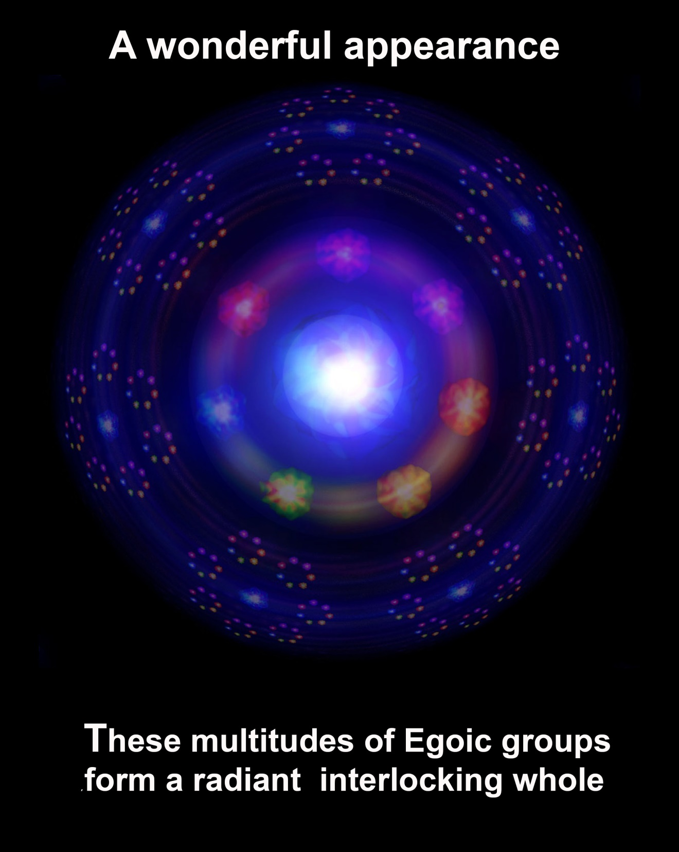

Slide 13
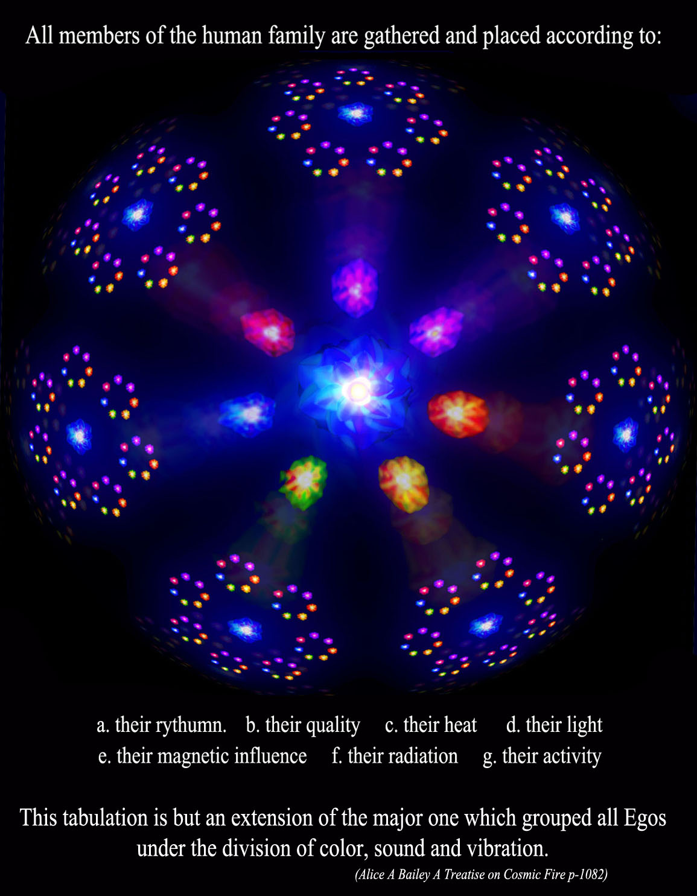
Notes:
Going back to our opening quote on color, vibration and sound and applying it to the Masters Ashrams and the larger macrocosm

Slide 14
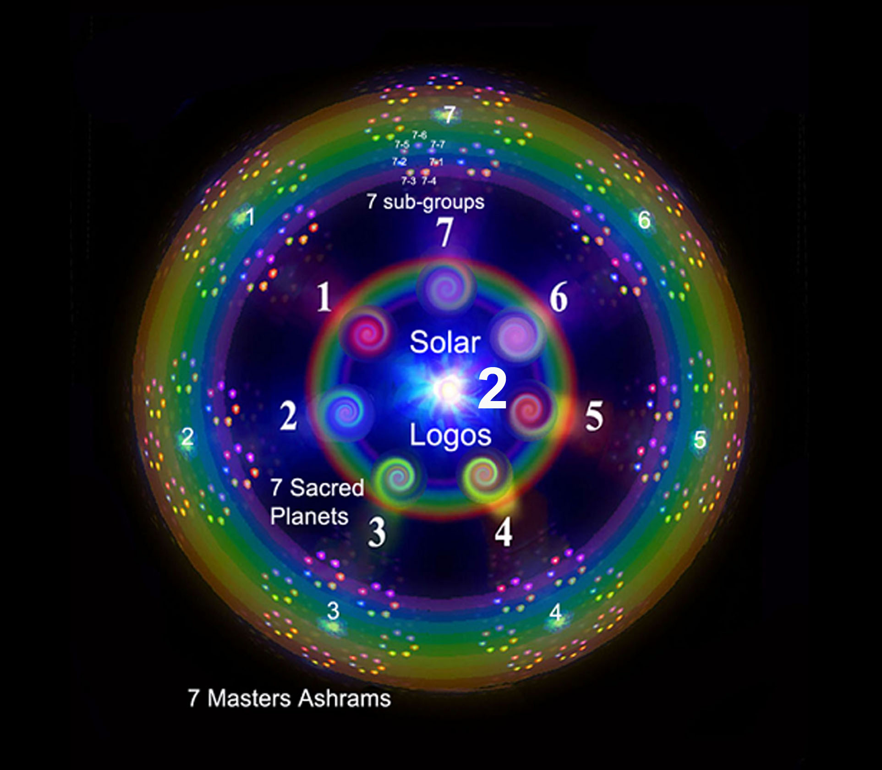
Notes:
7 Heavenly men or planetary Logoi and the subgroups

Slide 16
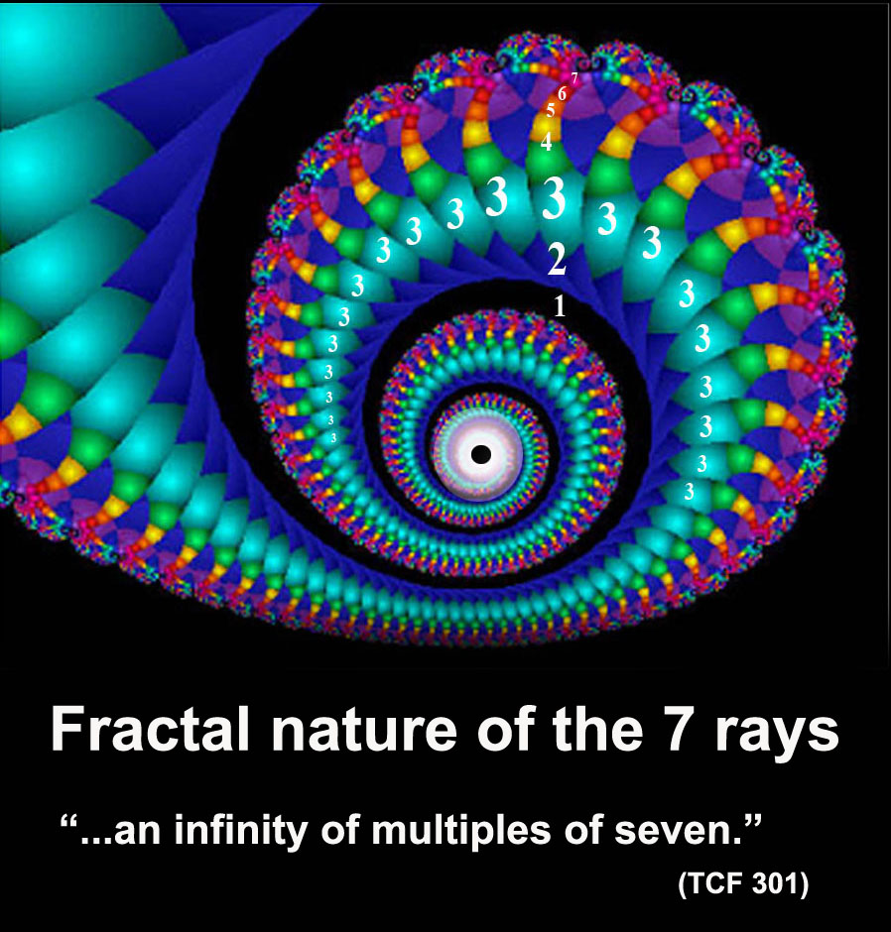
Notes:
Take just one spiral and blow it up.

Slide 17
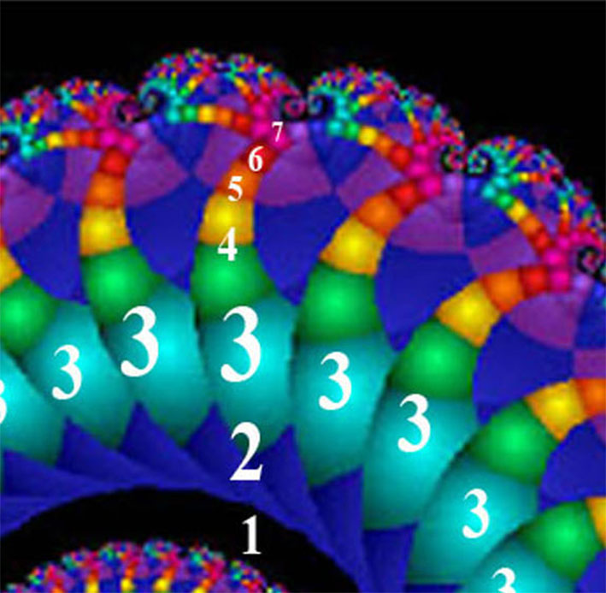
Notes:
Law of cp0rrespondances and law of analogy why holograms and fractals

Slide 18
