Slide 1
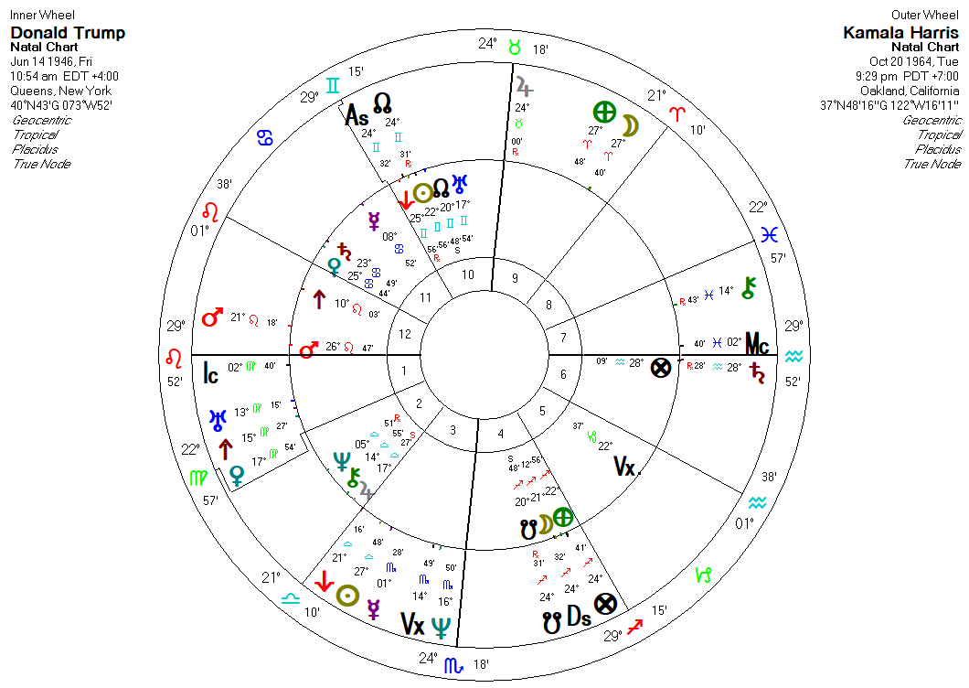

Slide 2
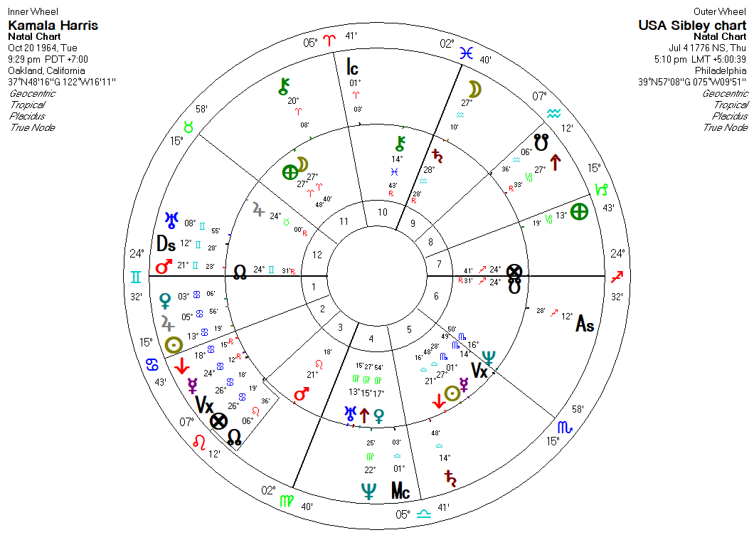

Slide 3
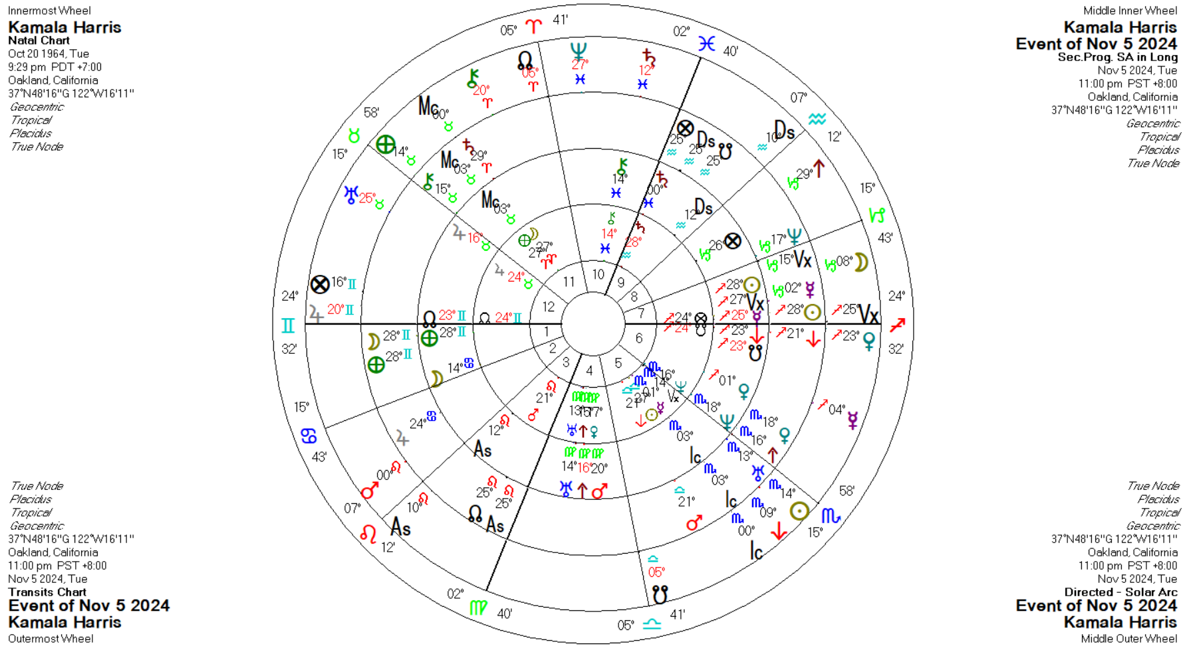

Slide 4
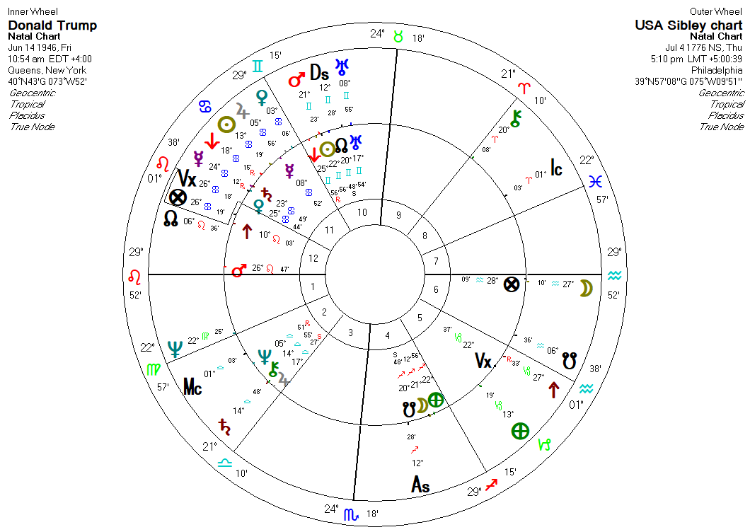

Slide 5
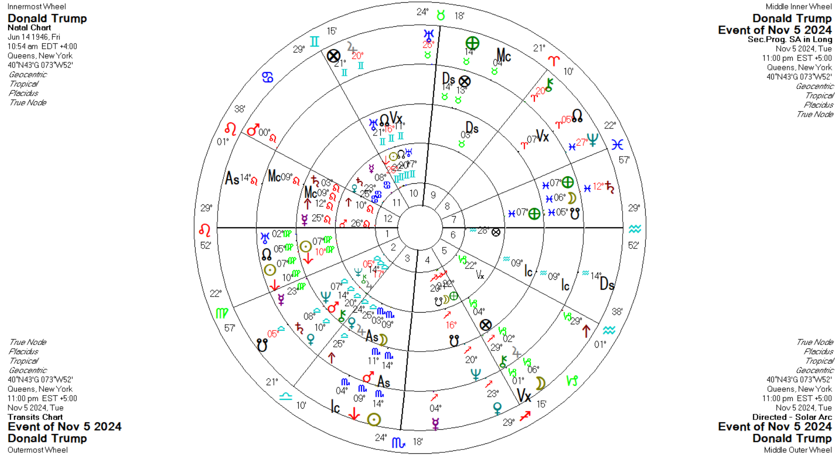

Slide 6
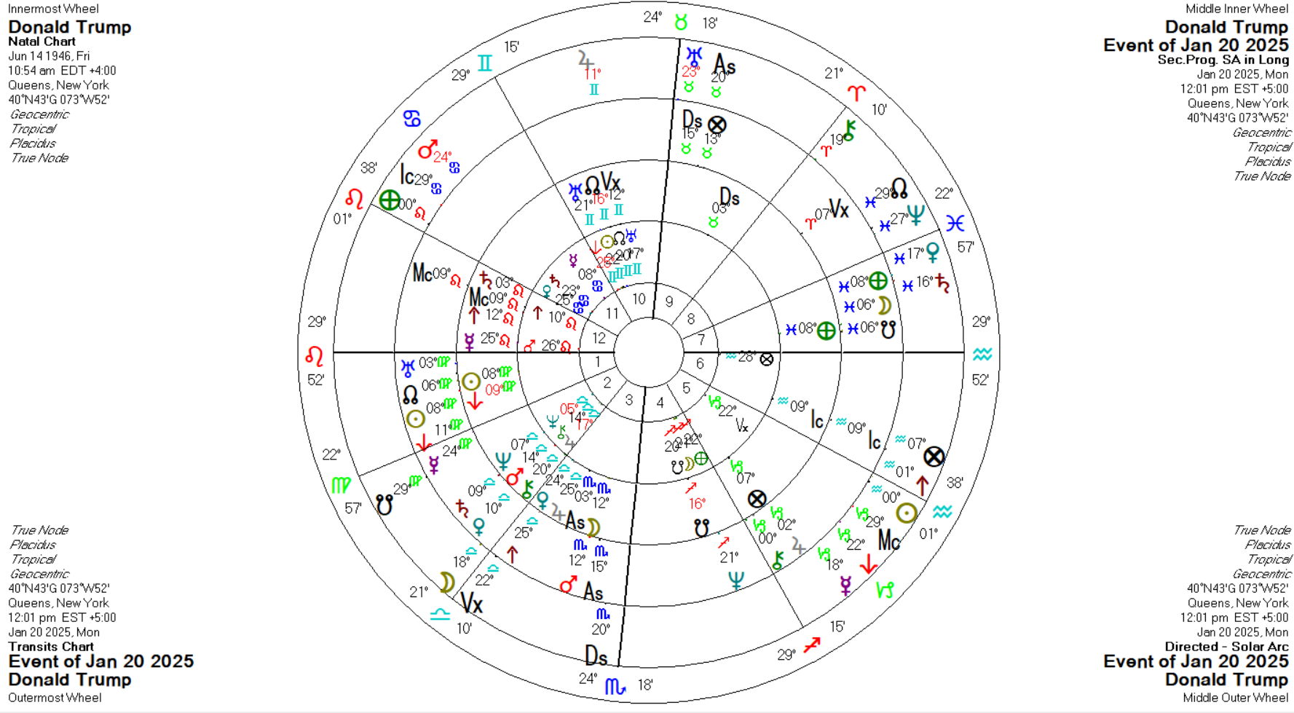
As we saw with his Nov win:
- Transiting Uranus still tap-dancing around his Mid-heaven while progressed Uranus is still at his natal Sun for a few years
- Transiting Mars is still hovering between his natal Saturn and Venus
- Solar Arc Neptune remains for a few years at his natal Moon/Earth
Donald Trump assumes the Presidency at Noon, 20 Jan 2025

